Slide 1
Does God Exist?
“The recurring proof of the existence of God, therefore, is that from time immemorial He has repeatedly manifested Himself.”
One Common Faith, Baha’i World Centre, 2005

Slide 2
“The recurring proof of the existence of God, therefore, is that from time immemorial He has repeatedly manifested Himself.”
OVERVIEW
CONCEPTS:
Proofs
God
Signs
Knowing
Manifestations of God
BAHA’I TEACHINGS ABOUT GOD:
Proofs (Revealing God’s Love)
God (Daystars of Divine Guidance)
Signs (“every atom in existence”)
Knowing (The Holy Spirit)
Manifestations of God (Spiritual Educators of History)

Slide 3
PROOFS
CONCEPTS #1
… proofs and arguments must needs be in connection with the subject which is to be proven and demonstrated; otherwise they cannot be accounted as proofs, even though they might be very wonderful and astonishing.
Mirza Abu’l-Fadl, The Bahá’í Proofs
Examples:
A doctor
An engineer
A public speaker
An educator
A good tree
…every good tree bears good fruit, but a bad tree bears bad fruit. A good tree cannot bear bad fruit, and a bad tree cannot bear good fruit. …Thus, by their fruit you will recognize them.
Words of Jesus as recorded in Matthew 7:15-20

Slide 4
CONCEPTS #2
GOD
What does the word “God” mean in this presentation?
For the LORD God is a sun and shield; the LORD bestows favor and honor; no good thing does he withhold from those whose walk is blameless.
LORD Almighty, blessed is the one who trusts in you.
Psalms 84:11-12 (New International Version)

Slide 5
CONCEPTS #3
SIGNS
Where might we look to see if God is making Himself known?
In nature
In other people
In ourselves
In reason
In experience
In tradition
In beauty
In prayer
In service
And yet belief in God is weakening.
“The vitality of men’s belief in God is dying out in every land…”
Gleanings from the Writings of Bahá’u’lláh

Slide 6
CONCEPTS #4
KNOWING
Some ways of knowing things:
Sensory perception
Reason
Tradition and Authority
Science
"The heart cannot rejoice in what the mind rejects as false."
C.S. Lewis

Slide 7
CONCEPTS #5
MANIFESTATIONS OF GOD
Such as Krishna, Buddha, Zoroaster, Abraham, Moses, Christ, Muhammad, the Báb, Bahá’u’lláh, First Nations Messengers and Those yet to appear.
From the days of Adam until today, the religions of God have been made manifest, one following the other, and each one of them fulfilled its due function, revived mankind, and provided education and enlightenment. They freed the people from the darkness of the world of nature and ushered them into the brightness of the Kingdom. As each succeeding Faith and Law became revealed it remained for some centuries a richly fruitful tree and to it was committed the happiness of humankind. However, as the centuries rolled by, it aged, it flourished no more and put forth no fruit, wherefore was it then made young again.
The religion of God is one religion, but it must ever be renewed.
Selections from the Writings of ‘Abdu’l‑Bahá

Slide 8
BAHA’I TEACHINGS ABOUT GOD #1
PROOFS
HOW DID THE FOUNDERS OF WORLD RELIGIONS REVEAL GOD’S LOVE?
The first proof: His Person
The second proof: His Word
The third proof: His Teachings
The fourth proof: Promises Fulfilled
“He hath endowed every soul with the capacity to recognize the signs of God.”
Gleanings from the Writings of Bahá’u’lláh

Slide 9
BAHA’I TEACHINGS ABOUT GOD #2
GOD
The door of the knowledge of the Ancient Being hath ever been, and will continue forever to be, closed in the face of men. No man’s understanding shall ever gain access unto His holy court. As a token of His mercy, however, and as a proof of His loving-kindness, He hath manifested unto men the Daystars of His divine guidance, the Symbols of His divine unity, and hath ordained the knowledge of these sanctified Beings to be identical with the knowledge of His own Self. Whoso recognizeth them hath recognized God. Whoso hearkeneth to their call, hath hearkened to the Voice of God, and whoso testifieth to the truth of their Revelation, hath testified to the truth of God Himself. Whoso turneth away from them, hath turned away from God, and whoso disbelieveth in them, hath disbelieved in God. Every one of them is the Way of God that connecteth this world with the realms above, and the Standard of His Truth unto every one in the kingdoms of earth and heaven. They are the Manifestations of God amidst men, the evidences of His Truth, and the signs of His glory.
Gleanings from the Writings of Bahá’u’lláh

Slide 10
BAHA’I TEACHINGS ABOUT GOD #3
SIGNS
…every time I turn my gaze to Thine earth, I am made to recognize the evidences of Thy power and the tokens of Thy bounty.”
Bahá’u’lláh
Out of the wastes of nothingness, with the clay of My command I made thee to appear, and have ordained for thy training every atom in existence and the essence of all created things.
The Hidden Words of Bahá’u’lláh

Slide 11
BAHA’I TEACHINGS ABOUT GOD #4
KNOWING
But the grace of the Holy Spirit is the true criterion regarding which there is no doubt or uncertainty. That grace consists in the confirmations of the Holy Spirit which are vouchsafed to man and through which certitude is attained.
‘Abdu’l-Bahá, The Four Criteria of Comprehension

Slide 12
BAHA’I TEACHINGS ABOUT GOD #5
THE SPIRITUAL EDUCATORS OF HISTORY
The door of the knowledge of the Ancient Being hath ever been, and will continue forever to be, closed in the face of men. No man’s understanding shall ever gain access unto His holy court. As a token of His mercy, however, and as a proof of His loving-kindness, He hath manifested unto men the Daystars of His divine guidance, the Symbols of His divine unity, and hath ordained the knowledge of these sanctified Beings to be identical with the knowledge of His own Self. Whoso recognizeth them hath recognized God. Whoso hearkeneth to their call, hath hearkened to the Voice of God, and whoso testifieth to the truth of their Revelation, hath testified to the truth of God Himself. Whoso turneth away from them, hath turned away from God, and whoso disbelieveth in them, hath disbelieved in God. Every one of them is the Way of God that connecteth this world with the realms above, and the Standard of His Truth unto every one in the kingdoms of earth and heaven. They are the Manifestations of God amidst men, the evidences of His Truth, and the signs of His glory.
Gleanings from the Writings of Bahá’u’lláh

Slide 13
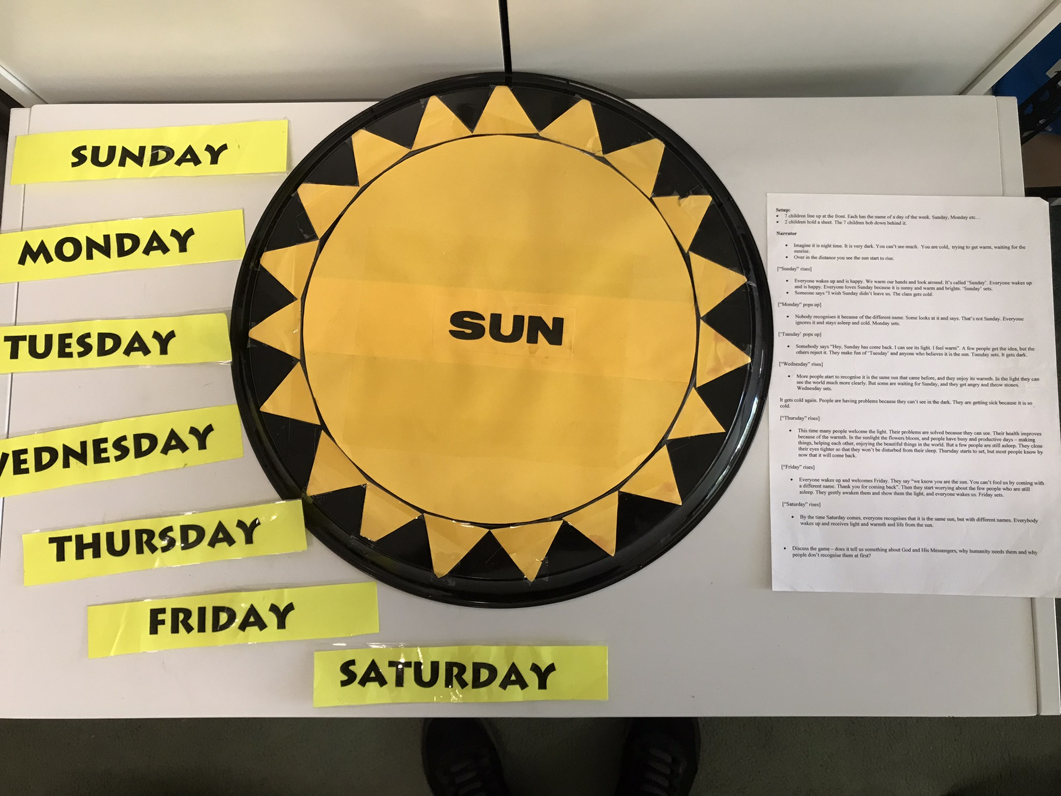
BAHA’I TEACHINGS ABOUT GOD #5 (continued)
Why are God’s Manifestations Rejected?

Slide 14
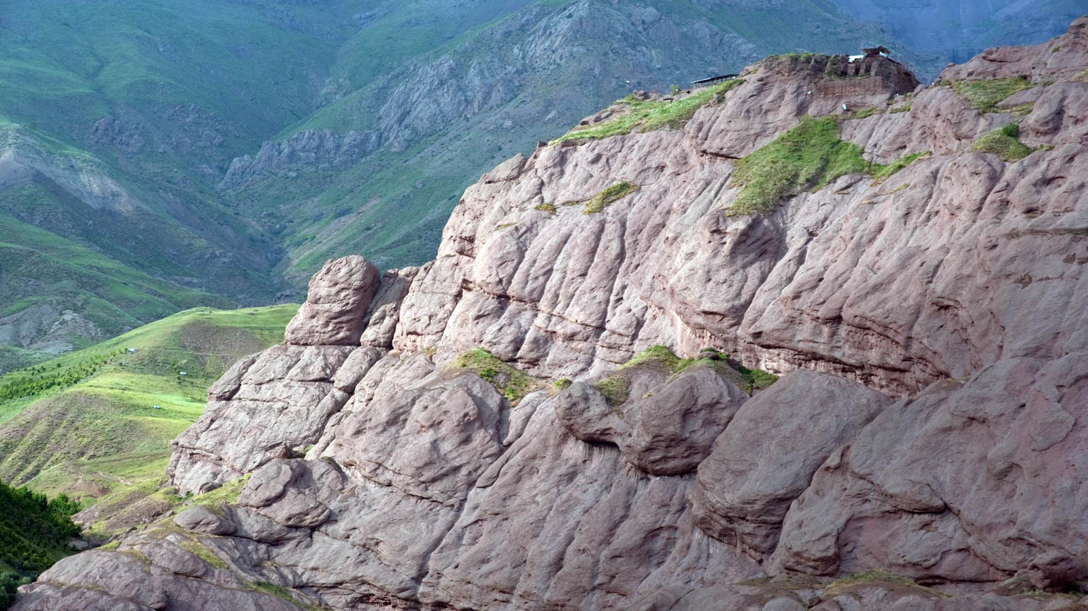
A STORY
THE HERMIT
from a children’s book called “The Love of Baha’u’llah” by Jacqueline Mehrabi

Slide 15
CONCLUSION
“The recurring proof of the existence of God, therefore, is that from time immemorial He has repeatedly manifested Himself.”
One Common Faith, Baha’i World Centre, 2005
…if the eye of inner vision be opened, a hundred thousand clear proofs will be seen. Thus, when man feels the indwelling spirit, he is in no need of arguments for its existence
‘Abdu’l‑Bahá

