Slide 1
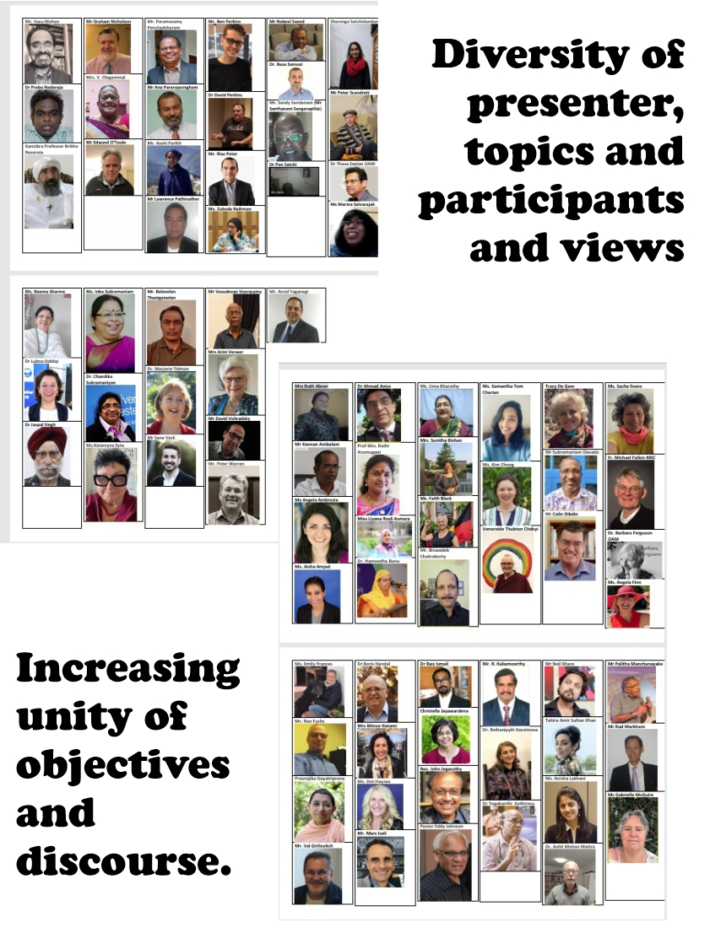
Diversity and Unity
200 Thursday Zoom Interfaith meetings (2020-2024)

Slide 2
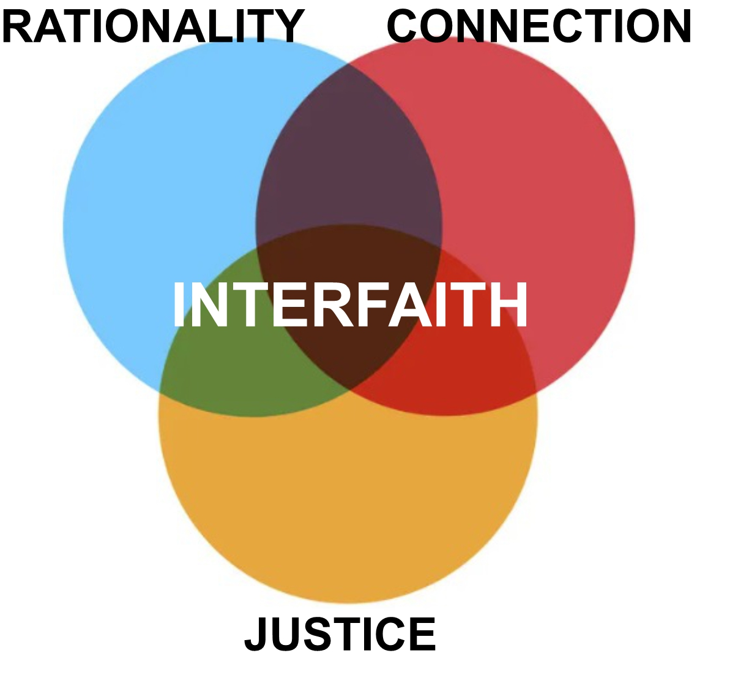
Mind
Logic
Beliefs
Reason
Heart
Beauty
Spirit
Compassion
Action
Justice
Order
Change

Slide 3
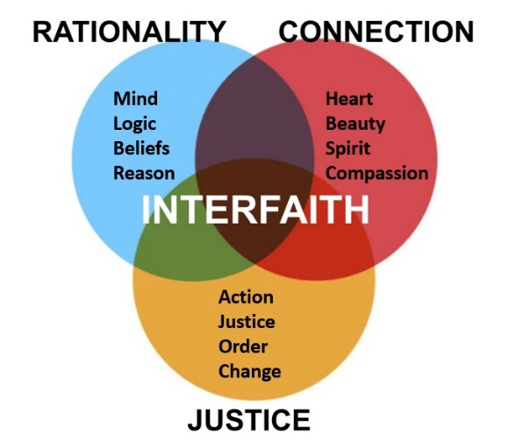
#10 Christian Explanations of Suffering
#17 Power of Science *
#42 Mandaean Religion
#139 Four Noble Truths of Buddhism
#146 Covenants of Peace in the Quran
#196 The Biblical Messiah
* This topic prompted a lively discussion group.
https://colindibdin.com/weekly-zoom-interfaith/

Slide 4
#58 Divine Love in a Human Heart
#51 Sifting the Dust
#76 Our Interactions with Beauty
#91 Scriptural Reasoning *
#97 Our Brain is Wired for Unity
#153 Reconciliation
* Reasoning using a method that builds connection
https://colindibdin.com/weekly-zoom-interfaith/

Slide 5
#9 Domestic Violence
#19 Congo Pygmy Program
#21 Climate Change
#64 Indigenous Health
#123 Justice
#127 Constructive Resilience
#136 Addressing Poverty in India
#137 Women’s Refuges in Australia
#175 Countering Hate Speech
* These and many other presenters talked from experience.
https://colindibdin.com/weekly-zoom-interfaith/

Slide 6
QUESTIONS
What is the point of just talking, listening, learning and asking questions?
Shouldn’t we be more actively solving social problems or bringing beliefs together?
REFLECTION POINTS
Dialogue does not replace the planning, action and reflection that we do in other spaces – family, neighbourhood, city, national and global.
We ARE helping to solve a serious problem – RELIGIOUS PREJUDICE

Slide 7
RELIGIOUS PREJUDICE
Humans have a tendency to pre-judge on the basis of religion.
We draw mental circles around our nation or religion, and are suspicious of enemies outside the circle.
Fortunately our circles are widening as we travel, communicate and live and work together.
World unity is slowly developing.
Sadly, religious prejudice is resistant – it closes eyes, blocks ears, creates fear, leads to conflict.
It’s easier to avoid discussing religion.
It’s easier to outsource our thinking, seeing, acting and seeking to religious leaders or to the media.
We are addressing religious prejudice in a small way.
In this group we are trying to see with our own eyes.

Slide 8
SEEING WITH OUR OWN EYES
In this group:
We are using our capacity to recognise truth in unexpected places.
We find beauty in the sacred scriptures of another religion, and in the discoveries of science, and from presenters who share their experiences from life and their striving to establish peace, love and justice in their communities and sometimes in the academic, social or religious arenas.
We learn from others.
We contribute to unity in diversity.
We enlarge our circles of friendship.

