Slide 1
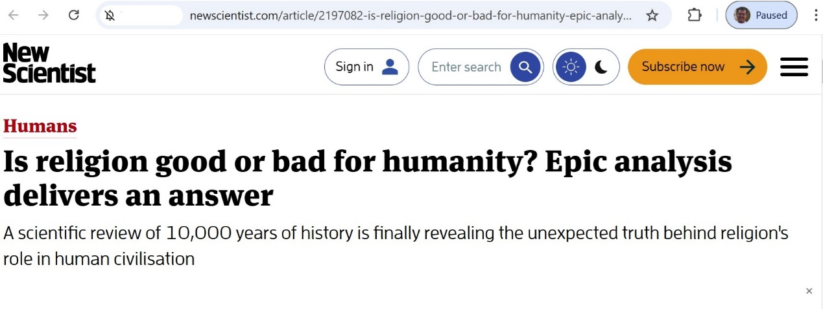
Is religion good or bad for humanity?
A discussion starter
Prepared by Colin Dibdin for Interfaith discussion 7 November 2024

Slide 2
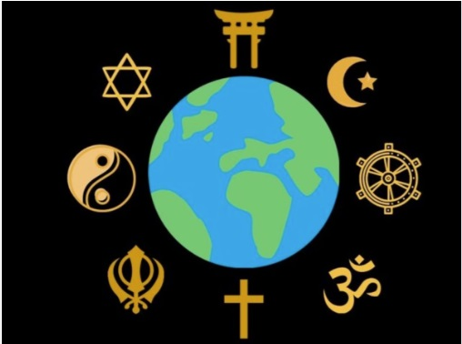
Religion – some current views:
Faith can be very, very dangerous. Suicide bombers do what they do because they really believe what they were taught in their religious schools: that duty to God exceeds all other priorities....”
Dr Richard Dawkins, The God Delusion

Slide 3
Religion – some current views:
Religions have no reasonable explanations for the destruction and suffering caused by uncontrollable natural disasters and other problems caused by fellow humans who create violence, wars, and genocides.
Dr. Pon Satchi, Nature, the True God

Slide 4
Religion – some current views:
…the greater part of organized religion stands paralyzed … gripped in those very dogmas and claims of privileged access to truth that have been responsible for creating some of the most bitter conflicts dividing the earth’s inhabitants.
…To take only one of many examples, Europe’s sixteenth century wars of religion cost that continent the lives of some thirty percent of its entire population. …
Bahá’í letter To The World’s Religious Leaders, April 2002

Slide 5
“Has religion been good or bad for humanity?” by Harvey Whitehouse
(Extracts from New Scientist, 6 April 2019)
Religion has given us algebra and the Spanish Inquisition, Bach’s cantatas and pogroms. The debate over whether religion lifts humanity higher or brings out our basest instincts is ancient…

Slide 6
“Has religion been good or bad for humanity?” by Harvey Whitehouse
(Extracts from New Scientist, 6 April 2019)
But first, what do we mean by “good” and “bad”? Should religion be considered good if it has inspired magnificent art but enslaved millions? Would it be judged bad if it ensured equality at the price of free expression?...

Slide 7
“Has religion been good or bad for humanity?” by Harvey Whitehouse
(Extracts from New Scientist, 6 April 2019)
Alternatively, we can ask whether religion has helped societies grow and flourish. Is it, as many believe, a form of social glue that builds cooperation? …
A study involving 60 societies, ranging from small groups to the very largest, found that people everywhere equate “good” with cooperative behaviours and “bad” with non-cooperative ones….
In 2010 [we] began building a history databank…to investigate these hypotheses rigorously and on a global scale. To date, it contains information on more than 400 societies that have existed around the world over the past 10,000 years…

Slide 8
“Has religion been good or bad for humanity?” by Harvey Whitehouse
(Extracts from New Scientist, 6 April 2019)
The societies that expanded to a million or more were those that found a new way to build cooperation – Big Gods*. They demoted their rulers to the status of mortals, laid the seeds of democracy and the rule of law, and fostered a more egalitarian distribution of rights and obligations…
“Big Gods”: deities who demand that their moral code be observed by all, and who have supernatural powers of surveillance and enforcement.

Slide 9
What do religions say about “cooperation”?
No one is superior, none inferior. All are brothers marching forward to prosperity.
Rig Veda V.60.5

Slide 10
What do religions say about “cooperation”?
Again, truly I tell you that if two of you on earth agree about anything they ask for, it will be done for them by my Father in heaven. For where two or three gather in my name, there am I with them.
Words of Jesus as recorded in Matthew 18:19-20 (NIV)

Slide 11
What do religions say about “cooperation”?
[The Prophet’s] goal was to establish security and peace among the people regardless of their beliefs by way of establishing and maintaining covenants and treaties.
Halim Rane, “Higher Objectives of Covenants in Islam”, https://www.mdpi.com/2077-1444/14/4/514.

Slide 12
What do religions say about “cooperation”?
Universal benefits derive from the grace of the divine religions, for they lead their true followers to sincerity of intent, to high purpose, to purity and spotless honor, to surpassing kindness and compassion, to the keeping of their covenants when they have covenanted, to concern for the rights of others, to liberality, to justice in every aspect of life, to humanity and philanthropy, to valor and to unflagging efforts in the service of mankind. It is religion, to sum up, which produces all human virtues, and it is these virtues which are the bright candles of civilization.
‘Abdu’l‑Bahá, The Secret of Divine Civilization

Slide 13
Is religion good or bad for humanity?

