Slide 1
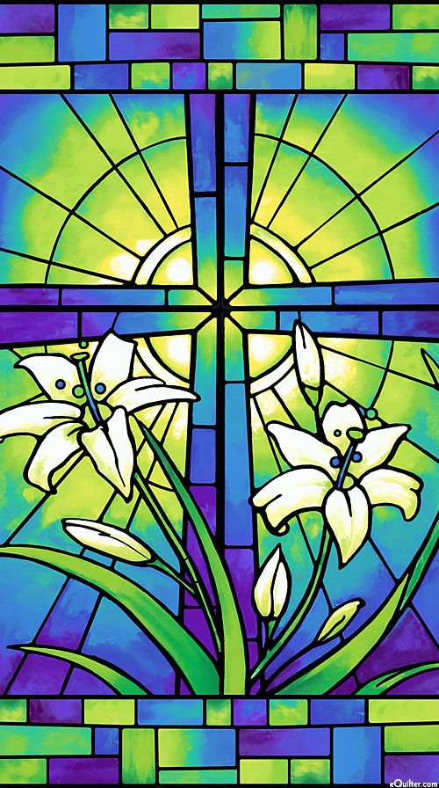
The Catholic Community
Amiable Encounters with…
Inclusivity
The Church and the Word of God
Sacraments and the Nicene Creed
Faith and Works
Vocations, Saints and Miracles
Love
Unity
Colin Dibdin September 2024
Notes:
AMIABLE ENCOUNTERS WITH THE CATHOLIC COMMUNITY
One of the practices of this interfaith group is learn from others. You may have heard of Leonard Swidler, the Professor of Catholic Thought and Interreligious Dialogue. He wrote that in dialogue “Each participant eventually must attempt to experience the partner’s religion or ideology “from within,” for a religion or ideology is not merely something of the head, but also of the spirit, heart, and “whole being,” individual and communal. ”
As you can see from this opening slide, I will skate over a lot of ground in the next 30 minutes, sharing a little of what I have learned and experienced. Where I think I have experienced something “from within” I will mention that, but my perspective is limited because I have not participated in some of the most important elements of the Catholic experience such as baptism or communion.

Slide 2
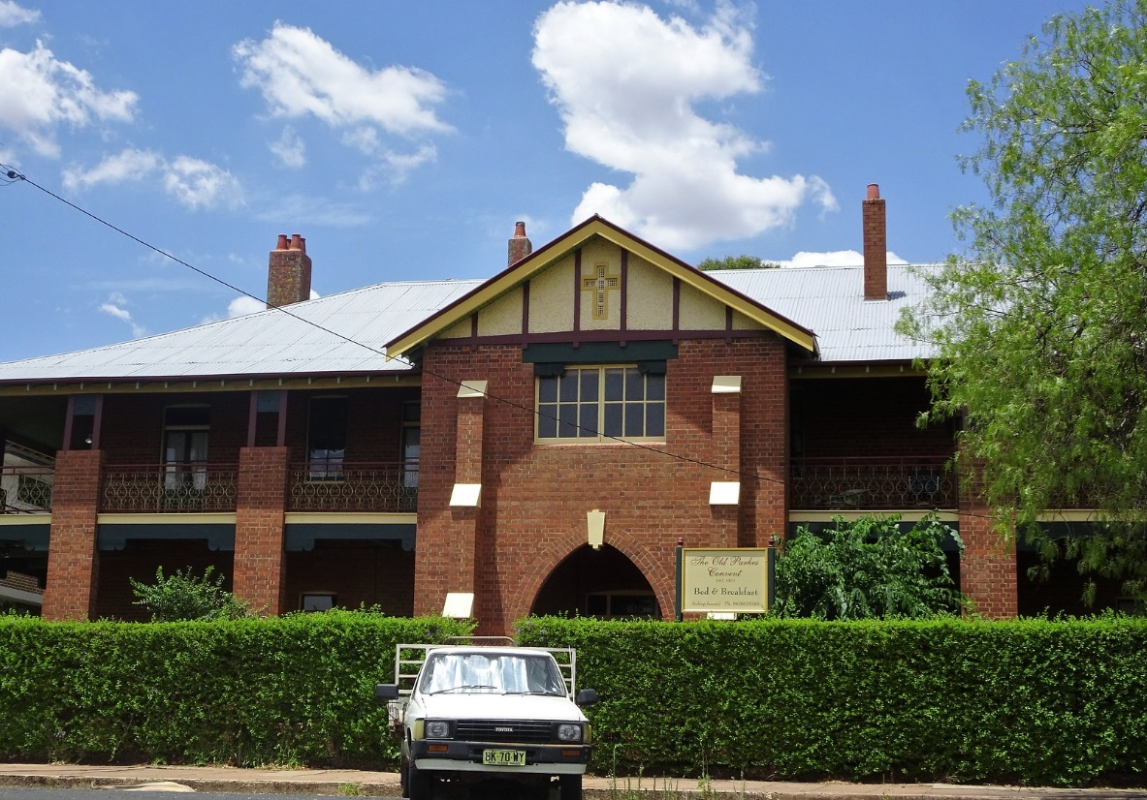
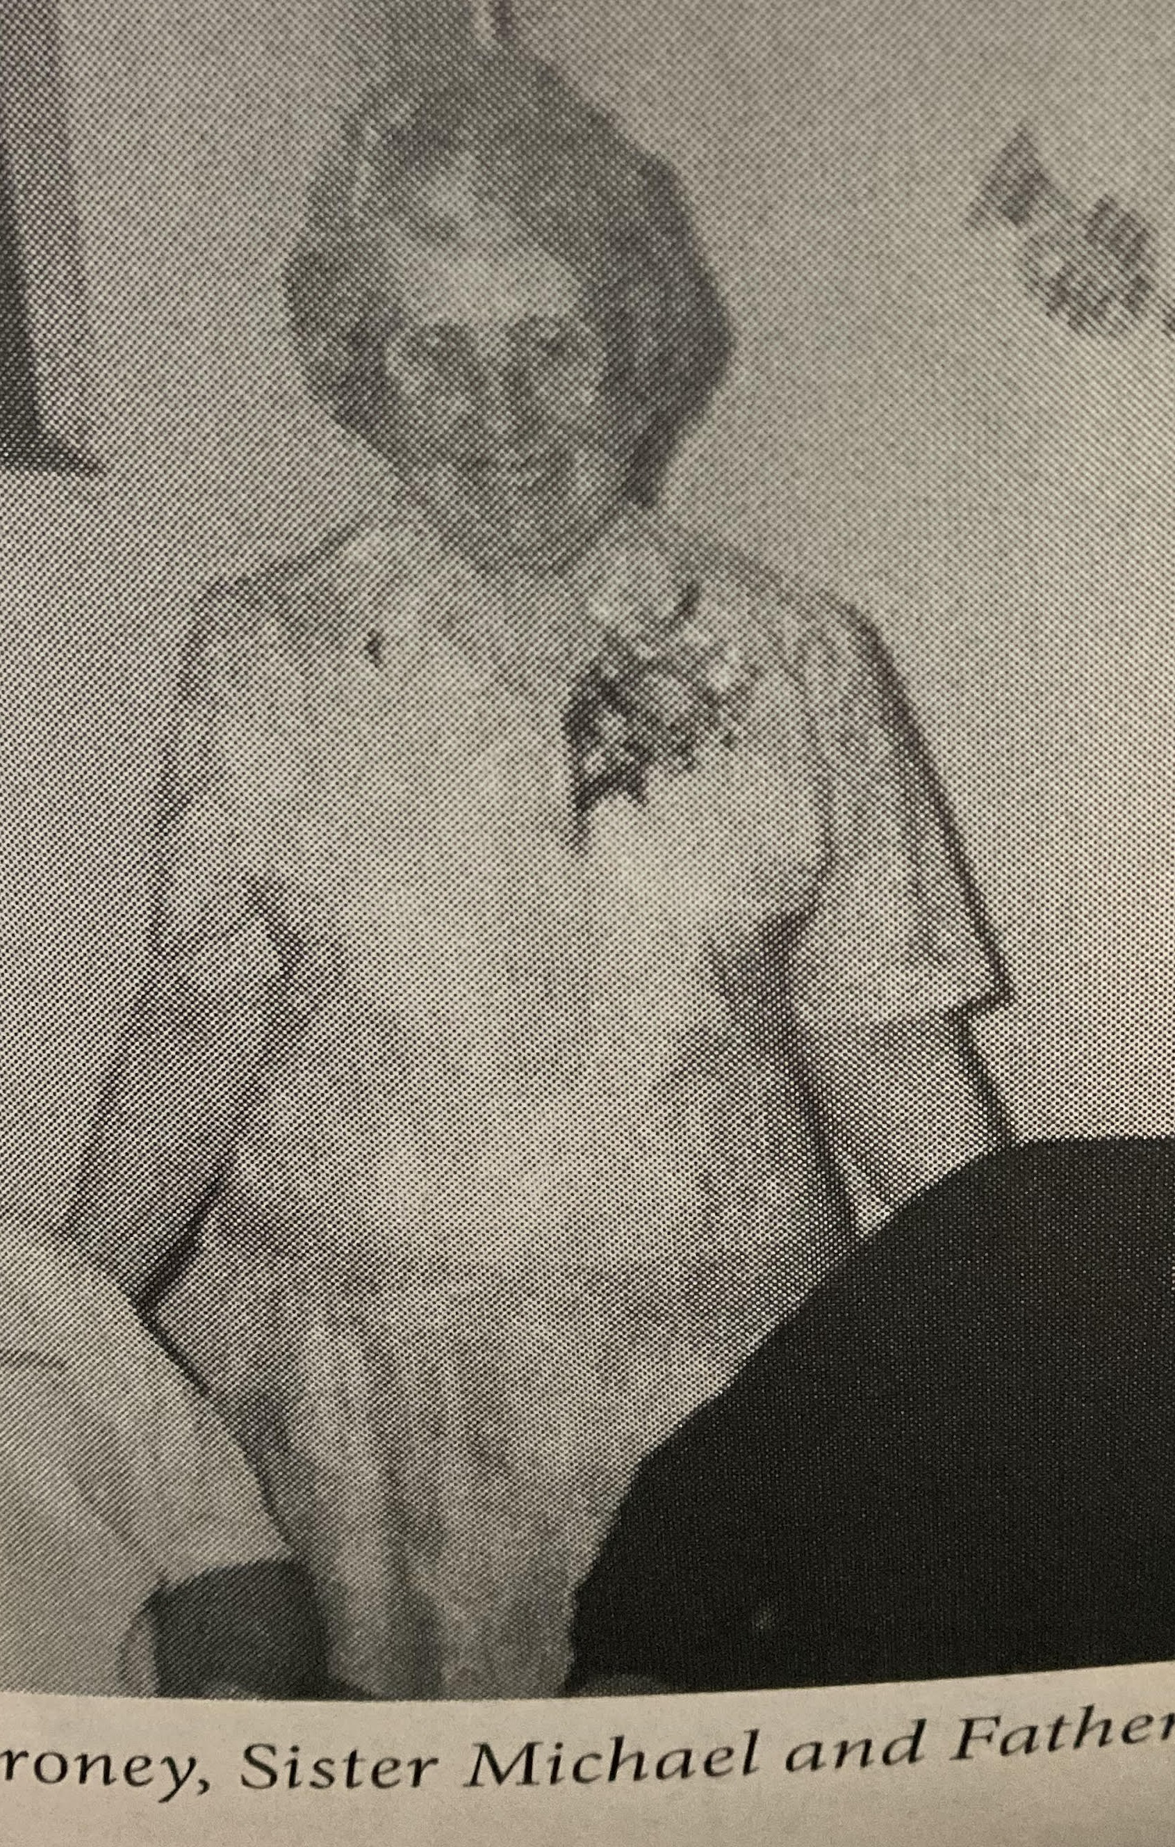
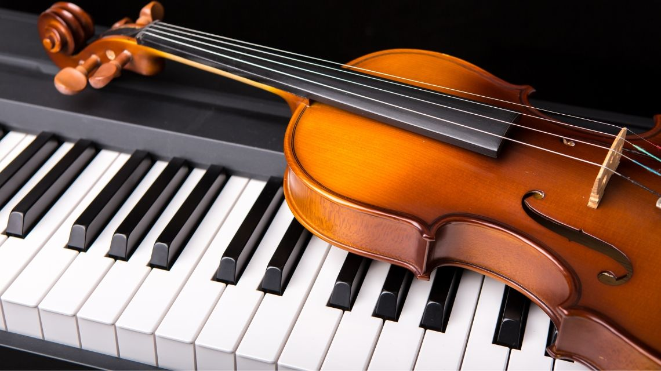
Inclusivity – 1960s – Parkes NSW.
Sister Michael (Music teacher)
Sister Michael RSM OAM – (Mary Elizabeth Fitgerald)
Notes:
SISTER MICHAEL
My sisters and I were raised in Parkes, NSW, about 5 hours drive west of Sydney. Sister Michael was my piano and violin teacher at the Catholic Convent. The Convent, run by the Sisters of Mercy, and Sister Michael are pictured here. I have two enduring memories. The first was her kindness. The second is that when I did not practice before a lesson, which was usually, she said - truthfully: “Colin, you would try the patience of a saint!”

Slide 3
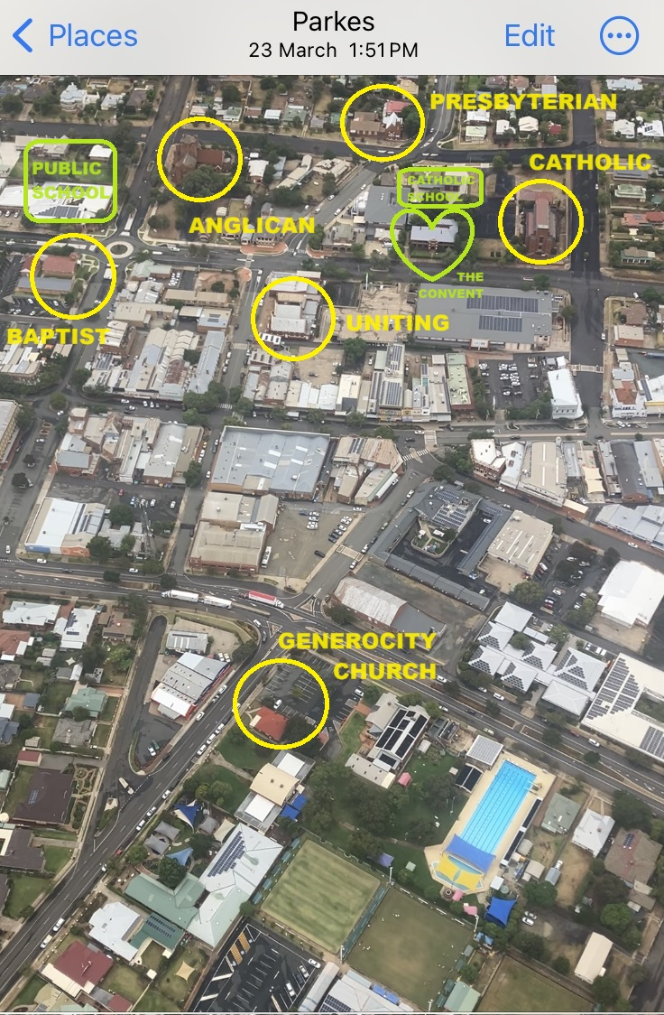
Inclusivity – 1960s – Parkes NSW.
A Christian community
Notes:
A CHRISTIAN COMMUNITY
Parkes had several Christian churches. A few months ago I flew over the town while taking a video. I chose this image from the video because it shows the local churches that I remember and which are still standing.
I would walk from home to school past the Presbyterian Church. My father had been accepted to train as a Presbyterian Minister before he found the Baha’i Faith.
I would walk home past the Anglican Church. The Rector warned the Parkes population about the newly arrived Baha’is. Later he became my scripture teacher.
I have not been inside the Catholic Church, but every week I walked to the Convent next door for music lessons. You can see the Catholic School in the same block.
In this image you can also see the Uniting Church which was then called the Methodist Church. One of the supporters of this interfaith weekly meeting is Rev John Jegasothy. John was a minister for the Uniting Church in Parkes for 18 years.

Slide 4
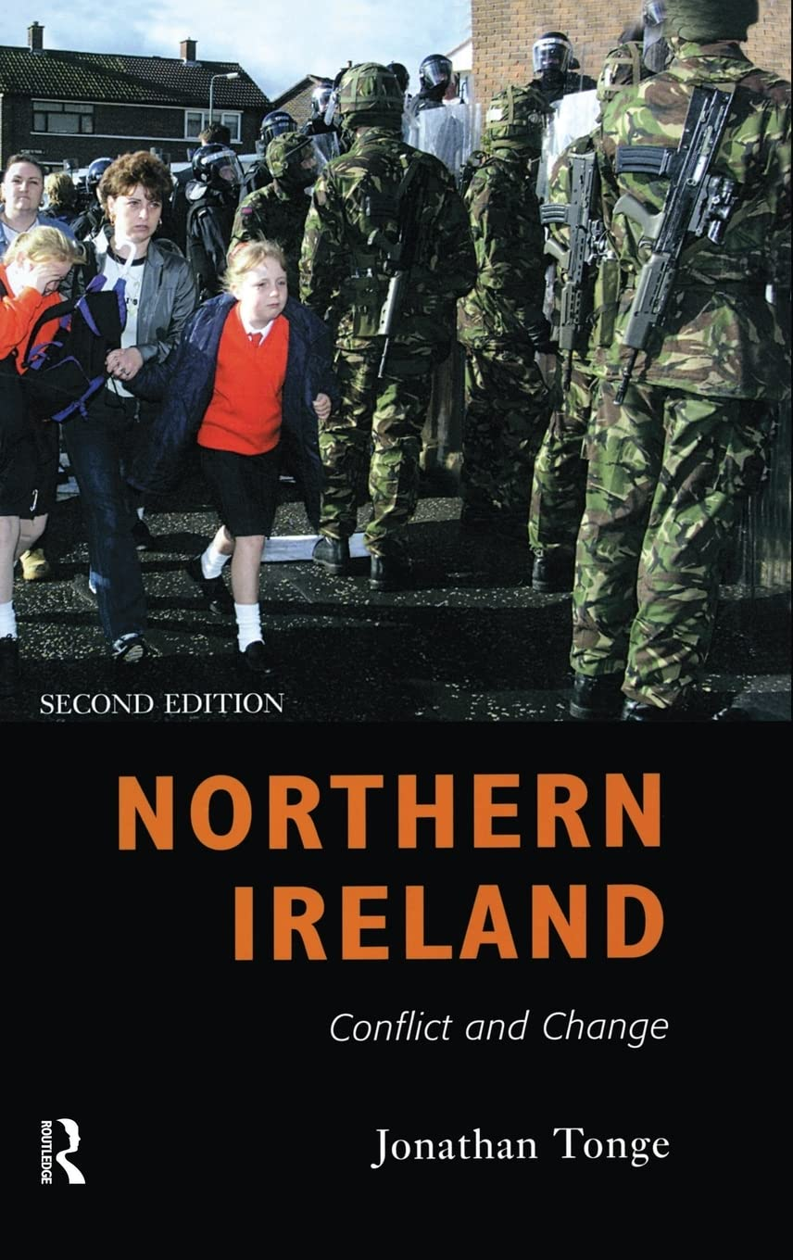
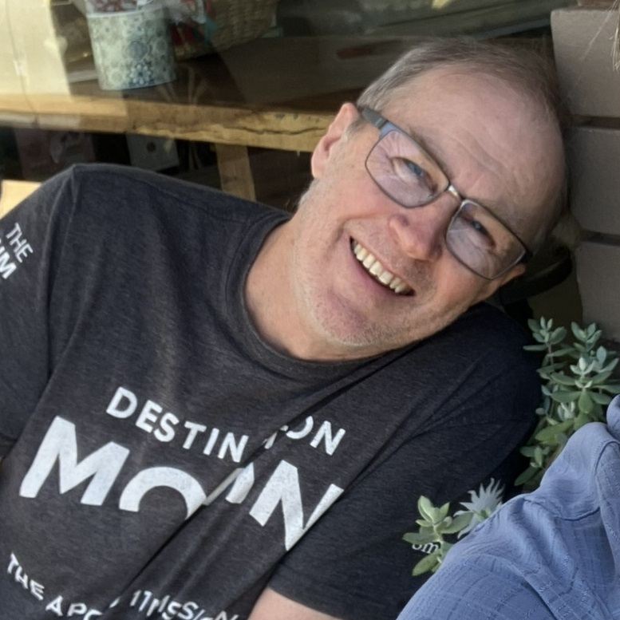
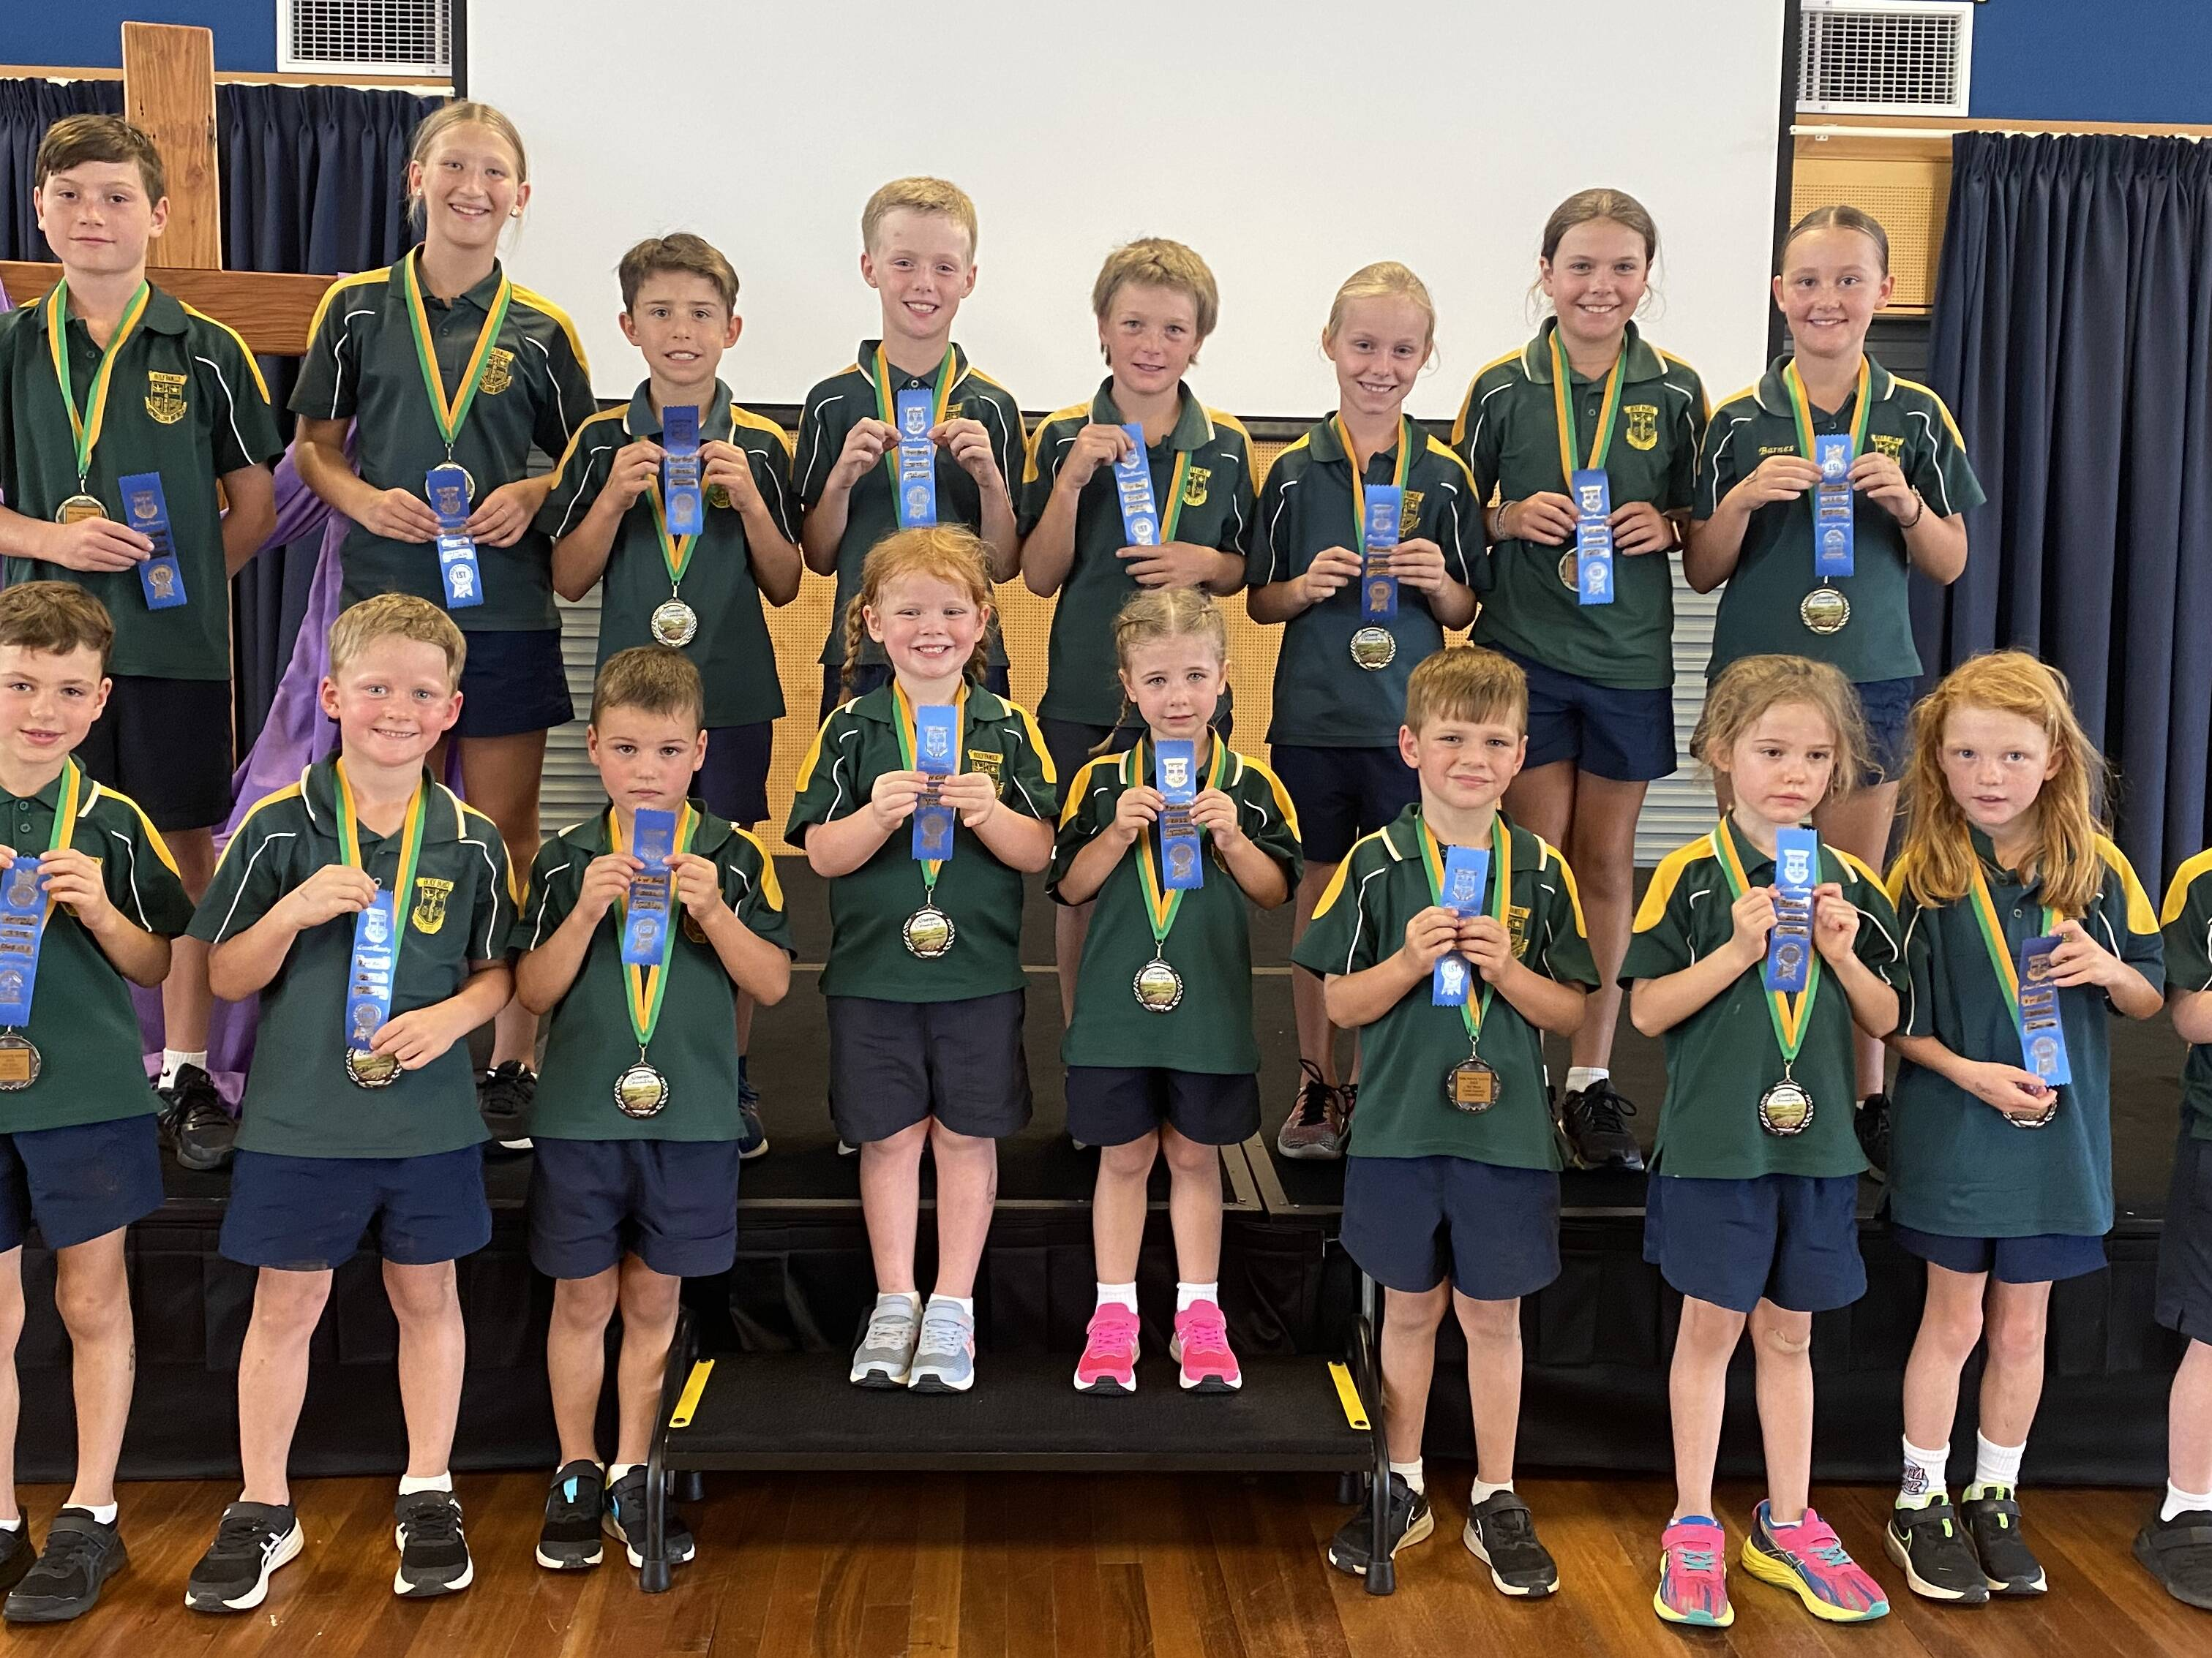
Inclusivity – 1960s – Parkes NSW.
Religious prejudice – small and large
Spirituality is an element of the wellbeing and mental health that makes up the whole child.
Catholic Schools NSW
Solidarity …presupposes the effort for a more just social order where tensions are better able to be reduced and conflicts more readily settled by negotiation.
Catholic Catechism https://www.vatican.va/archive/ENG0015/__P6Q.HTM
Notes:
ADDRESSING RELIGIOUS PREJUDICE
David McFall was one of my best school friends in Parkes. He is still there. I’ll see him tomorrow for our 50 year school reunion. David’s mother was our teacher in year 2 in Infants School. He is a scientist, and has no prejudice. I just want to mention this because I have two memories which show the beginnings and the result of prejudice:
The first is that when I was about 9 years old I saw some public school children walking past the catholic school. The children on either side of the fence were calling each other names.
The second is that David’s family was from Northern Ireland. They migrated to Australia because of the violence happening at that time in the name of Protestants and Catholics. When it seemed safe, they returned to Ireland. But before long they came back to Parkes. David’s parents are buried there.
Getting back to the name-calling at the school fence. It didn’t mean much, as we still did sport together and became combined in High School. But it illustrated the effect of a fence on our identity.

Slide 5
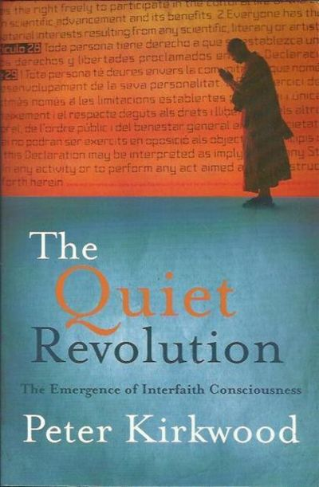
Inclusivity – 1960s – Parkes NSW.
The quiet revolution
No one remaining outside the Catholic Church…can become partakers of eternal life, but they will go to the everlasting fire…”
Council of Florence (1438-45 CE)“
The Catholic Church rejects nothing that is true and holy in these religions….[they] often reflect a ray of that Truth which enlightens all men.
[DECLARATION ON THE RELATION OF THE CHURCH TO NON-CHRISTIAN RELIGIONS, NOSTRA AETATE PROCLAIMED BY HIS HOLINESS POPE PAUL VI ON OCTOBER 28, 1965:]
Notes:
THE QUIET REVOLUTION
In his book “The Quiet Revolution” Peter Kirkwood writes about the emergence of interfaith consciousness.
The book notes that for many centuries the Church emphasized that non-Catholics would go to hell. In the 1960s, after the Second Vatican Council, the Church declared that other religions “often reflect a ray of that Truth which enlightens all men.”

Slide 6
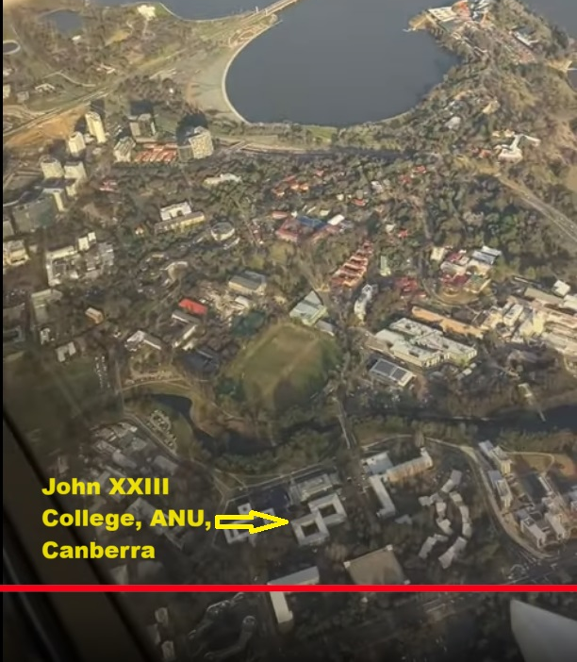
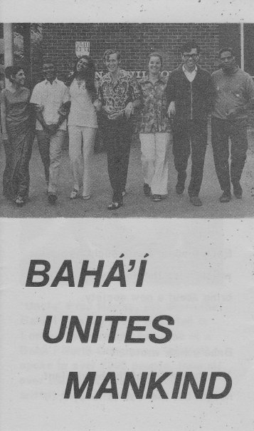
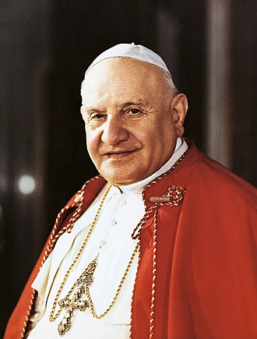
The Church and the Word of God [1970s Canberra and Melbourne]
John XXIII College
Pope John XXIII was head of the Catholic Church and sovereign of the Vatican City State from 28 October 1958 until his death in June 1963.
1970 – Baha’i Youth Conference at John XXIII College, ANU, Canberra
Notes:
POPE JOHN XXIII
The Second Vatican Council was announced by Pope John XXIII in 1959, around the time we went to Parkes. “as a means of spiritual renewal for the church”.
Coincidentally, when David and I finished High School we both studied science at the Australian National University, and we stayed in John XXIII College.
A few years earlier the College had hosted a National Baha’i Youth Conference.

Slide 7
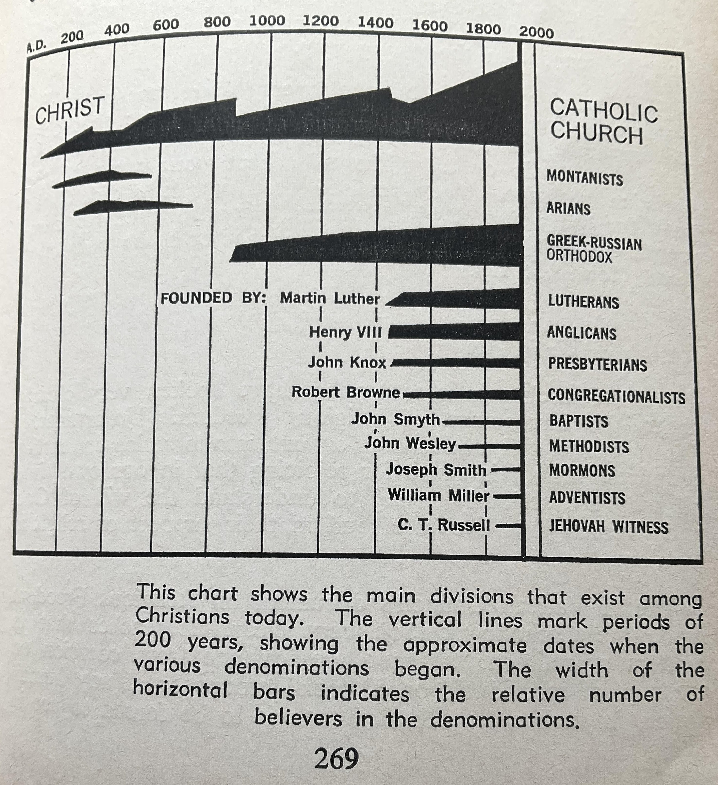
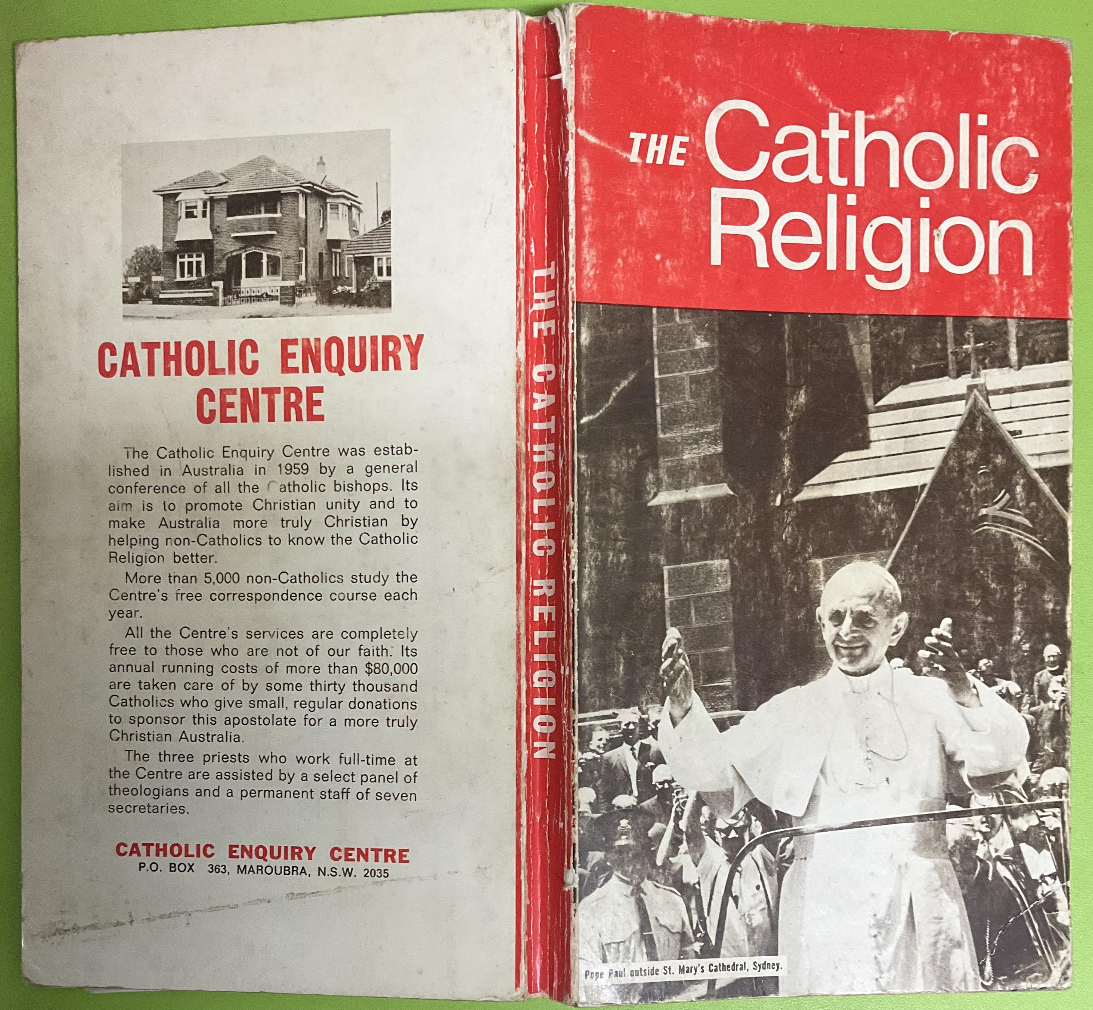
The Church and the Word of God [1970s Canberra and Melbourne]
Catholic/Orthodox/Protestant
Notes:
CATHOLIC/ORTHODOX/PROTESTANT
From Canberra I went to Melbourne to study Air Traffic Services. Something prompted me to learn more about the Catholic religion, so I ordered a book from the Catholic Enquiry Centre.
This chart from the book shows the main divisions that existed among Christians at that time. The vertical lines mark periods of 200 years, showing the approximate dates when the various denominations began. The width of the horizontal bars indicates the relative number of believers in the denominations.
If you search online for similar diagrams by the Orthodox and Protestant denominations you will find the same information organized differently. Each one demonstrates its direct connection with Jesus, and how the others started later.

Slide 8
The Church and the Word of God [1970s Canberra and Melbourne]
Church authority
As Catholics, we do see the Bible as authoritative, but not as the only and supreme authority. We believe this because of the simple fact that as the Bible itself teaches, Jesus didn’t come to found a book; he came to found a church. As a matter of fact, for the first few centuries of Christianity, the New Testament had not been put together yet, but only existed as individual writings. It was the Catholic Church who ultimately made the decision on which books were included in the Bible and which ones weren’t.
Father Michael Bower
https://www.journalreview.com/stories/why-do-catholics-focus-so-much-on-the-church-rather-than-just-on-the-bible,203298
Notes:
CHURCH AUTHORITY
In my late teens I started asking questions about the Bible – its authority, reliability and interpretation. It remained a personal research project for more than 20 years. Scholars saw the Bible. as a collection of documents written by humans. Some Christians viewed the Bible as the Word of God. This passage by Michael Bower does not use the language of an official Church teaching, but could be an interesting discussion starter about the authority of the Church.

Slide 9
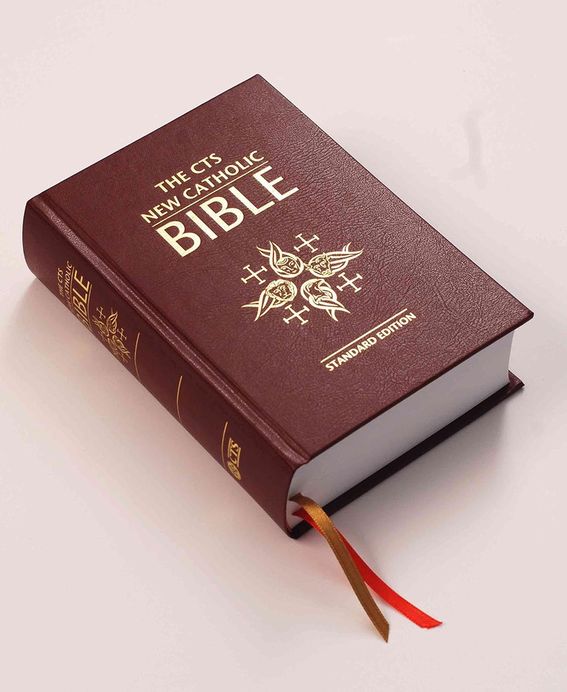
The Church and the Word of God [1970s Canberra and Melbourne]
The Bible (Michael Fallon)
In the poetic and dramatic scripts of the Gospels, we sometimes have Jesus’ actual words, and simple account of his actual deeds. We always have a presentation of words and actions that are true to the historical Jesus’ intentions as grasped by those closest to him.
The implications of this for the Gospels as a literary form can be illustrated by comparing a photograph with a painted portrait.
…The Gospels…are portraits of Jesus painted by people who loved him. How else could the authors communicate what they had seen and heard, and also what they had come to understand?
Father Michael Fallon MSC
Notes:
THE GOSPELS
This passage is helpful in appreciating the Gospels and why they inspire without necessarily being historically consistent.

Slide 10
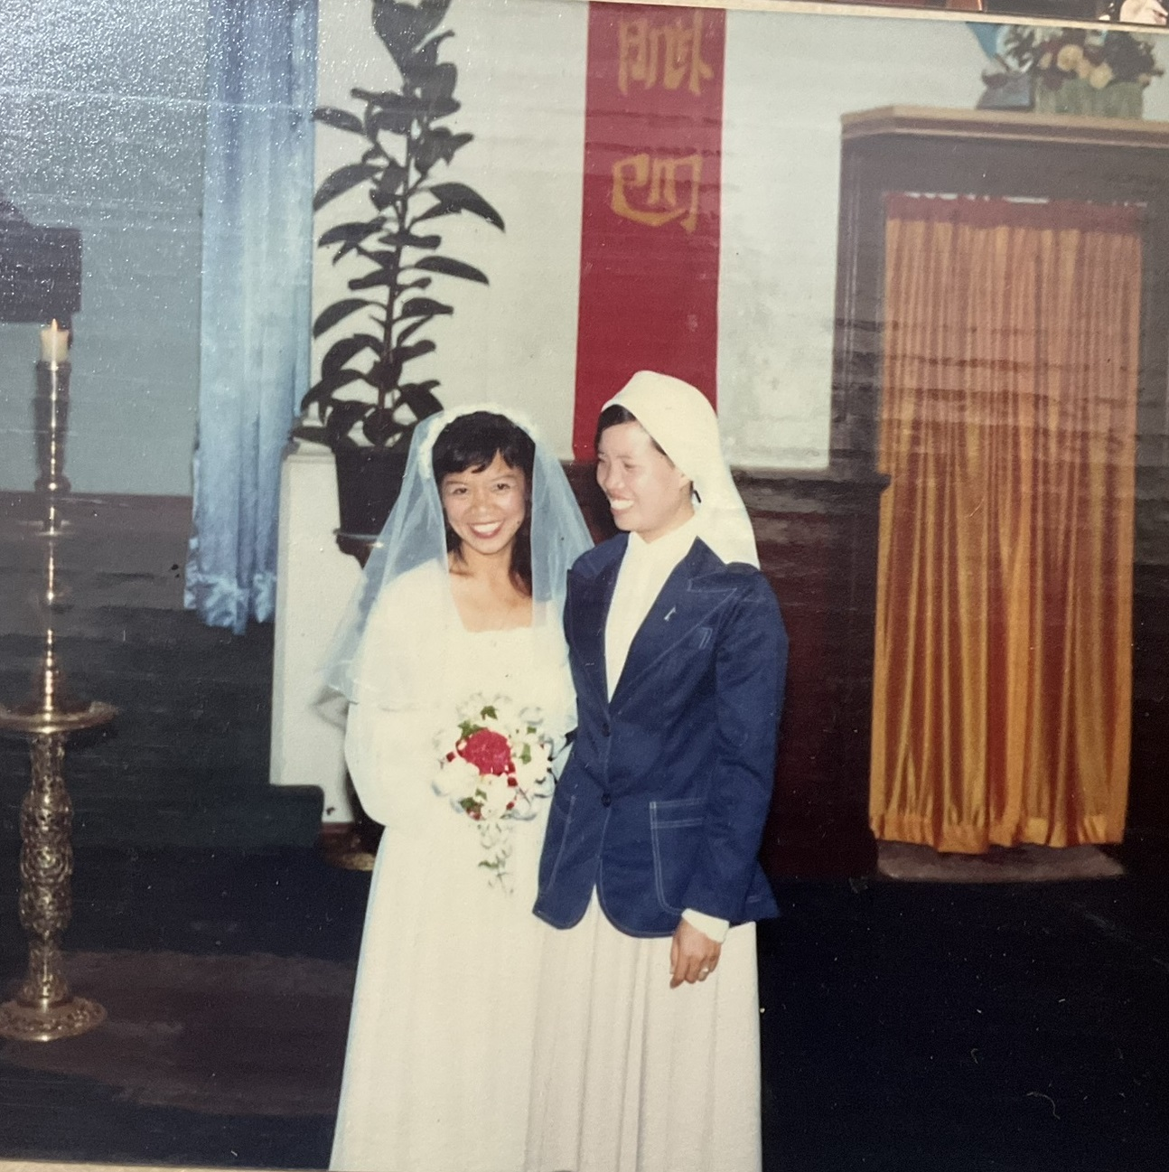
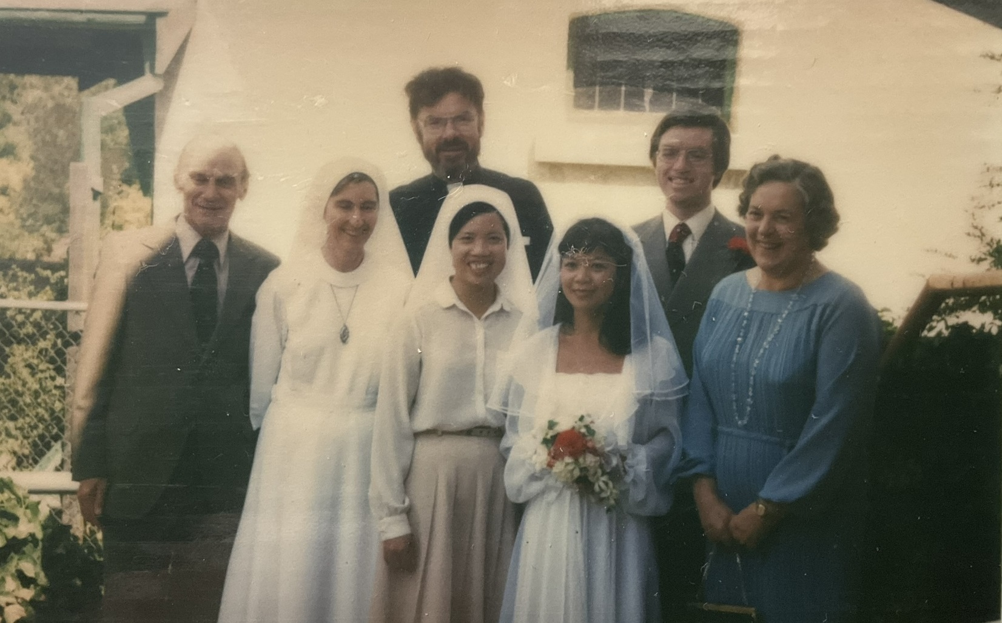
Sacraments and the Nicene Creed [1980s Adelaide and Sydney]
Marriage
Marriage is a basic way of giving and growing in love and together attaining salvation.
https://catholicidentity.bne.catholic.edu.au/scripture/SitePages/Sacrament-of-Marriage.aspx
Notes:
MARRIAGE
Yung and I married in 1981 in Adelaide. The photo on the right shows Yung and I with Father Jeff Foale. One of the Nuns is Pauline Compton. The Compton family has been very kind to us in Sydney. In the Catholic religion marriage is one of 7 official sacraments. Sacraments are ways in which we experience God's love, healing, forgiveness, nourishment and strengthening.

Slide 11
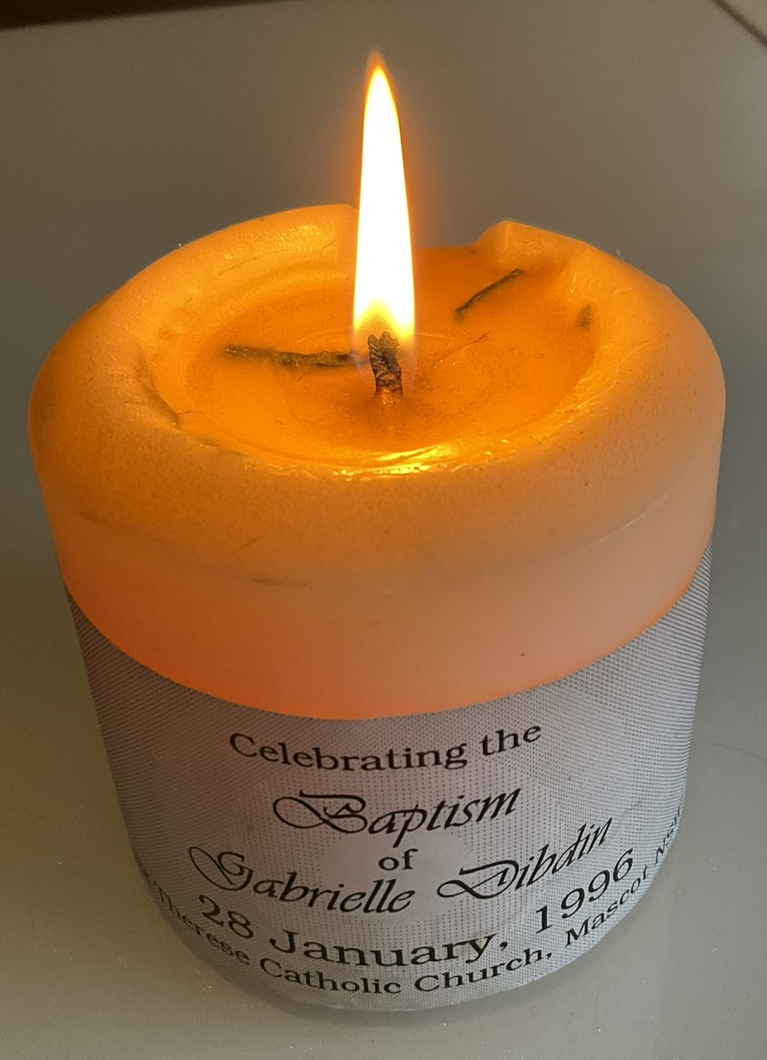
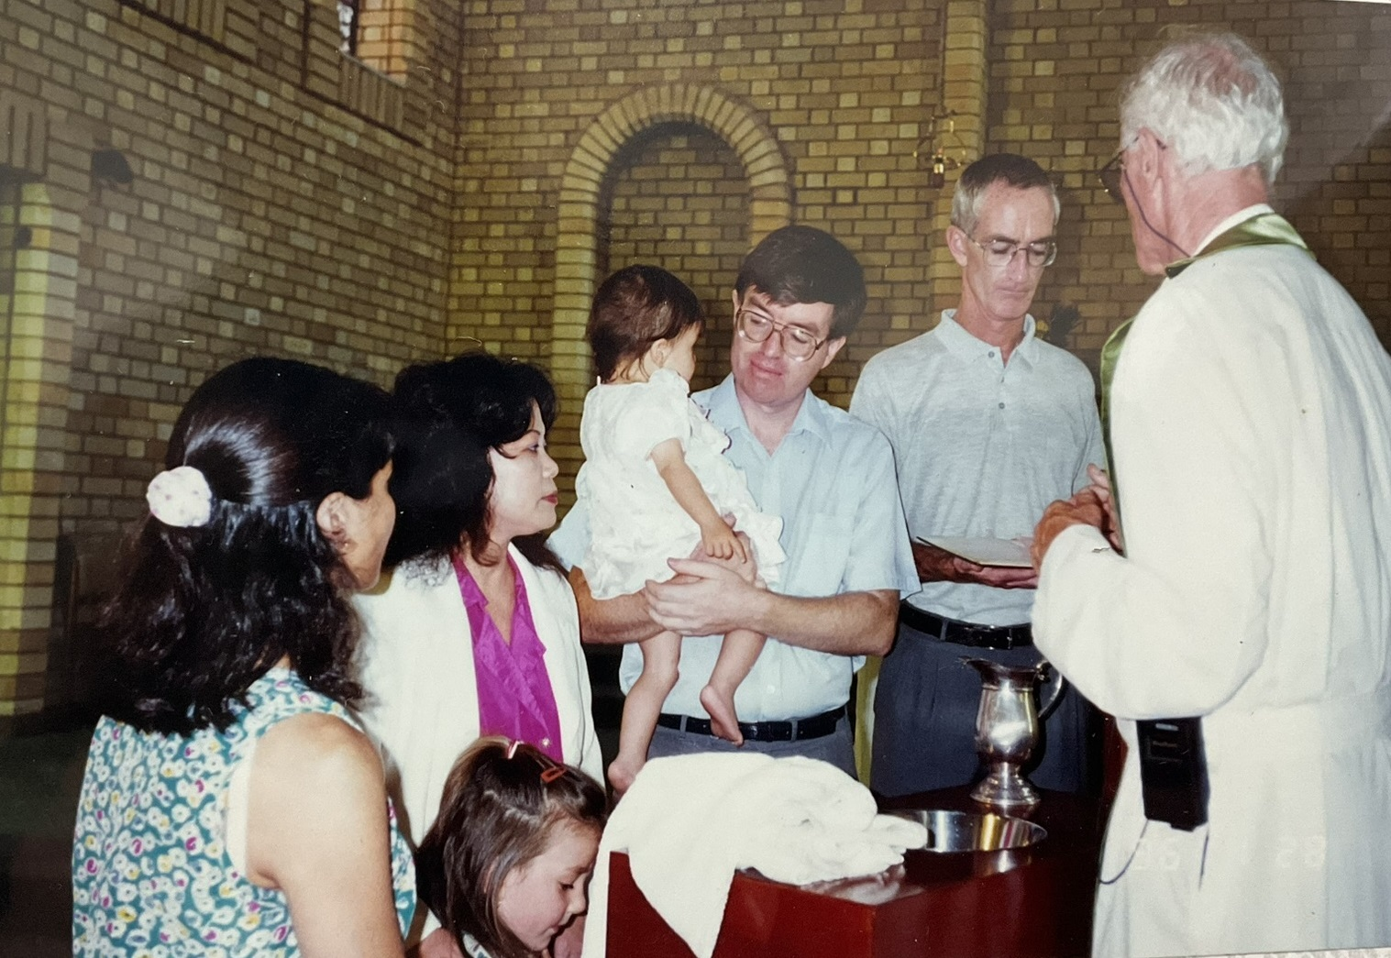
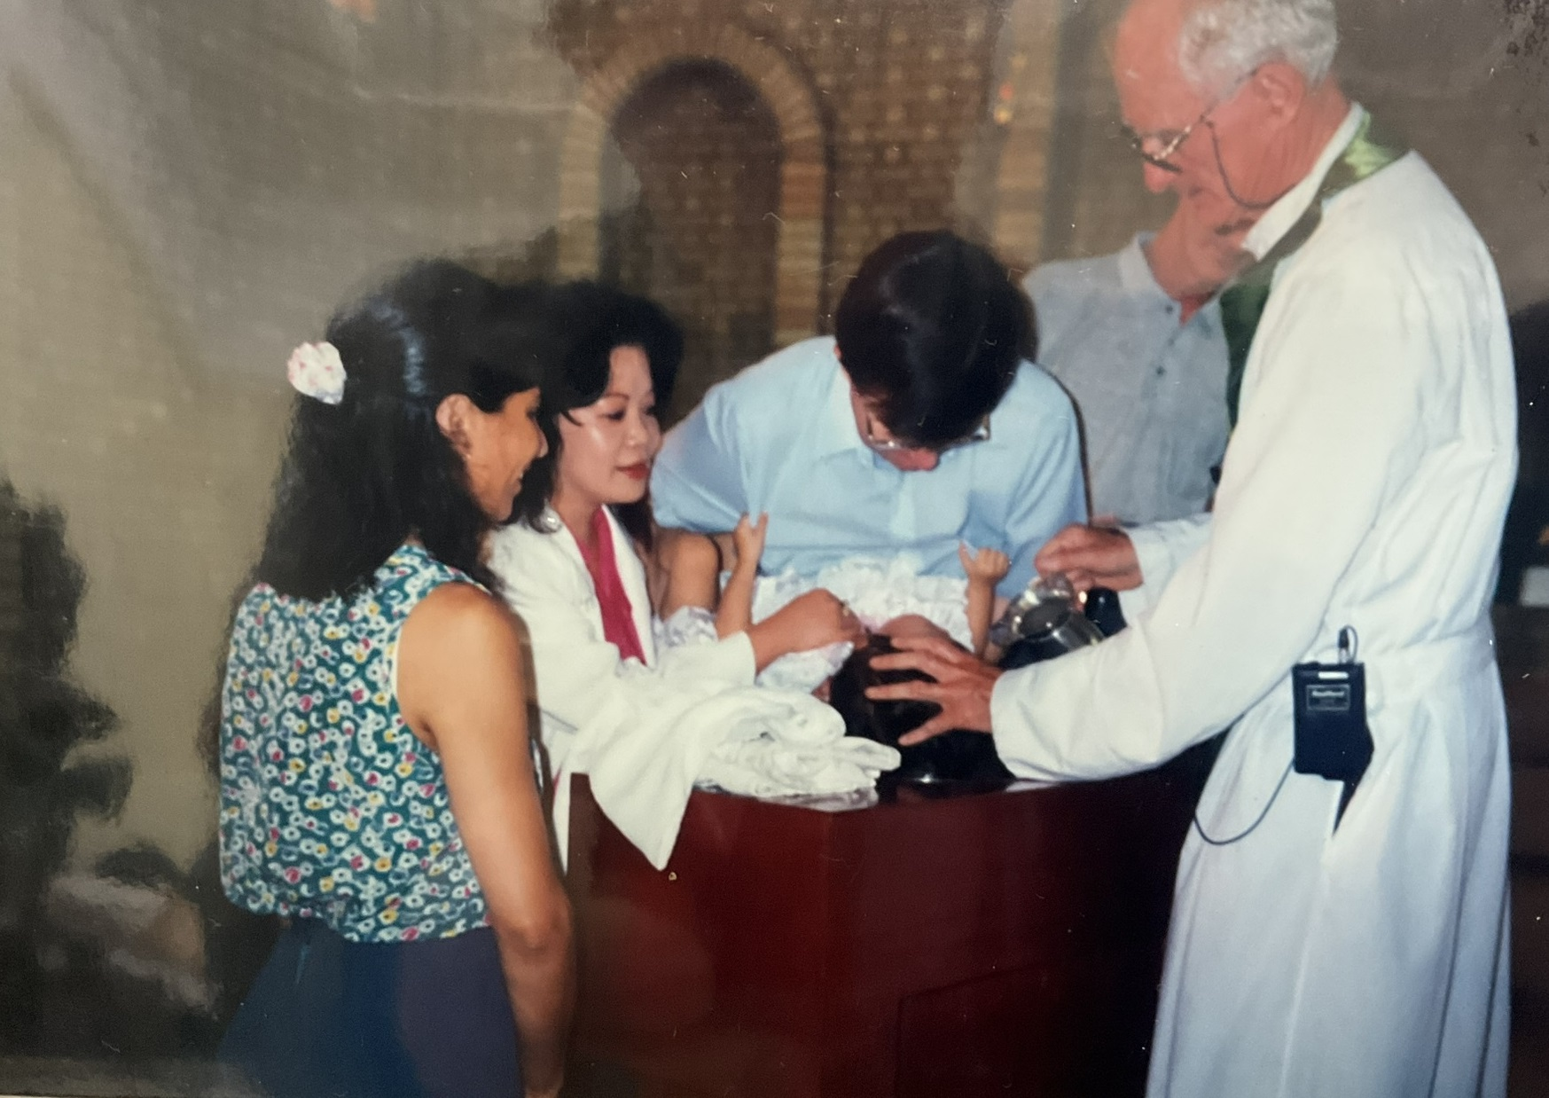
Sacraments and the Nicene Creed [1980s Adelaide and Sydney]
Baptism
Baptism and Confirmation are two of the three sacraments of Initiation of the Catholic Church. The third sacrament of Initiation is Eucharist.
https://catholicidentity.bne.catholic.edu.au/scripture/SitePages/Baptism-and-Confirmation.aspx
Notes:
BAPTISM
Another sacrament is baptism. These images are from the baptism of our daughter Gabrielle on 28 January 1996.
The Godparents of both of our children, Danny and Gaby, are Colin Weekes and Vickie Bonanno-Weekes. In the photos Vickie is on Yung’s left and Colin is on my right.

Slide 12
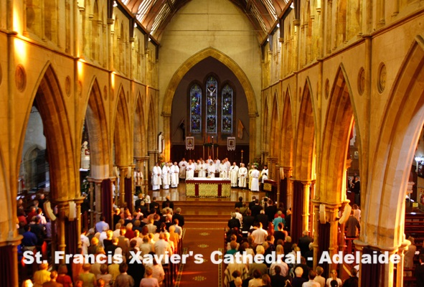
Sacraments and the Nicene Creed [1980s Adelaide and Sydney]
Mass (including the Eucharist]
By invocation of the Holy Spirit, Jesus, who is the Bread of Life, is made present sacramentally. Christians are fed at this table of the Lord.
https://catholicidentity.bne.catholic.edu.au/scripture/SitePages/The-meaning-of-Eucharist.aspx
Basic Structure of the Mass:
Introductory Rites
LITURGY of the WORD
LITURGY of the EUCHARIST
Concluding Rites
Notes:
THE MASS
One of the most solemn sacraments is communion, also called the Eucharist, which Catholics partake of during Mass.
I attended a Mass in this Cathedral in Adelaide. All are welcome to attend a Mass, but only Catholics may receive the bread which, in a sense, makes Jesus present. I immersed myself in the beauty of the architecture, the meaning of the Words being recited, the sense of the sacred, the experience of incense and bells, the unity of the participants singing, and the glorious uplifting harmonies of the choir.

Slide 13
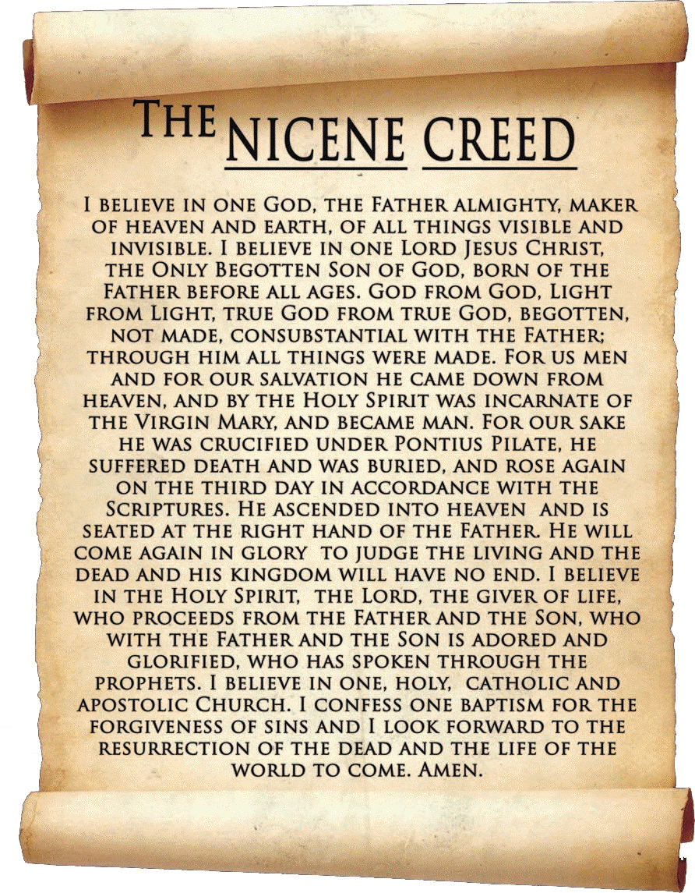
Sacraments and the Nicene Creed [1980s Adelaide and Sydney]
The Nicene Creed
Notes:
THE NICENE CREED
Our children, Danny and Gaby, routinely recited the Nicene Creed with Yung before bed.
The basic framework is the Trinity (God) and the church.
I believe in:
One God…
One Lord Jesus Christ…
The Holy Spirit
And
One holy catholic and apostolic church.
The word “catholic” in the creed means universal.
This Creed is accepted by the major branches of Christianity, and to some extent unites Christianity

Slide 14
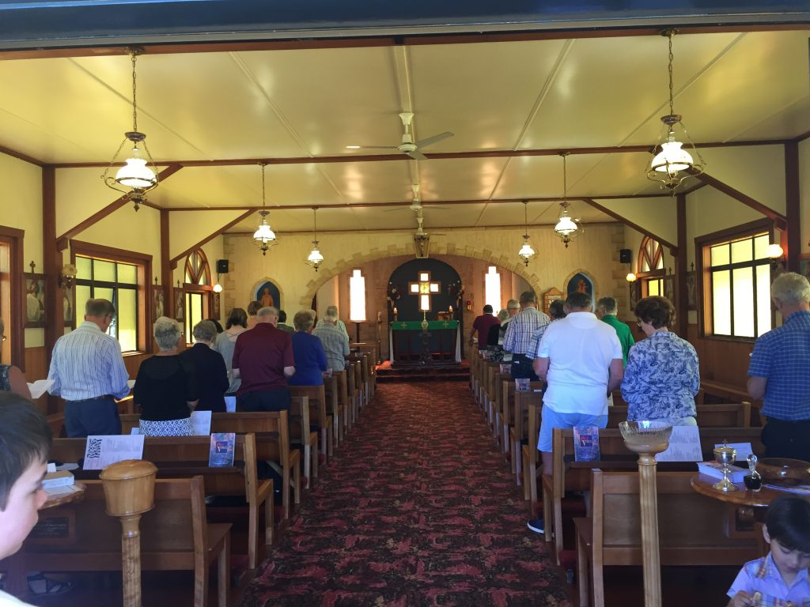
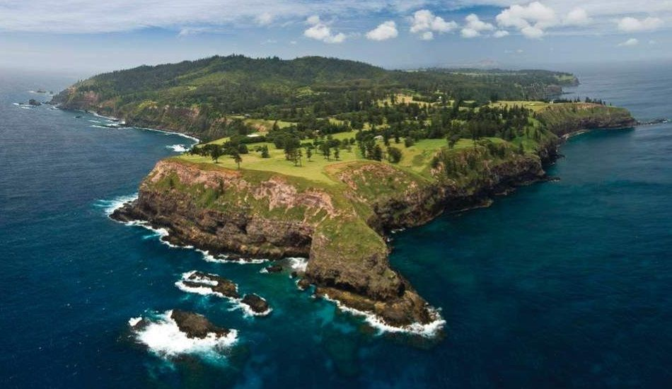
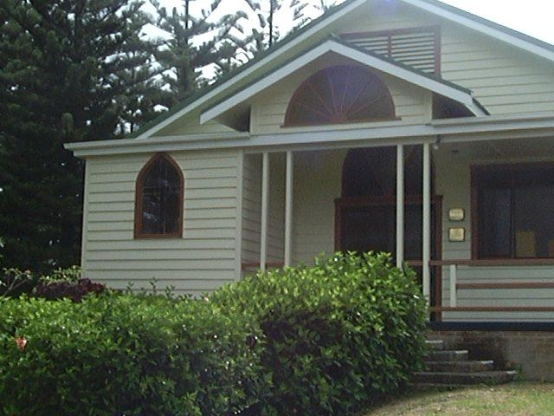
Faith and Works [1990s Norfolk Island, Yerrinbool and Randwick]
Practical dialogue vs theological dialogue
Then there was war in heaven. …
Revelation 12:7-9
The four forms of dialogue:
Daily Life
Social Action
Theological exchange
Religious experience
https://www.cdsale.org.au/ecumenism-and-interfaith-dialogue
Notes:
KINDS OF DIALOGUE
I worked at Norfolk Island airport from 1989 to 1991. Norfolk island is small: 5km by 8km and about 2 hours by jet to the north-east of Sydney. There were about 2000 residents and several active Christian churches including the Seventh Day Adventists and the Catholics.
What does inter-faith dialogue look like in a small, geographically isolated community where some members of one church (the Seventh Day Adventist) believed that the other was led by the antichrist (the Pope, or more accurately the Papacy)? Was there war in heaven, as predicted in the book of Revelation?
No, and yes. I’ll describe the war shortly.
In fact three forms of dialogue prevailed. The community members interacted in daily life, and in social action such as looking after the poor (there was no Medicare), and in sharing religious experience by singing the words of Jesus in the Norfolk anthem [Matthew 25:34-36,40]. These things bring harmony.
Theological exchange is where wars can start if not done respectfully and with care for the feelings of others. Both churches were respectful and caring. And the Catholic Priest, Father Harry, also had a sense of humour. So, in his weekly radio broadcast he described himself as “the Pope of Norfolk Island”, knowing that his Adventist friends would be listening. He chose for his car’s number plate “666”, knowing that this number has a negative connotation in the Book of Revelation.
How did the Adventist congregation respond? They raised money for the Catholics to have their own church organ.
I think there’s a lesson in that. Don’t choose Bible texts as weapons. It is better to unite around texts about love, charity and service, as they did on Norfolk Island.
And if you think about it, the world is not much bigger than Norfolk Island.

Slide 15
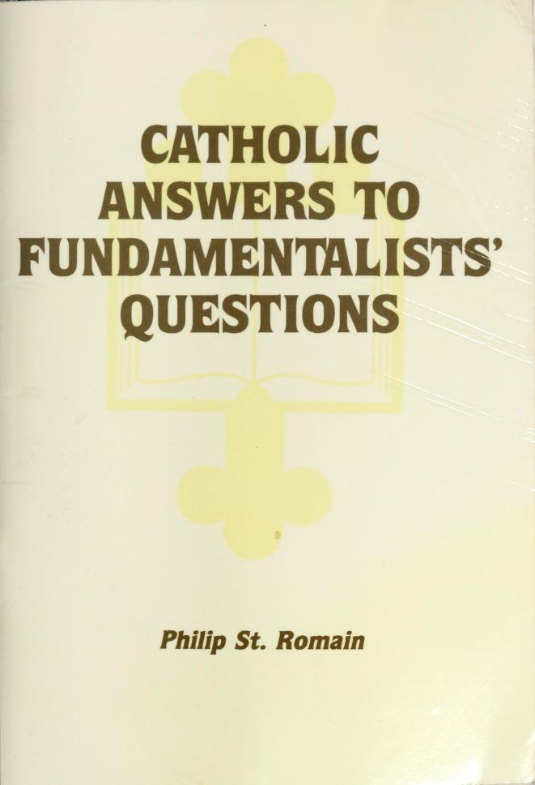
Faith and Works [1990s Norfolk Island, Yerrinbool and Randwick]
Fundamentalism
Remember that religious beliefs lie very close to one’s self-concept; this is why religious discussion sometimes becomes very emotional. Criticizing a person’s religious beliefs cuts to the heart.
(Philip St. Romain, How to Get Along With a Fundamentalist, Liguori Publications, Missouri, 1988.)
Notes:
FUNDAMENTALISM
Which leads me to a Catholic pamphlet I bought from the Church in Avoca St, Randwick. It was titled “How to get along with a fundamentalist”. I really liked this part:
Remember that religious beliefs lie very close to one’s self-concept; this is why religious discussion sometimes becomes very emotions. Criticizing a person’s religious beliefs cuts to the heart.

Slide 16
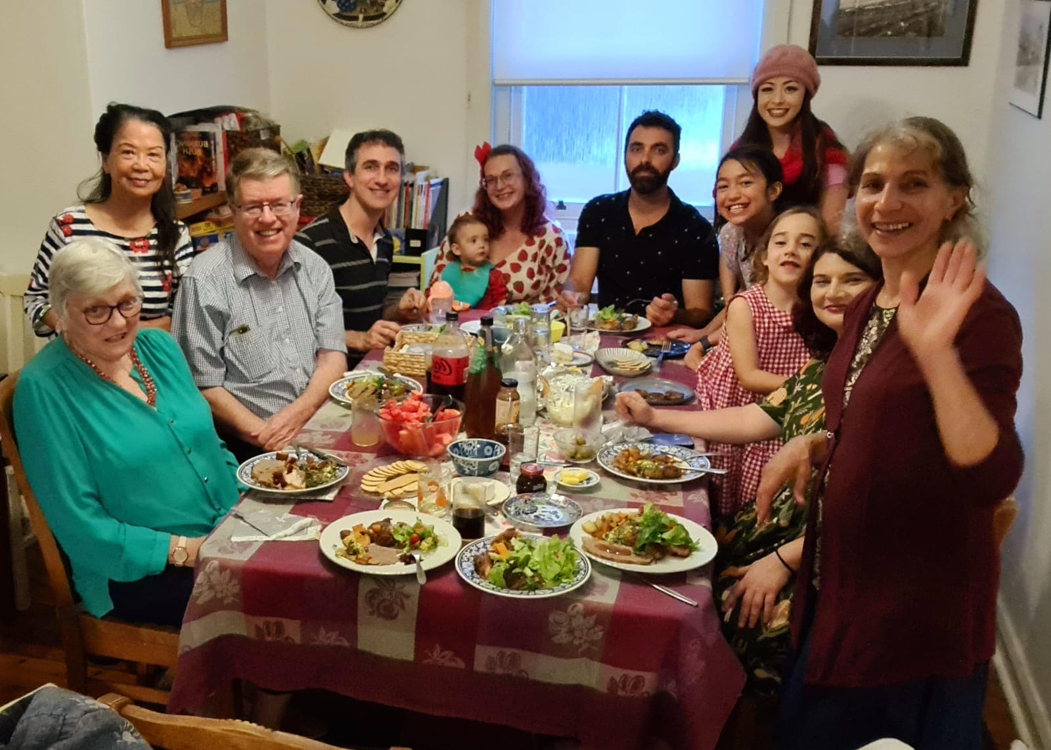
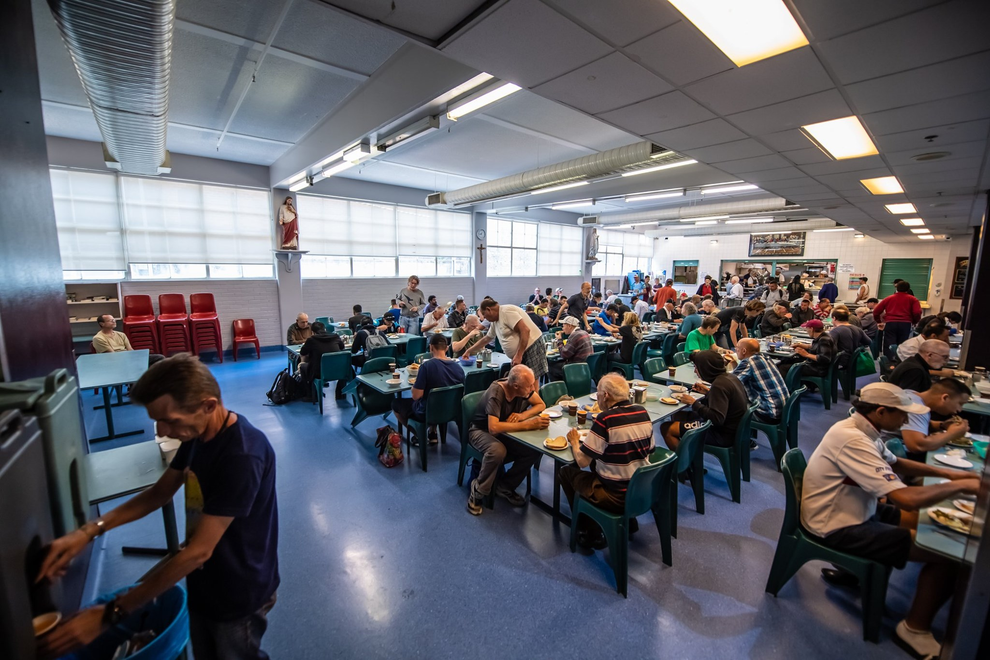
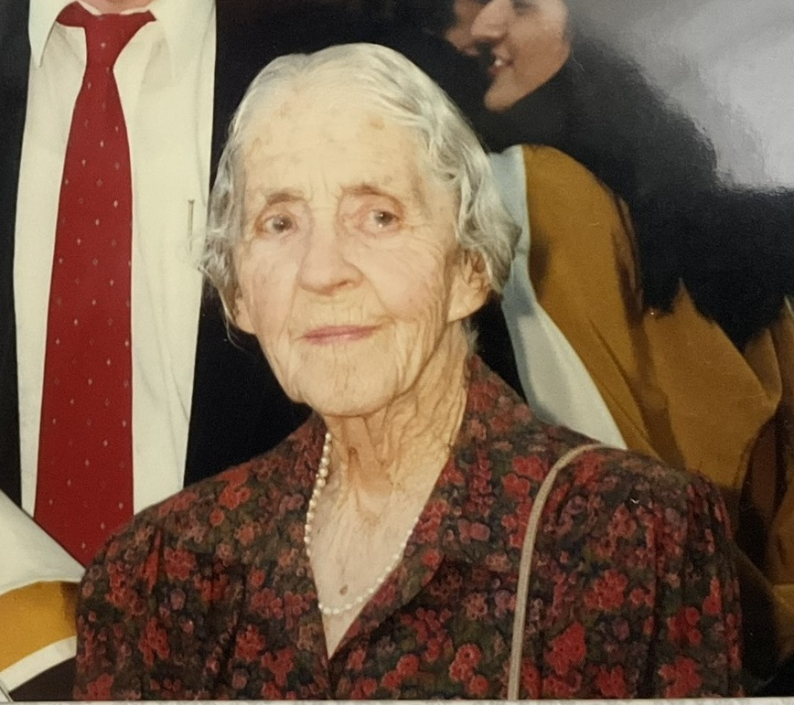
Faith and Works [1990s Norfolk Island, Yerrinbool and Randwick]
Community
…the Lord Jesus himself said: ‘It is more blessed to give than to receive.’
St Paul, quoted in Acts 20:35
Notes:
COMMUNITY
I’d like to briefly introduce you to some of our friends in the Catholic community of the eastern suburbs of Sydney. This is at Vickie Weeke’s home with her children and grandchildren on Christmas Eve. Rita (in the blue green top) is a retired Nun. Mrs Compton (now deceased) was someone who lived the teaching that it is more blessed to give than to receive. Mr Compton’s daughter-in-law Therese is a nurse and cared for Yung’s brother when he was ill.
The other image is the Matthew Talbot Hostel, providing food and shelter for homeless men, which Mrs Compton often mentioned as an opportunity to serve others.

Slide 17
Faith and Works [1990s Norfolk Island, Yerrinbool and Randwick]
Jesus
Jesus answered, "My teaching is not my own. It comes from the one who sent me.
John 7:16 NIV
Quoted by Michel Fallon MSC
Notes:
JESUS
Regular participants of this weekly interfaith group may remember the presentation by Father Michael Fallon on 27 January 2022. Michael read from his book – Jesus as Portrayed in the New Testament: Divine Love in a Human Heart. The quality of the discussion that followed was the best I have seen. I met Michael through the Comptons and the Weeks families
The quote on the screen with more context is:
¹⁴ Not until halfway through the festival did Jesus go up to the temple courts and begin to teach. ¹⁵ The Jews there were amazed and asked, “How did this man get such learning without having been taught?”
¹⁶ Jesus answered, “My teaching is not my own. It comes from the one who sent me. ¹⁷ Anyone who chooses to do the will of God will find out whether my teaching comes from God or whether I speak on my own.

Slide 18
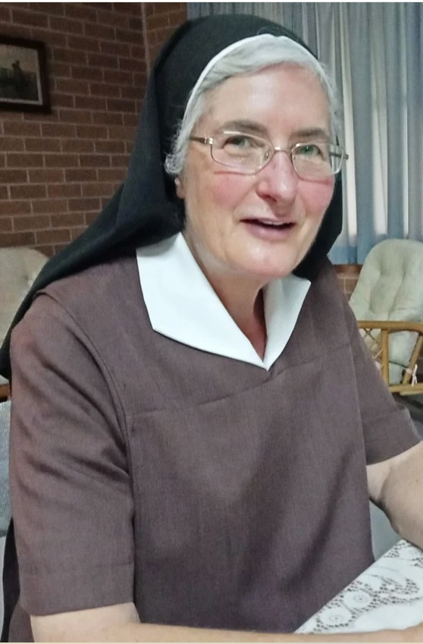
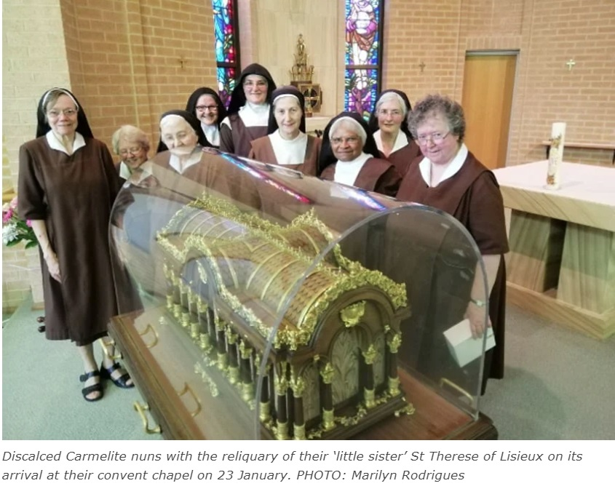
Vocations, Saints and Miracles [2000-2010 Varroville, Mascot and Coogee]
Sister Jocelyn Kramer (Palliative care doctor/Carmelite Nun)
Sifting the Dust is an uplifting book with many profound positive insights. I will treasure it and revisit it from time to time. I will share it with all my sisters here and I am sure that they will appreciate it. Those who entered religious life in the Carmel in Parkes (which closed in the late ‘80s and eventually became part of our community here at Varroville) will have an additional reason to connect with it.
2 May 2025 email from Jocelyn Kramer to Colin Dibdin
Notes:
JOCELYN KRAMER
This is Sister Jocelyn Kramer, a member of the Carmelite order. The Carmelites originate from a group of Christians who, seeking a deeper way of life, settled on Mount Carmel in Israel 800 years ago.
… while a medical student at the University of NSW, Jocelyn became a Catholic.
She spent more than 20 years working as a palliative care doctor. She also helped care for Yung’s brother.
Then, at age 47, Jocelyn began the process of becoming a Carmelite. It took six-and-a-half years.
Yung and I were honoured to be invited to her solemn profession as a Nun in Varroville south of Sydney.
I gave Jocelyn a copy of my sister, Marjorie’s, book “Sifting the Dust”. In Jocelyn’s reply she wrote that “Those who entered religious life in the Carmel in Parkes…eventually became part of our community here at Varroville.” So that’s an interesting connection with my childhood town.
The smaller image is of Jocelyn and the nuns at the chapel in Varroville in 2002, which was blessed to be the first stop on a four month Australian tour of the relics of a Saint – St Therese of Lisieux.

Slide 19
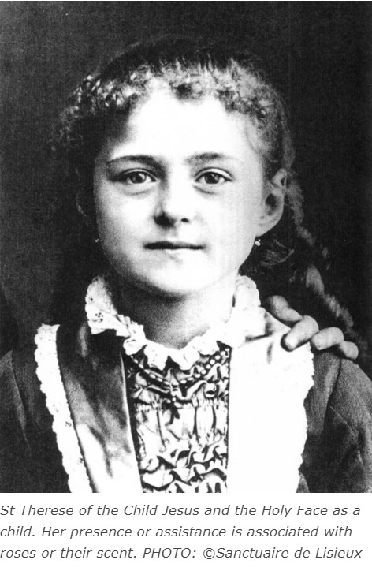
Vocations, Saints and Miracles [2000-2010 Varroville, Mascot and Coogee]
Saint Therese of Lisieux (b.1873-d.1897)
The world came to know Therese through her autobiography, "Story of a Soul".
Therese's spirituality is of doing the ordinary, with extraordinary love. https://kids.kiddle.co/Th%C3%A9r%C3%A8se_of_Lisieux
Notes:
ST THERESE
The church in Mascot, near our home, is called “St Therese Church”.
At age 15 Therese entered the Carmelite convent In Lisieux, France to give her whole life to God. When Therese was struggling with tuberculosis her mother superior asked her to write her autobiography which was later published as “Story of a Soul”. Her spirituality was of doing the ordinary, with extraordinary love. She died in 1897, at the age of 24. Her last words were the story of her life: "My God, I love You!" She became known as Saint Therese of Lisieux.
I asked our daughter, Gaby, to read the next 3 slides, which is a short extract from “Story of a Soul”.

Slide 20
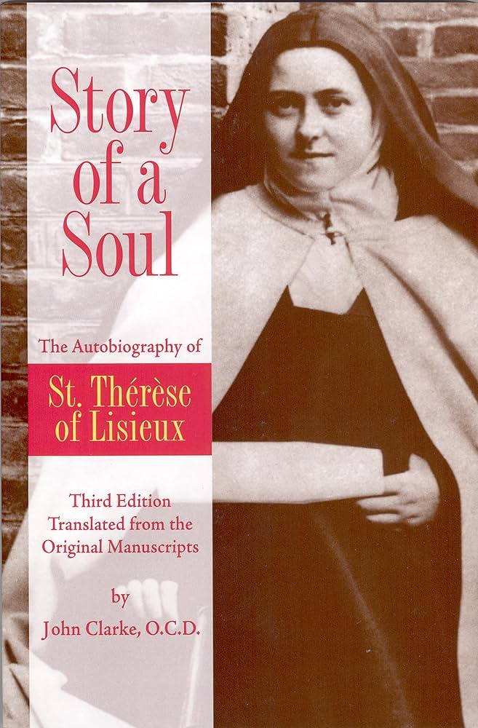
Vocations, Saints and Miracles [2000-2010 Varroville, Mascot and Coogee]
“The Story of a Soul”
Dear Mother, I feel that I have expressed myself with more than usual confusion, and I do not know what you can find to interest you in these rambling pages, but I am not aiming at a literary masterpiece, and if I weary you by this discourse on charity, it will at least prove your child’s good will. I must confess I am far from living up to my ideal, and yet the very desire to do so gives me a feeling of peace. If I fall into some fault, I arise again at once—and for some months now I have not even had to struggle. I have been able to say with our holy Father, St. John of the Cross: “My house is entirely at peace,” and I attribute this interior peace to a victory I gained over myself. Since that victory, the hosts of Heaven have hastened to my aid, for they will not allow me to be wounded, now that I have fought so valiantly.
Continued…
Notes:
Dear Mother, I feel that I have expressed myself with more than usual confusion, and I do not know what you can find to interest you in these rambling pages, but I am not aiming at a literary masterpiece, and if I weary you by this discourse on charity, it will at least prove your child’s good will. I must confess I am far from living up to my ideal, and yet the very desire to do so gives me a feeling of peace. If I fall into some fault, I arise again at once—and for some months now I have not even had to struggle. I have been able to say with our holy Father, St. John of the Cross: “My house is entirely at peace,” and I attribute this interior peace to a victory I gained over myself. Since that victory, the hosts of Heaven have hastened to my aid, for they will not allow me to be wounded, now that I have fought so valiantly.

Slide 21
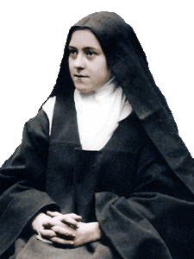
A holy nun of our community annoyed me in all that she did; the devil must have had something to do with it, and he it was undoubtedly who made me see in her so many disagreeable points. I did not want to yield to my natural antipathy, for I remembered that charity ought to betray itself in deeds, and not exist merely in the feelings, so I set myself to do for this sister all I should do for the one I loved most. Every time I met her I prayed for her, and offered to God her virtues and merits. I felt that this was very pleasing to Our Lord, for there is no artist who is not gratified when his works are praised, and the Divine Artist of souls is pleased when we do not stop at the exterior, but, penetrating to the inner sanctuary He has chosen, admire its beauty.
Continued…
Notes:
A holy nun of our community annoyed me in all that she did; the devil must have had something to do with it, and he it was undoubtedly who made me see in her so many disagreeable points. I did not want to yield to my natural antipathy, for I remembered that charity ought to betray itself in deeds, and not exist merely in the feelings, so I set myself to do for this sister all I should do for the one I loved most. Every time I met her I prayed for her, and offered to God her virtues and merits. I felt that this was very pleasing to Our Lord, for there is no artist who is not gratified when his works are praised, and the Divine Artist of souls is pleased when we do not stop at the exterior, but, penetrating to the inner sanctuary He has chosen, admire its beauty.

Slide 22
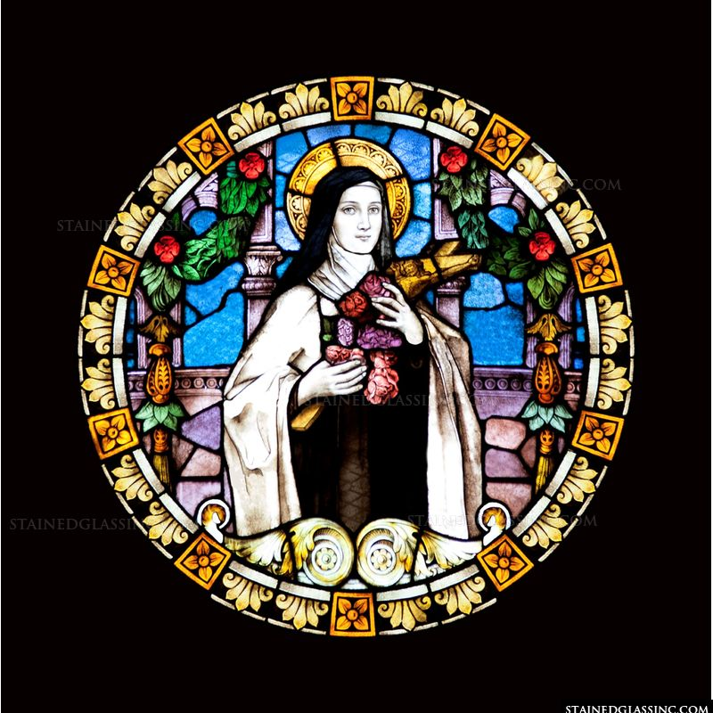
I did not rest satisfied with praying for this Sister, who gave me such occasions for self-mastery, I tried to render her as many services as I could, and when tempted to answer her sharply, I made haste to smile and change the subject, for the Imitation* says: “It is more profitable to leave everyone to his way of thinking than to give way to contentious discourses.” And sometimes when the temptation was very severe, I would run like a deserter from the battlefield if I could do so without letting the Sister guess my inward struggle.
One day she said to me with a beaming face: “My dear [Sister] Thérèse, tell me what attraction you find in me, for whenever we meet, you greet me with such a sweet smile.” Ah! What attracted me was Jesus hidden in the depths of her soul—Jesus who maketh sweet even that which is most bitter.
https://mycatholic.life/books/story-soul-saint-therese-lisieux/chapter-ix-night-soul/
Notes:
I did not rest satisfied with praying for this Sister, who gave me such occasions for self-mastery, I tried to render her as many services as I could, and when tempted to answer her sharply, I made haste to smile and change the subject, for the Imitation* says: “It is more profitable to leave everyone to his way of thinking than to give way to contentious discourses.” And sometimes when the temptation was very severe, I would run like a deserter from the battlefield if I could do so without letting the Sister guess my inward struggle.
One day she said to me with a beaming face: “My dear [Sister] Thérèse, tell me what attraction you find in me, for whenever we meet, you greet me with such a sweet smile.” Ah! What attracted me was Jesus hidden in the depths of her soul—Jesus who maketh sweet even that which is most bitter.

Slide 23
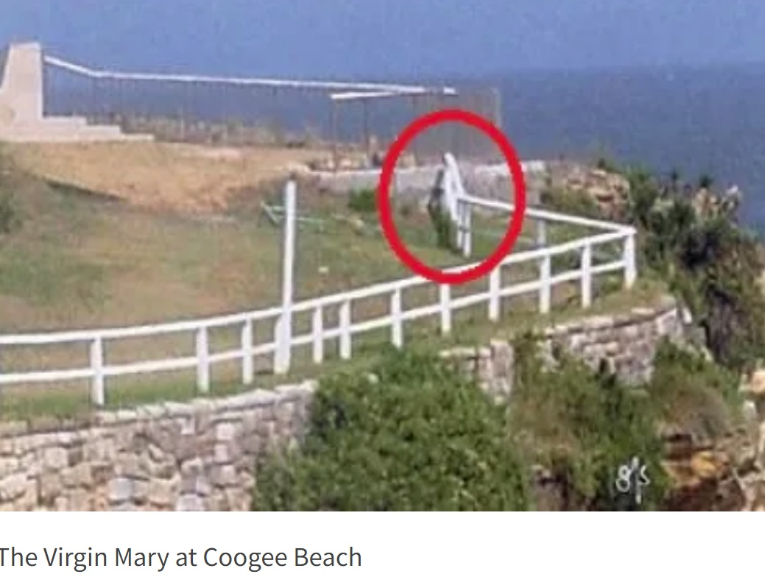
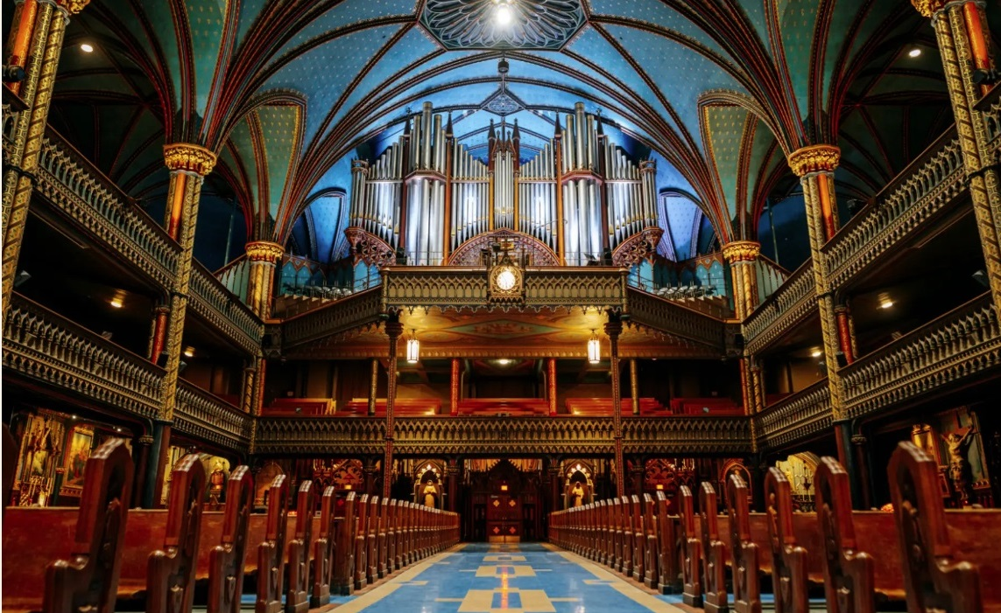
Vocations, Saints and Miracles [2000-2010 Varroville, Mascot and Coogee]
Miracles
Coogee - Apparition
Montreal – The Notre Dame Basilica
"It was the total self-abnegation of the apostles of Christ which had raised that splendorous edifice in a land far, far from the scene of their labours. Those disciples, said 'Abdu'l-Bahá, made a pact to go out into the wide world, preach the Gospel, and accept every tribulation for the sake of their Master. They stood by their pledge, and not a single one of them ever returned. And there beside them, He told that company, stood the concrete evidence [] of the selfless efforts of the disciples of Christ.
H.M. Balyuzi, ‘Abdu’l-Baha
Notes:
MIRACLES
So now this presentation glides from the heights of individual inspiration to the concrete work of building peace. How to spread Jesus’ teachings of peace? Miracles might be needed.
A reported miracle was The apparition of the Virgin Mary at Coogee, a seaside suburb of Sydney, first revealed to the press in January 2003 by a local resident. The parish priest described it as an optical illusion. More interesting were the responses of those who believed, as reported by Carole M Cusack in the Australian Religious Studies Review, such as Irene of Kensington who said that “[s]he is coming here because there are so many naked girls on the beach. She comes in her veils, head to foot, to say “Cover yourselves”.
Perhaps a more verifiable miracle was the spread of Christianity.
In the readings earlier we read ‘Abdu’l-Baha’s description of Montreal. Now I will share an observers account:
"The day after His arrival in Montreal 'Abdu'l-Bahá went for a drive, and sighting the magnificent Roman Catholic Church of Notre Dame, He went in. When He came out, standing in the porch, He turned to those who were in His company and told them to take a lesson from that very church. It was the total self-abnegation of the apostles of Christ which had raised that splendorous edifice in a land far, far from the scene of their labours. Those disciples, said 'Abdu'l-Bahá, made a pact to go out into the wide world, preach the Gospel, and accept every tribulation for the sake of their Master. They stood by their pledge, and not a single one of them ever returned. And there beside them, He told that company, stood the concrete evidence of the selfless efforts of the disciples of Christ.
(H.M. Balyuzi, Abdu'l-Baha - The Centre of the Covenant, p. 259)

Slide 24
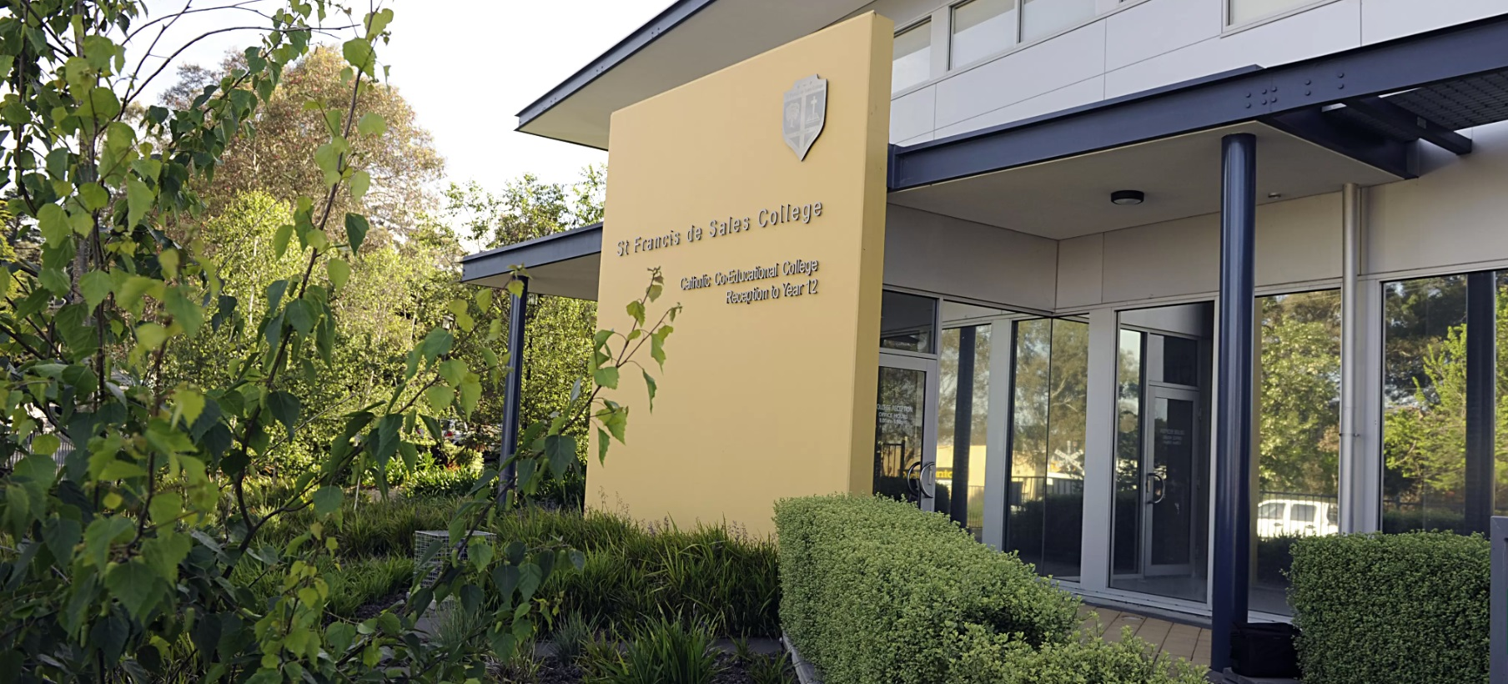
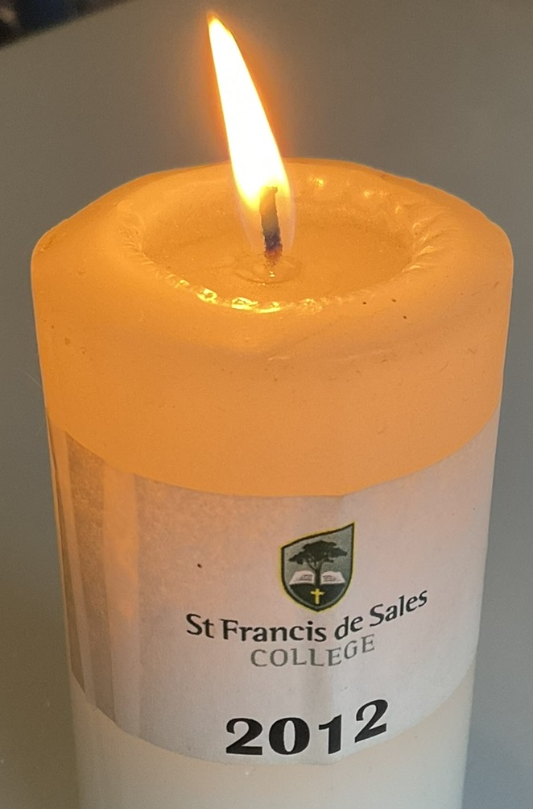
Love [2010-2024 Mt Barker, Miranda and Rosebery]
St Francis de Sales
Privileged to have found a school that was not only so wonderful, but also welcomed me with open arms and made me feel at home.
From Gaby Dibdin to St Francis De Sales College Teachers, 2012.
Notes:
EDUCATION
Another evidence of the constructive power of Christ is the quality of Catholic education. Our daughter, Gaby, thrived in her final year. In 2012 she wrote a letter to her teachers at St Francis De Sales College in Mt Barker, South Australia. The school principal asked her to read it to the parents, teachers and other students.
[play audio, or]
Gaby wrote that she was privileged to have found a school that was not only so wonderful, but also welcomed [her] with open arms and made [her] feel at home.

Slide 25
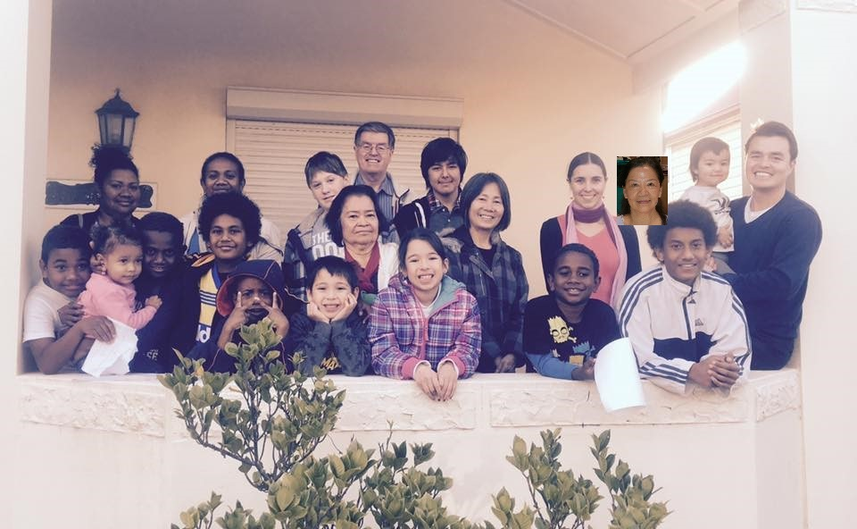
Love [2010-2024 Mt Barker, Miranda and Rosebery]
Neighbourhood class
Jesus …said to them, 'Let the little children come to me, and do not hinder them, for the kingdom of God belongs to such as these.'
Mark 10:13-16
2016 School Holidays
Sat 9 July 3-5pm
- Purity of heart
Sun 10 July 3-5pm
- Maintaining a prayerful attitude
Mon 11 July 3-5pm
- Truthfulness
Tues 12 July 3-5pm
- Generosity
Wed 13 July 3-5pm
- Kindness
Notes:
PEACE-BUILDING
More peace-building.
In 2016, with our Catholic, Jewish and Baha’I neighbours, we had a school holiday program in our street, where children learned about:
Purity of heart
Maintaining a prayerful attitude
Truthfulness
Generosity, and
Kindness

Slide 26
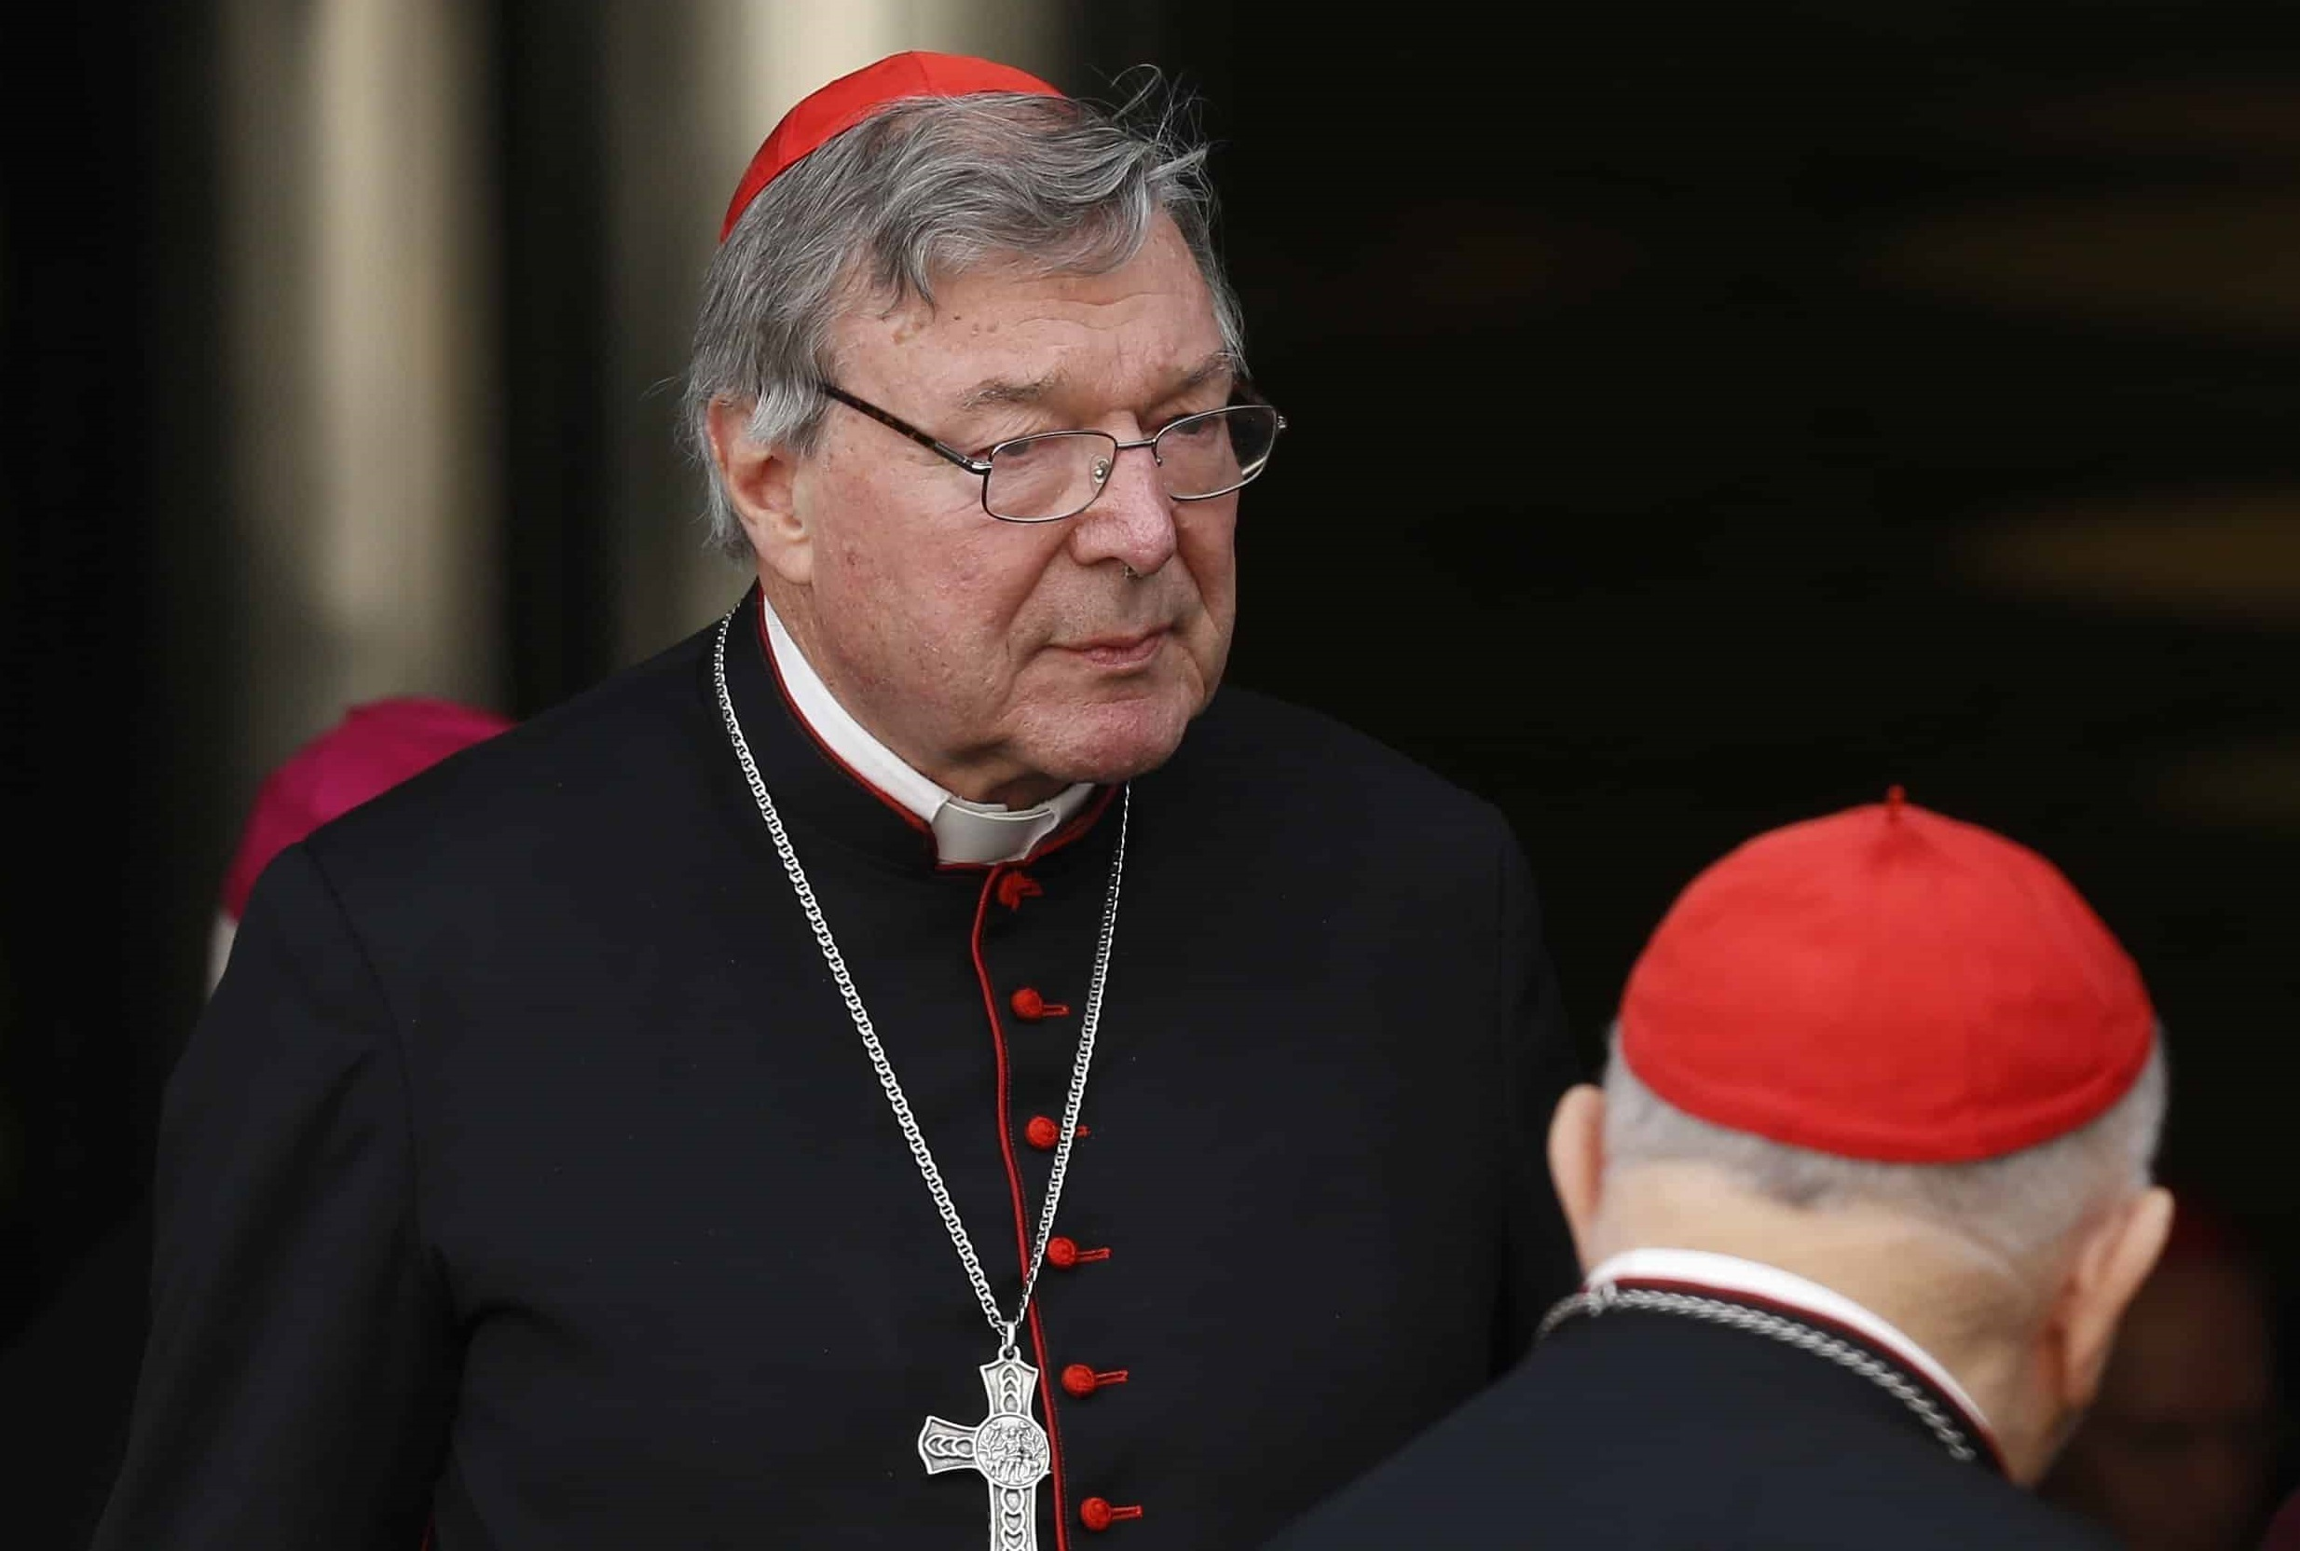
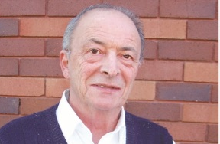
Love [2010-2024 Mt Barker, Miranda and Rosebery]
Conversations with Priests
We know that we are all on a journey. We know that each of us is a pilgrim, not only in a spiritual way … but some of us are physical pilgrims.
I think the Church in Sydney has realised that diversities in people … are resources to be shared.
Father Dominic Ceresoli, 2011
Notes:
CONVERSATIONS WITH PRIESTS
Our family has enjoyed conversations with Catholics.
Around 2002 Gaby and I had a meeting with the late Fr Dominic Ceresoli of St Therese Catholic Church in Mascot. We shared views on the problem of religious prejudice, its effects, and what could be done about it.
Around 2011 Yung and Gaby attended a youth service at a church in Miranda. When it was over I waited outside and chatted with Cardinal George Pell’s driver. When Cardinal Pell exited I stepped back into the shadow so as not to disturb his departure. However he introduced himself to me and we had a short chat.
I enjoyed these conversations, and I feel for priests who are sometimes unfairly blamed.

Slide 27
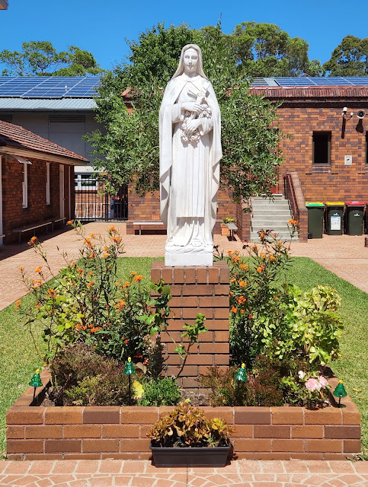
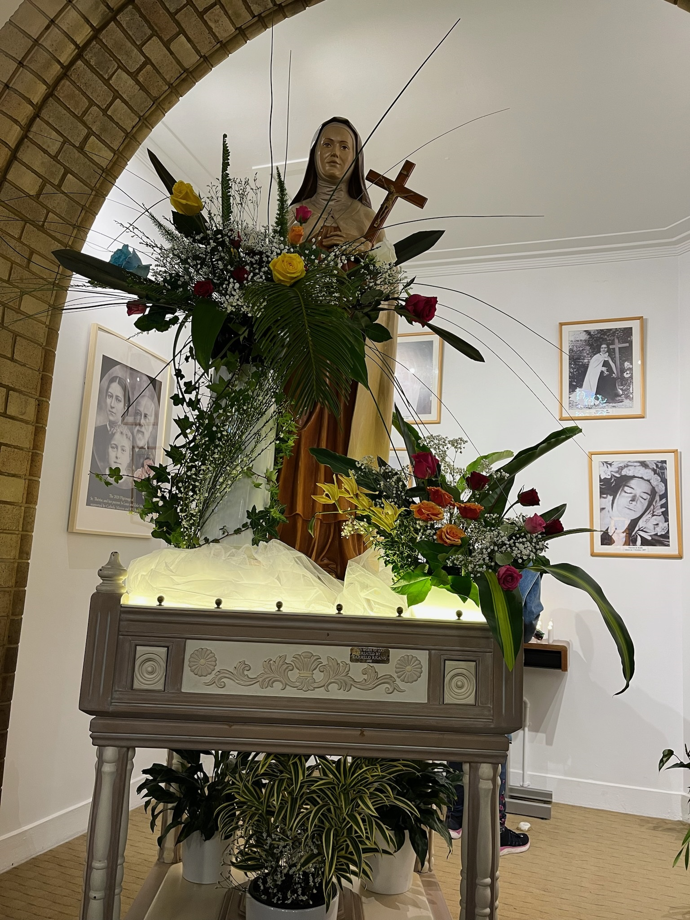
Love [2010-2024 Mt Barker, Miranda and Rosebery]
St Therese
Miss no single opportunity of making some small sacrifice, here by a smiling look, there by a kindly word; always doing the smallest right and doing it all for love.
Thérèse de Lisieux
Notes:
LOVE
These are statues of St Therese in our local Church.
St Therese wrote that we should…
Miss no single opportunity of making some small sacrifice, here by a smiling look, there by a kindly word, always doing the smallest right and doing it all for love.

Slide 28
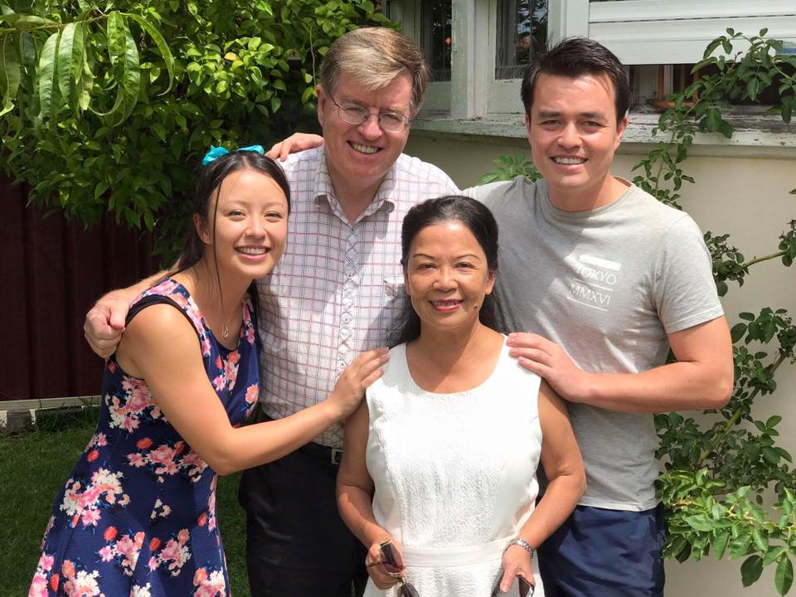
Unity [Present and Future, Everywhere]
Family
“How good and pleasant it is when God’s people live together in unity!” – Psalm 133:1
Notes:
FAMILY
And the most amiable encounters with a Catholic have of course been 44 years with Yung. We love children Gaby and Danny. They bring the world a lack of prejudice and an abundance of empathy.

Slide 29
Unity [Present and Future, Everywhere]
Oneness
A new command I give you: Love one another. As I have loved you, so you must love one another.
Words of Jesus as recorded in John 13:34
Notes:
ONENESS
Which brings me to the beginning and end of it all, God’s guidance, as revealed by Jesus:
A new command I give you: Love one another. As I have loved you, so you must love one another.

