Slide 1
Investigating Religion:
Some effects of religious prejudice on the quality of scholarship
PART 1 – The Problem (8 slides) PART 2 – Examples (6 slides) PART 3 – What can we do? (6 slides)
Presentation by Colin Dibdin 16 January 2025
colin.dibdin@gmail.com

Slide 2
Part 1: Religious prejudice
“Warn… the beloved of the one true God, not to view with too critical an eye the sayings and writings of men. Let them rather approach such sayings and writings in a spirit of open-mindedness and loving sympathy.”
Bahá’u’lláh
Notes:
In the next 20 or 30 minutes we will look, hopefully with compassionate eye, at five examples of published scholarship (some academic, some religious, some popular) in which the writer has presented an unjustifiably negative view about one or other religion. Religions are not immune from being studied and criticised. However I have chosen examples where I believe religious prejudice has negatively affected the quality of the scholarship.

Slide 3
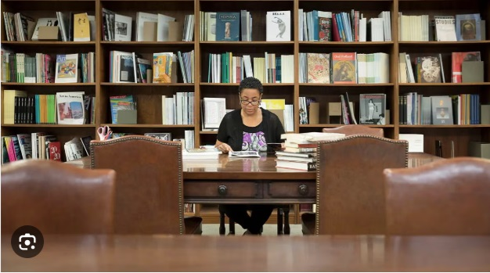
What is scholarship?
A SCHOLAR:
A person who attends a school or studies under a teacher
A person who has done advanced study in a special field
A learned person
SCHOLARSHIP:
Serious, detailed, study
https://www.merriam-webster.com/dictionary/scholar
and
https://dictionary.cambridge.org/dictionary/english/scholarship
Notes:
Scholarship is a way to add to the world’s knowledge. It is normally equated with academic achievement. That is, when someone has devoted much time to absorb what others have learnt about a subject, and is able to ask good questions, research those questions, analyse the information in a way that will withstand scrutiny, and communicate his or her findings clearly in a journal or a book, then he or she is a scholar contributing to the world’s body of knowledge.
All of us need to develop some of the qualities of a good scholar – such as asking questions, knowing our own limitations, and seeking the truth without prejudice.

Slide 4
What are REsearch, and search?
Research and its reporting are social acts that require you to think steadily about …the responsibility you have not just toward your subject and yourself, but towards your readers as well, especially when you believe that you have something to say that is important enough to cause readers to change their lives by changing what and how they think.”
Booth, Colomb, Williams “The Craft of Research”.
On this journey the wayfarer dwelleth in every abode, however humble, and resideth in every land. In every face he seeketh the beauty of the Friend; …that haply in some heart he may discern the secret of the Beloved, or in some face behold the beauty of the Adored One.
Bahá’u’lláh, Call of the Divine Beloved
Notes:
All of us learn, ask questions and do research on a daily basis. The purpose might be as mundane as choosing which product to buy or where to go on our next holiday. Sometimes it as important as deciding whether a religion is good or bad for humanity – where we are making a judgement about a religion.

Slide 5
What is prejudice?
An unfair and unreasonable opinion or feeling, especially when formed without enough thought or knowledge
https://dictionary.cambridge.org/dictionary/english/prejudice
Notes:
Whatever our level of expertise, or the subject of our research, we all try not to make our judgement too early. We don’t want to be cheated when buying a used car, so we are careful to do enough research (“Is this car reliable, roadworthy and good value?”) and not pre-judge (“It looks great, it’s cheap, I want it, therefore it is a good car”). Pre-judging is called “prejudice”. Pre-judging a religion is called “religious prejudice”. The difference between scholars and the rest of us is that their work might pass a review and be published for you and me to read.

Slide 6
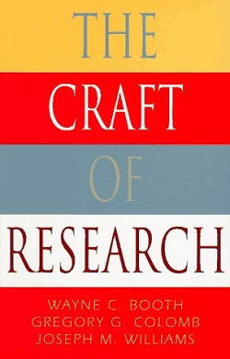
Research done by others determines most of what we believe
“…without reliable published research, we would be prisoners of what we alone see and hear, locked in the opinions of the moment. No doubt most of our everyday opinions are sound (after all, we derive many of them from our own research and experience). But mistaken ideas, even ugly and dangerous ones, flourish because too many people accept what they hear, or want to believe, on no very good evidence… Only when we know that we can trust the research of others can we free ourselves from those who by controlling our beliefs would control our lives.”
Booth, W., Colomb, G. and Williams, J. The Craft of Research, University of Chicago Press, 1995, p.7.
Notes:
I have not been to London, but I have talked to people who claim that London exists, and I believe London is a real place. I did not observe the ice age, or the evolution of species, or an oxygen molecule, or Jesus speaking the Sermon on the Mount, but I believe in these things because of the published research of others.
“…without reliable published research, we would be prisoners of what we along see and hear, locked in the opinions of the moment. No doubt most of our everyday opinions are sound (after all, we derive many of them from our own research and experience). But mistaken ideas, even ugly and dangerous ones, flourish because too many people accept what they hear, or want to believe, on no very good evidence… Only when we know that we can trust the research of others can we free ourselves from those who by controlling our beliefs would control our lives.”
Booth, W., Colomb, G. and Williams, J. The Craft of Research, University of Chicago Press, 1995, p.7.

Slide 7
When to question what you read ?
If you are seeking knowledge you should not outsource your search to another researcher. Why would you want to?
Bahá’u’lláh wrote that “…every man hath been, and will continue to be, able of himself to appreciate the Beauty of God...”
‘Abdu’l- Bahá said that “It is the duty of everyone to investigate reality, and investigation of reality by another will not do for us.”
Notes:
We may question anything we read at any time. However sometimes we should ask questions. Sincere questions mean that we are trying to see with our own eyes, hear with our own ears and understand with our own minds and hearts. That is the best way to learn about religions. We should be thoughtful about our beliefs. If you are searching for God you cannot outsource your search to another researcher. Any why would you want to? Baha’u’llah wrote that “…every man hath been, and will continue to be, able of himself to appreciate the Beauty of God, the Glorified.” When we hear that there is a beautiful painting, or movie, or garden, or restaurant, we want to experience it ourselves. If we are thirsty we need a drink of water. It’s not enough to read that a researcher experienced the water for us.

Slide 8
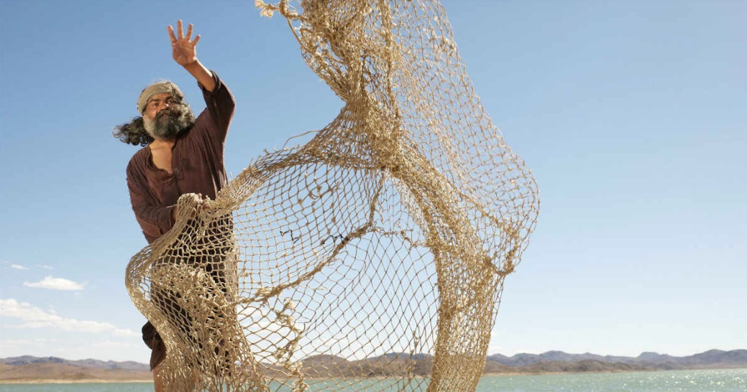
Narrowness of vision
Pride and Fear
Moreover, call thou to mind the one who sentenced Jesus to death. He was the most learned of his age in his own country, whilst he who was only a fisherman believed in Him. Take good heed and be of them that observe the warning.
Bahá’u’lláh
Fundamentalism
”that dogmatic attitude on the part of the adherent of any ideology, whether religious or political, that makes for a rigidity of attitude, a narrowness of vision and an unrelieved intolerance towards differing points of view.”
Bahiyyih Nakhjavani, Asking Questions: A Challenge to Fundamentalism, George Ronald, 1990
Notes:
If we want to see with our own eyes, then we should get our eyes checked first. Do we have narrow vision or do we see with the eye of oneness of humanity? Do we have pride, or fear something new, that makes us blind to spiritual reality?

Slide 9
PART 2: EXAMPLES OF SCHOLARSHIP THAT SHOULD NOT BE UNCRITICALLY BELIEVED
Referring to some very specific aspects of these otherwise reputable, reliable or popular books:
Edward Gibbon “The Decline and Fall of the Roman Empire” (1789)
Maulana Muhammad Ali “History and Doctrines of the Babi movement” (1933)
Bernie Power “Understanding Jesus and Muhammad” (2015)
Michael Fallon “The Christian New Testament and the Islamic Qur’an: a comparison” (2017)
Robert Spencer “The History of Jihad” (2018)
Notes:
I have selected the following examples of published scholarship on the subject of religions because they are influential. That is, the authors have reputable credentials (some academic, some religious, some through the popularity of their books) therefore their readers might be inclined to believe what they are reading without inquiring independently.
Edward Gibbon “The Decline and Fall of the Roman Empire”
Maulana Muhammad Ali “History and Doctrines of the Babi movement” 1933
Robert Spencer “The History of Jihad”
Bernie Power “Understanding Jesus and Muhammad”
Michael Fallon “The Christian New Testament and the Islamic Qur’an: a comparison”

Slide 10
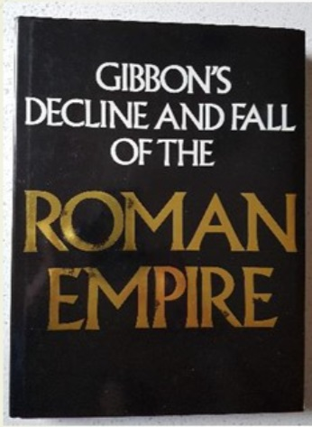
1. Before modern scholarship
Edward Gibbon “the Decline and Fall of the Roman Empire (1789)
According to historian Bernard Lewis “Gibbon’s influence on the Western perception of the Prophet, Islam, and their place in history was enormous.”
Lewis observes, however, that Gibbon was overreliant on the deficient scholarship of others:
“Gibbon recognized the late and legendary character of much of the Arabic material made available to him in Latin translations and attempted some critical analysis of its content. However, his own imperfect knowledge and the defective state of European scholarship at the time hampered his work and sometimes blunted the scepticism which he usually brought to the sources and subjects of his historical inquiries.
Lewis, Bernard, “Edward Gibbon and the Decline and Fall of the Roman Empire” in Daedalus, vol. 105, No.3, Summer 1976, MIT Press.
Notes:
Edward Gibbon in chapter L of The Decline and Fall of the Roman Empire provides a history of “Mahomet” and concludes that after the Prophet moved to Medina “the means of persuasion had been tried, the season of forbearance was elapsed, and he was now commanded to propagate his religion by the sword, to destroy the monuments of idolatry, and, without regarding the sanctity of days or months, to pursue the unbelieving nations of the earth… “”.
Gibbon, Edward, The History of the Decline and Fall of the Roman Empire: Abridged Edition. (Ed. & Abridged by Womersley, David), Penguin, London, 2000 (Full edition first published 1776), Chapter L.
“Gibbon wrote in the 18th century, relying on the secondary sources available to him at that time.”

Slide 11
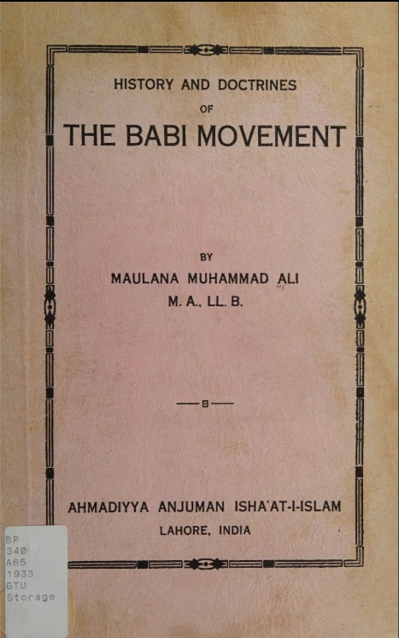
2. Failure to research
Maulana Muhammad Ali
“History and Doctrines of the Babi movement” (1933)
Maulana Muhammad Ali’s main, or only, source was a document called Nuqtat Al Kaf from the early 1850s. Without looking into the scholarship of the subsequent 83 years, in 1933 he published his conclusion that:
Thus Babism, along with its offshoot, Bahaism, is clearly a repetition not only of the doctrines of Ismailiyya* but also of the horrible deeds of murder and the attempt to bring about a revolution.
Maulana Muhammad Ali relied on one early document, of historically contested date, source and and editing, and neglected to independently research the topic. In 1933, for example, he could easily (had the intention in the title of his book been sincere) have aquired Nabil’s Narrative. Wikipedia states “Nabil’s Narrative relies mainly on the memoirs of surviving early Bábís, and Nabíl himself was a participant in many of the scenes which he recounts.”
* Ismailiyya was a sect of Shia Islam. Maulana Muhammad Ali was leader of a different sect Ahmaddiyah
Notes:
What causes an intelligent, humble, conscientious, scholar like Maulana Muhammad Ali – whose other work I have found extraordinarily helpful in understanding the Religion of Islam – to “drop the ball” when writing about another religion.
I assume it is because he did not take the other religion seriously – and had a possibly unconscious religious prejudice which affected the quality of his work in this case.
Sources for further information available on request.

Slide 12
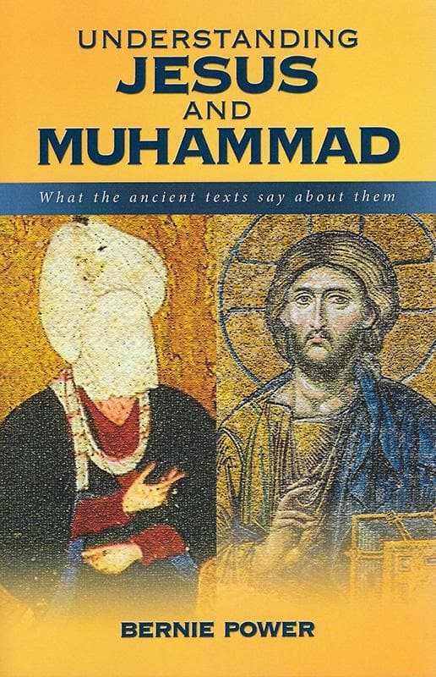
3. Neglects historical context
Bernie Power “Understanding Jesus and Muhammad” (2015)
Dr Bernie Power’s commitment to a particular Christian perspective, reinforced by his position at a Bible college with a strong focus on preparing and equipping Christian leaders for mission, might have led to him holding a preconceived bias against Muḥammad which is evident in the way information is presented in his book.
The challenge for any Christian writer with such an orientation was described by the historian Douglas Martin:
Conceptual weaknesses … are difficult to understand in a writer whose professional training is in the field of theology and who holds distinguished credentials in this highly specialized discipline. Questions of prejudice aside, they arise presumably from a failure to take seriously the intellectual foundations of the Faith being studied. There is no more risky lapse in the examination of beliefs other than one’s own.
Martin, Douglas, “The Missionary as Historian”, The Journal of Bahá’í Studies.
Notes:
Bernie Power claims to be helping the followers of Jesus and Muhammad to understand each other’s religion’s founder.
Problems:
His explanation for relying on the Hadiths
His dismissal of the idea that “jihad” can simply mean individual struggle, not necessarily war.
His presentation of battles without the ‘defensive wars only” context.
His failure to present a view of Muhammad that Muslims would recognise, compared to his success in providing a view of Jesus that Christians would accept.
The possibility of his missionary background affecting his scholarship.

Slide 13
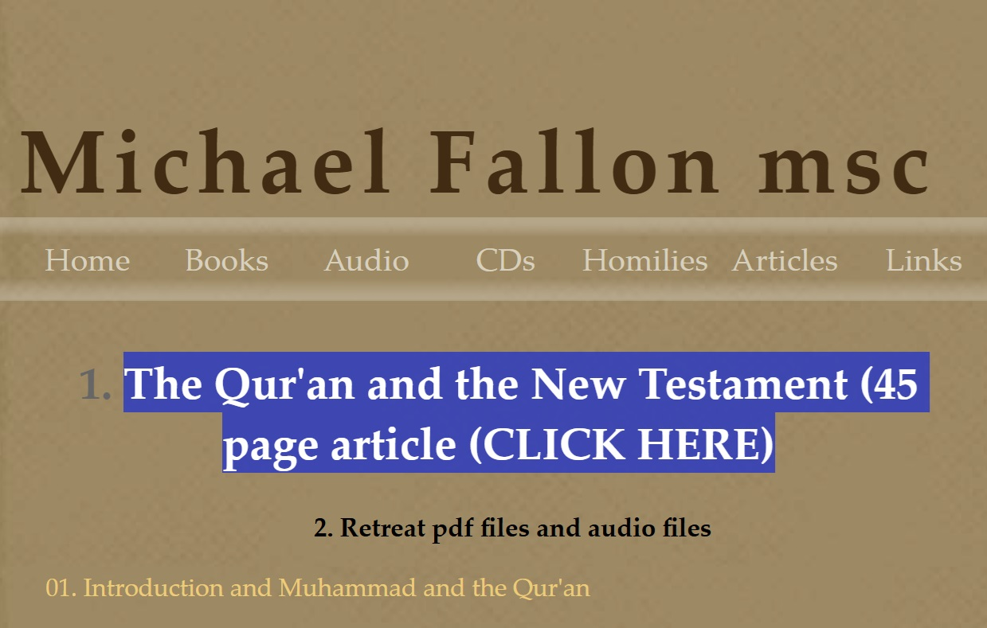
4. No engagement WITH CURRENT SCHOLARSHIP
Michael Fallon MSC “The Christian New Testament and the Islamic Qur’an: a Comparison” (2017)
Michael Fallon quotes from “The Study Qur’an: A New Translation and Commentary” by Caner Dagli and others, and argues in a section called “Texts that give divine authorisation for the use of force to propagate Islam” that in the Qur’an “Waging war is not restricted to defence”.
A problem is that Father Fallon does not engage with current scholarship on this question, and neglects a resource at his fingertips, namely the commentary throughout The Study Qur’an, and the Essay at the back of the Study Qur’an by Caner Dagli “Conquest and Conversion, War and Peace in the Quran”.
The gist of Caner Dagli’s analysis is that Islamic law prohibits aggression and is about “the maintenance and protection of life and the rights that people need to live in a just society”.
Caner Dagli’s analysis not new and was equally well argued by Maulana Muhammad Ali in “The Religion of Islam” where he concluded that “…the spread of Islam by force”, is a thing of which no trace can be found in the Holy Qur’án. ”
See also the interfaith talk by Prof Halim Rane on “Covenants in Islam: What they mean for peaceful coexistence”.
Notes:
Michael Fallon argues in the section called “Texts that give divine authorisation for the use of force to propagate Islam”, correctly I believe, that “Many texts speak of the use of force…Sometimes the focus is on defence” but he might be NOT correct where he quotes passage from the Qur’an to illustrate his conclusion that “Waging war is not restricted to defence”.
Strengths of Father Fallon’s book: He focussed on the scriptures instead of traditions. He uses a reputable translation called The Study Qur’an. He looks at context. He writes with sympathy. He promotes peace and understanding.
A problem is that Michael neglects a resource at his fingertips, namely The commentary throughout The Study Qur’an, and the Essay at the back of the Study Qur’an by Caner Dagli “Conquest and Conversion, War and Peace in the Quran”. These are in Michael’s source Qur’an. There is one reference to Caner Dagli’s essay but only in regard to a hadith, not the Qur’an verses that Michael quotes in his paper. The gist of Caner Dagli’s analysis is that Islamic law prohibits aggression and is about “the maintenance and protection of life and the rights that people need to live in a just society.
Caner Dagli’s analysis not new. See for example Maulana Muhammad Dagli’s book “The Religion of Islam” (chapter on Jihad) in which he demonstrates that “…the spread of Islam by force”, is a thing of which no trace can be found in the Holy Qur’án. ”
See also the interfaith talk by Prof Halim Rane on “Covenants in Islam: What they mean for peaceful coexistence”.
Michael Fallon’s paper: relevance to history: Missed opportunity to read or refer to paper in the study Quran.
Correct in saying the message of the new Testament is different from that of the Quran in regard to peace and use of force, however…. not only Michael Fallon but all of Christianity missed the opportunity for a progressive revelation of God path towards peace.

Slide 14
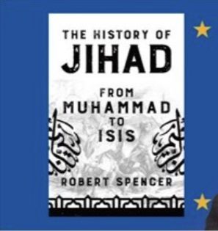
5. Bypasses expert scrutiny
Robert Spencer “The History of Jihad” (2018)
One wonders why Robert Spencer would have bypassed the peer-review and academic scrutiny that scholars normally welcome. He answered this question himself in an interview. When invited to respond to the possibility that, had he been an academic, he would not have been able to write his book and espouse his positions Spencer replied as follows:
Oh yes, there’s no chance whatsoever. I saw that in the 80s when I was getting my Masters and I wanted to continue and to get a Doctorate, but, I thought, ‘If I do this I’m going to be constantly coming against these people who state dogmatically things that I believe are false, and assume that they’re true, and make you assume they’re true’, so I thought ‘I’m just going to go out on my own and try to do this in the court of public opinion rather than in the academic world’.
Spencer, Robert in “My Latest Chat with Robert Spencer (THE SAAD TRUTH_707)”, YouTube, Jul 21, 2018, https://www.youtube.com/watch?v=KlPmdndVEKY, 26.45 - 27.33
Notes:
In The History of Jihad: from Muhammad to Isis, Robert Spencer begins by stating that “The beginnings of Islám are shrouded in mystery. There are thousands upon thousands of reports (hadith) of the words and deeds of Islám’s Prophet Muhammad, …Spencer selects from those hadith in a way that portrays Muḥammad quite unfavourably to his readers. He justifies this approach by explaining that many Muslims today act upon beliefs which are based on the hadith regardless of their truth value.
Yet in selecting which stories about Muḥammad to recount in his book, Spencer seems to lack an interest in the circumstances. An example is the account of the punishment imposed on a Jewish tribe, the Banu Qurayza. Spencer does not mention that they imperilled the lives of the inhabitants of Medina by breaking a treaty and siding with the attacking Meccan army. The relentless hostility of Muḥammad’s enemies is apparently not worth mentioning in this “history of Jihad”. Nor does Spencer imagine the consequences if the nascent Muslim community had decided to forgive the aforementioned breach. This historical context is well known to those who care to research the incident. It can be read, for example, in The Beliefnet Guide to Islám by Hesham A Hassaballa and Kabir Helminski.
Essentially Spencer is admitting that he does not want to subject his views to expert scrutiny, but is happy to have them published and consumed by a less critical audience.

Slide 15
Part 3: . Addressing religious prejudice
Institutions?
Communities?
Individuals?
An education revolution?
Notes:
The examples we have just looked at do not only tell us something about scholars and writers. They tell us something about ourselves, and our community, and our institutions.
We read earlier that research done by others determines most of what we believe. We have seen that if we are not independent seekers of the truth then we can fall into prejudice, and that can cause us to not care about the truth, or to reject it, or worse to react violently to it.
Mine is not an academic critique of the 5 writers reviewed. I’m not claiming to be a expert who could do that. Rather, just pointing out that has readers we should be using our critical thinking. That is, if the subject is important we should ask ourselves questions and suspend judgement until where have looked a little deeper. Or a lot deeper depending on our interest and the practical implications. If what we read is going to reinforce prejudice. And of course this applies 1000 times more to social media which enable everyone to publish and influence other people‘s views.

Slide 16
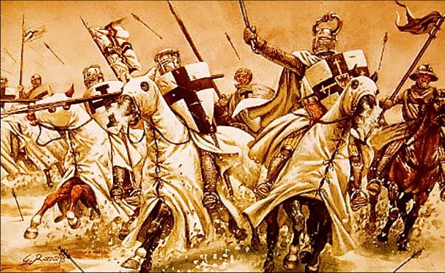
Institutions
…the greater part of organized religion stands paralyzed at the threshold of the future, gripped in those very dogmas and claims of privileged access to truth that have been responsible for creating some of the most bitter conflicts dividing the earth’s inhabitants. The consequences, in terms of human well-being, have been ruinous.
To The World’s Religious Leaders
from The Universal House of Justice, April 2002
Notes:
See letter to the World’s religious leaders April 2022.
Why is it addressed to leaders? :
Religious leaders (scholars of text and doctrine) have a long history of rejecting God’s messengers and prophets (eg Christ)
Religious leaders lead communities where individuals feel safe by believing the same things, and don’t have to confront their own confirmation biases. And because if leaders courageously address the issue of religious prejudice then it will be easier for their religious communities to do the same.

Slide 17
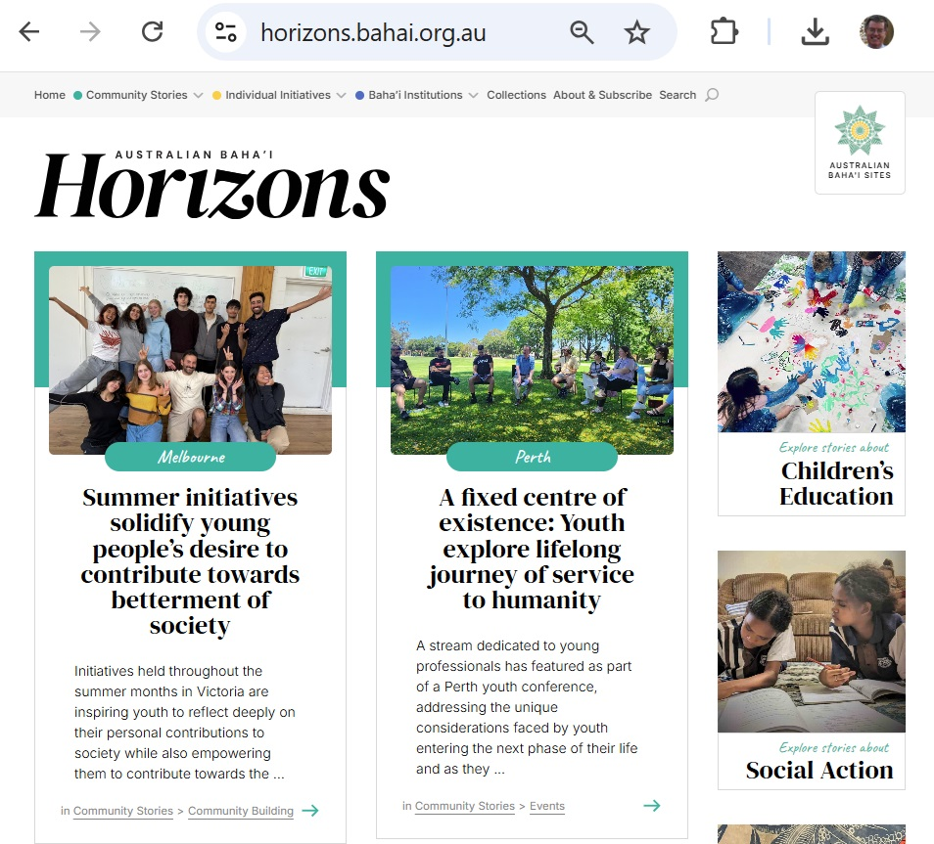
THE COMMUNITY
It is the local community where we learn to cooperate with one another, to grow together and become united.
Ruhi Institute, Book 6
“See each human as a shining star”
Creadell Haley, Love, Love, Love (song)
Notes:
Role of community
Insecurity and fear:
Confirmation bias comes from fear of new information, (see next slide) which comes from insecurity. Me against the world. My theories are impervious. I feel secure if I join a like-minded community
We can reduce fear when we create communities where we feel secure and when we feel secure, we can allow our personal theories to be challenged.
Jane Elliott “Blue Eyes Brown Eyes” class experiment

Slide 18
THE INDIVIDUAL
Throughout history humans have repeatedly rejected facts and evidence in favour of belief systems that serve their emotional and/or political needs.
Alexandra Senter, Truth is we can’t handle the truth, Sydney Morning Herald, 11 January 2025
When the channel of the human soul is cleansed of all worldly and impeding attachments, it will unfailingly perceive the breath of the Beloved across immeasurable distances, and will, led by its perfume, attain and enter the City of Certitude. Therein he will discern the wonders of His ancient wisdom…
Bahá’u’lláh, The Kitáb-i-Íqán
Notes:
See with own eyes.If you don’t know then hold it in suspension and say when talking about it. Say where you heard it instead of saying it’s true.
Confirmation bias
Morton is describing something which affects all humans. It makes life easier to block out uncomfortable information and not to spend much time questioning one’s beliefs. Generally that’s not too much of a problem, unless it causes us to dismiss something important
Morton’s Demon last paragraph:
“After years of weariness, the philanthropic individual dies of fatigue”.
Beautifully expressed. I used to be like that. I imagined that every one could or should, and eventually would, see reason. Now I believe that people are only reasonable if they are comfortable within themselves and with the person talking to them. There’s a good book by Hugh Mackay called “Why don’t people listen?”

Slide 19
AN EDUCATION REVOLUTION
…the world of existence stands in utmost need of an educator, and that its education must be achieved through a celestial power.
‘Abdu’l‑Bahá, Some Answered Questions
“Consider”, Bahá’u’lláh states, “the revelation of the light of the Name of God, the Educator.” …The significance of education in the work of community building is unmistakable, and in the field of social action the provision of education remains the signature contribution of Bahá’ís in most parts of the world.
The Universal House of Justice, 30 December 2021
Notes:
Transformation through the guidance and perception that comes from God’s revelations.
Some wrong ways because ineffective or impossible:
1.parents leave children to investigate for themselves without teaching them how to judge and perceive with fairne or to with their own eyes
2 try and learn The religions in detail and make an intellectual choice.
Better:
the Seven Valleys is better way. And the KI iqan What it means to be a seeker. Develop our spiritual perception (Ruhi book 9 looks at this) and be aware of our faults and educate ourselves
Overcoming prejudice is not only an intellectual process but also enables a new perception: “Then will the manifold favors and outpouring grace of the holy and everlasting Spirit confer such new life upon the seeker that he will find himself endowed with a new eye, a new ear, a new heart and a new mind…”

Slide 20
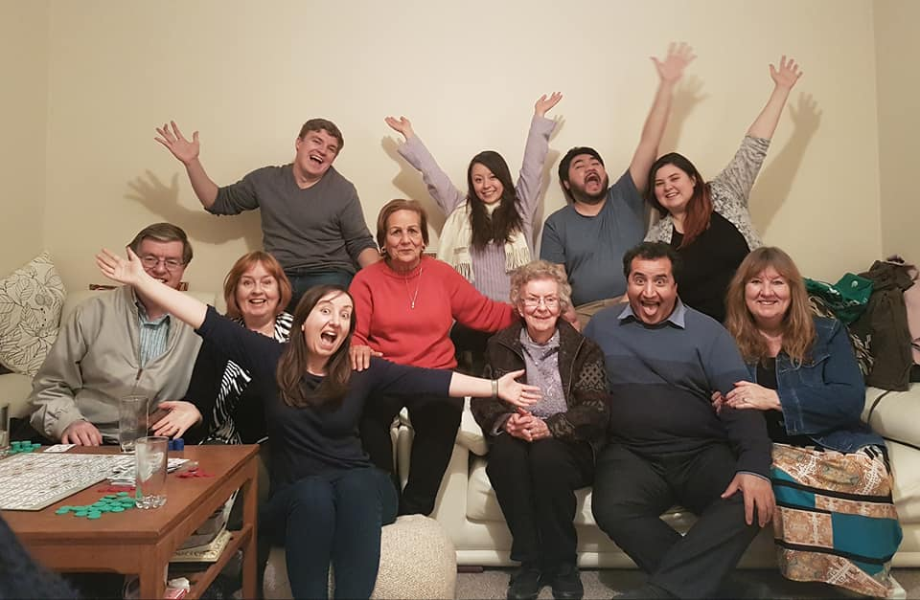
…see with thine own eyes and not through the eyes of others, and
…know of thine own knowledge and not through the knowledge of thy neighbor.
Bahá’u’lláh, The Hidden Words
Notes:
Q&A and Discussion
Optional stories:
Alice Buffett / Fear of being led astray (the devil? Disloyalty to Christ?)
Story of Vahid and the Bab (how he went with an open mind but needed 3 visits)
Story of ‘Abu’l Fadl and the Blacksmith (pride and prejudice)
Story about Yerrinbool and Sai Baba (recognising prejudice in oneself – an exercise)
Growing up in Parkes (how I addressed my own prejudice)
UNSW Library Lawn encounter.
Not just prejudice against other religions, but against religion in general or against atheism
FEAR
“regardless of social context and religious denomination, prejudice can to a large extent be explained by perceptions of threat, for example, to one’s belief system, which may especially be important for religious people.”
Prejudice and Religion by Jolanda van der Noll, from the precis.

