Slide 1
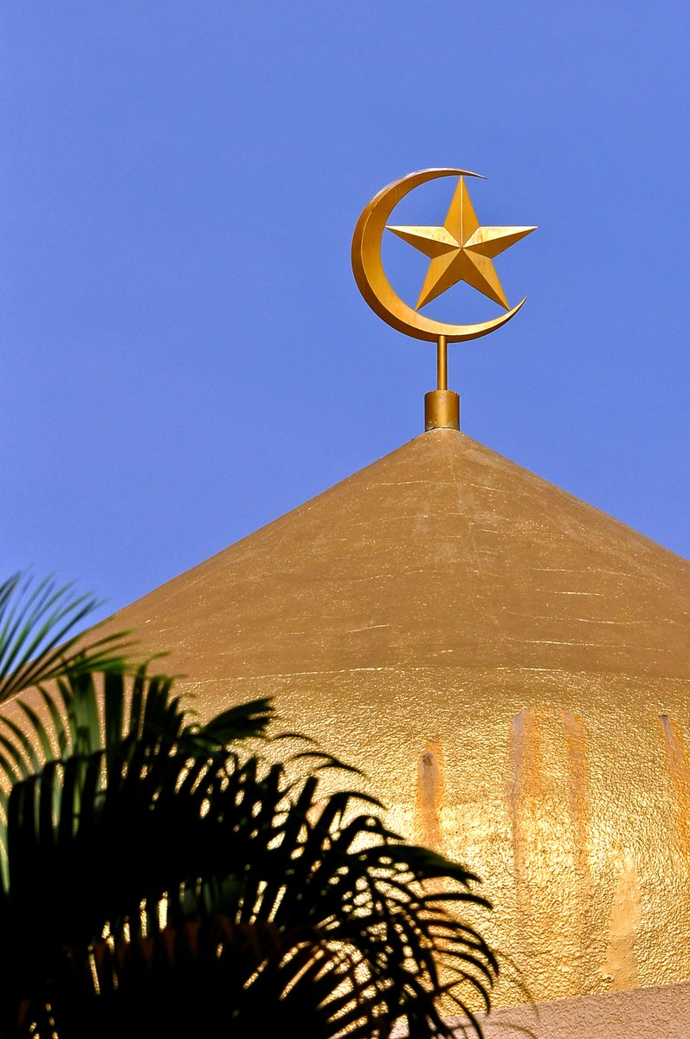
The attraction of Islam
Perspectives on Muhammad, The Qur’an, the Great Arab Conquests and the early spread of Islam
“There is so much misunderstanding about Islam in the West in general that you have to dispel.” (Shoghi Effendi)

Slide 2
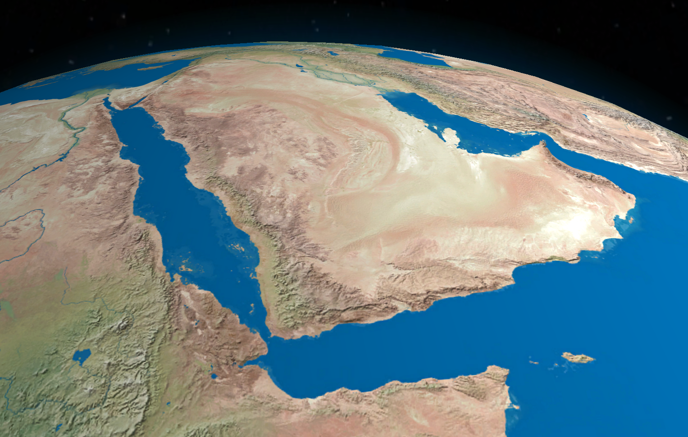
Muhammad
If only the whole world would acknowledge the greatness of Muhammad and all the Heaven-sent Teachers, strife and discord would soon vanish from the face of the earth, and God’s Kingdom would come among men.
Abdu’l-Baha,
Paris Talks, pp. 48-49.

Slide 3
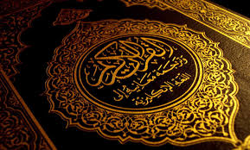
The Qur’an
When carefully and impartially compared, the Qur’an marks a definite advancement on the Gospel, from the standpoint of spiritual and humanitarian progress.
Shoghi Effendi
(From a letter written on behalf of Shoghi Effendi to an individual believer, April 27, 1936) quoted in http://bahai-library.com/hornby_lights_guidance_2.html&chapter=4#n1664

Slide 4
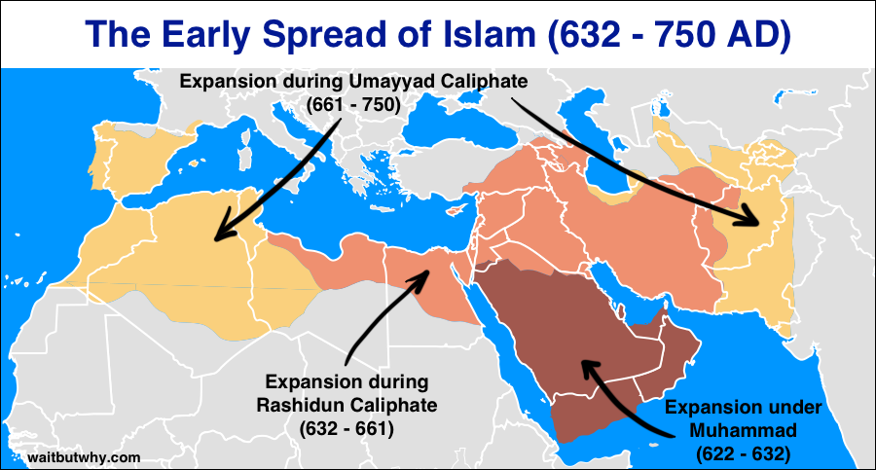
Arab Conquests and the Spread of Islam
Under the caliphs, the community of Medina, where the Prophet had held sway, grew in barely a century into a vast empire, and Islam became a world religion
Bernard Lewis
The Crisis of Islam:

Slide 5
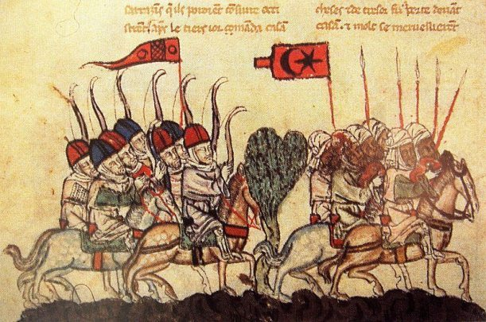
AN HISTORICAL QUESTION
Was Islam spread by the sword?

Slide 6
The History of Islam
Some reference points for considering whether or not Islam was “spread by the sword”:
The teachings of the Qur’án;
the example of the Prophet Muhammad;
the historical records; and
contemporary reports.

Slide 7
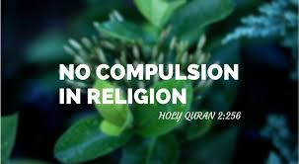
Teachings from the Qur’án: Religious Freedom
…”the spread of Islam by force”, is a thing of which no trace can be found in the Holy Qur’án. On the other hand, the Holy Book lays down the opposite doctrine in clear words. “There is no compulsion in religion”, and the reason is added: “The right way is clearly distinct from error”
Maulana Muhammad Ali, The Religion of Islam

Slide 8
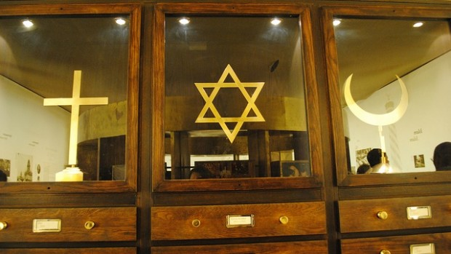
Teachings from the Qur’án: Permission for War – Defensive reasons
Permission (to fight) is given to those on whom war is made, because they are oppressed. And surely Allah is able to assist them – Those who are driven from their homes without a just cause except that they say: Our Lord is Allah. And if Allah did not repel some people by others, cloisters and churches and synagogues and mosques, in which Allah’s name is much remembered would have been pulled down. And surely Allah will help him who helps His cause” (22:39,40)
The Holy Qur’án, translated by Maulana Muhammad Ali, accessible online at https://www.muslim.org/english-quran/quran-intro.htm Surah 22 verses 39,40.

Slide 9
Actions of Muhammad
“The military expeditions of Muhammad…were always defensive actions”
‘Abdu’l-Baha

Slide 10
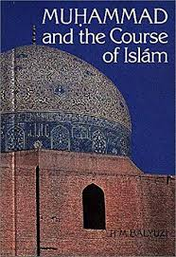
Actions of Muhammad
As long as he bore no responsibility for presiding over the fortunes of men, Muhammad, in the face of constant abuse, vilification, physical assault and injury, did not raise a finger to defend Himself. But as soon as the destinies and the security of His followers and indeed of a whole town came to rest in His hands, he acted as a ruler should, with tact and forbearance, with wisdom and justice. It was His duty to halt the aggressor, to counter the moves of the adversary, to neutralize the efforts of the enemy, and if need be to order his elimination. He had no other choice in a largely lawless land…
H. M. Balyuzi,
Muhammad and the Course of Islam

Slide 11
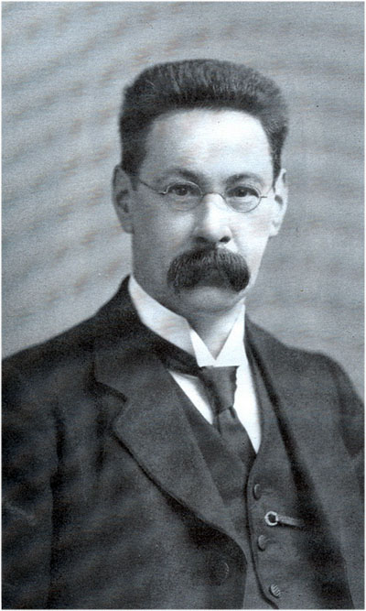
The spread of Islam: 1. Migration
…religious interests appear to have entered but little into the consciousness of the protagonists of the Arab armies. This expansion of the Arab race is more rightly envisaged as the migration of a vigorous and energetic people driven by hunger and want, to leave their inhospitable deserts and overrun the richer lands of their more fortunate neighbours.
T. W. Arnold, The Preaching of Islam

Slide 12
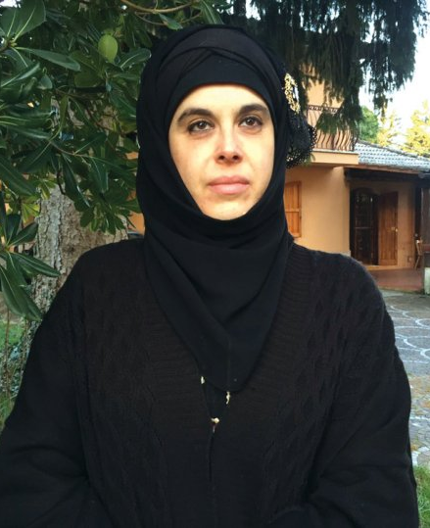
The spread of Islam: 2. Missionaries
Even though the Muslim conquest of the Middle East, North Africa and Spain had been very fast, occurred [sic] from within the early decades after the death of the Prophet to a century, the conversion of the population, living in those territories, has been a long and gradual process, without any active involvement of the political power in the process, and it was undertaken by peaceful missionaries.
Sabrina Lei

Slide 13
The spread of Islam: 3. Inducements
The conquered peoples were given various inducements, such as lower rates of taxation, to adopt Islam, but they were not compelled to do so
Lewis, Bernard
The Middle East: A Brief History of the Last 2,000 years

Slide 14
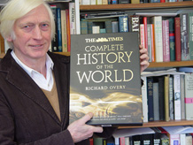
The spread of Islam: 4. Respect
Initially, Islam did not particularly encourage, far less insist upon, conversion. The Koran enjoins Muslims to respect the “people of the book”, that is, members of the other monotheistic religions with written scriptures. The peaceful co-existence of substantial Christian (and, until comparatively recently, Jewish) communities throughout the Muslim world is ample evidence that this injunction was heeded.
Richard Overy,
The Times Complete History of the World
Image credit: University of Exeter

Slide 15
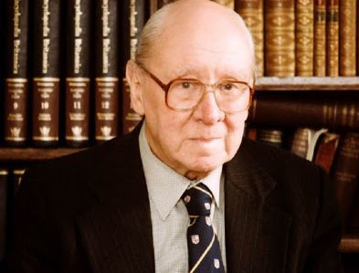
The spread of Islam: 5. Booty (plunder, spoils, gains)
The ordinary Arabs, and later the other peoples who took part in the wars of expansion, seem to have been chiefly interested in obtaining booty. What the military campaigns secured was the expansion of a political Islamic empire.
Watt, William Montgomery,
Religious Truth For Our Time

Slide 16
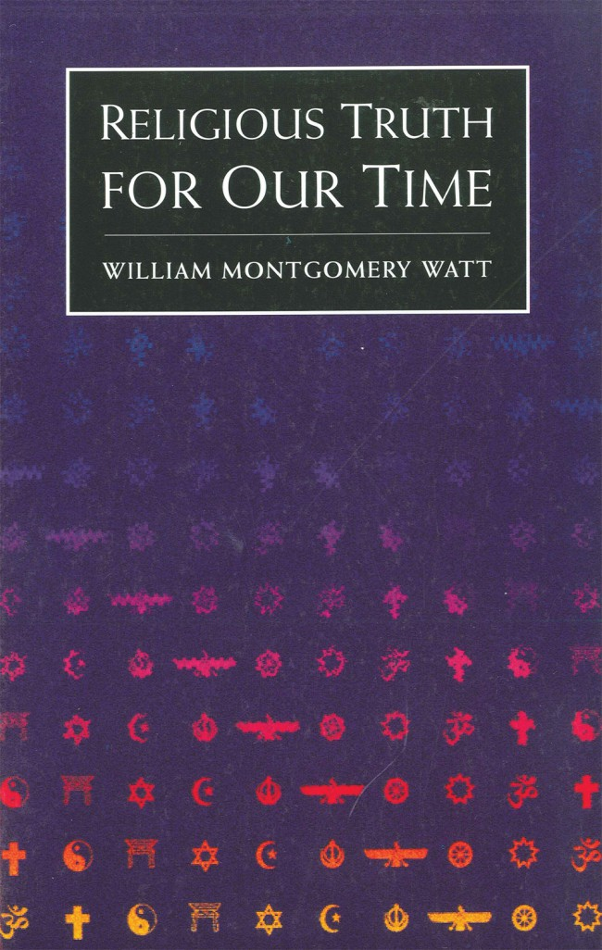
The spread of Islam: 6. Social Pressures
It is also true, of course, that once non-Muslims had been accepted as ‘protected minorities’ within the empire, there were certain social pressures on them to become Muslims. Though relatively few Jews and Christians yielded to the pressures, in Iran the majority of the Zoroastrians did, because the Zoroastrian religion had lost much of its religious meaning and had become little more than a department of state
Watt, William Montgomery,
Religious Truth For Our Time

Slide 17
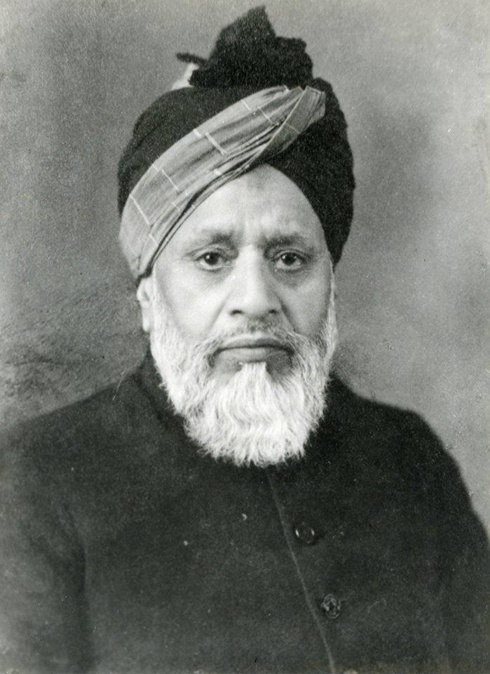
The spread of Islam: 7. The Holy Qur’án
Wars they had to wage, but these wars were due to reasons other than zeal for the propagation of Islam. And they could not do a thing which their Master never did, and which their only guide in life, the Holy Qur’án, never taught them.
Muhammad Ali, Maulana,
The Religion of Islam

Slide 18
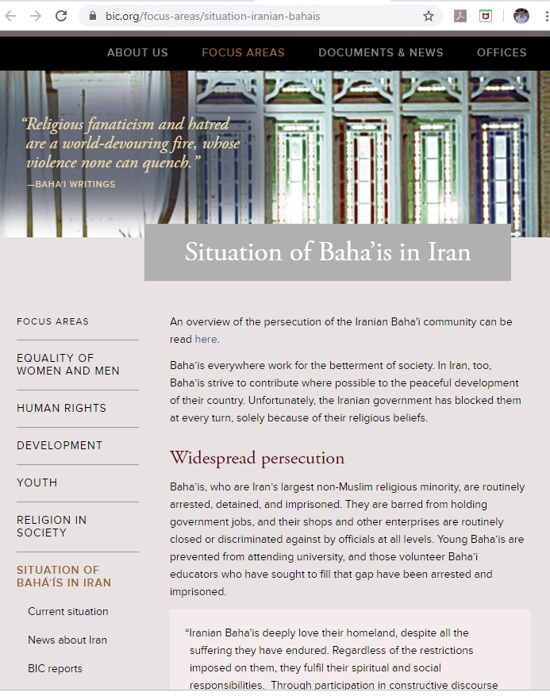
Modern Religion Persecution
For nearly four decades, the Iranian government has tried to eliminate the Bahá’í community as a viable entity. In the process, it has committed large-scale human rights violations. Today, arrests, arbitrary detention, long term imprisonments, unfair or mock trials, home raids, confiscation of belongings, harassment, physical and verbal abuse and pressure to recant their faith remain the day-to-day lot of thousands of Iranian Bahá’ís.
Extract from the 15 March 2017 Bahá’í International Community report to the UN Human Rights Council

Slide 19
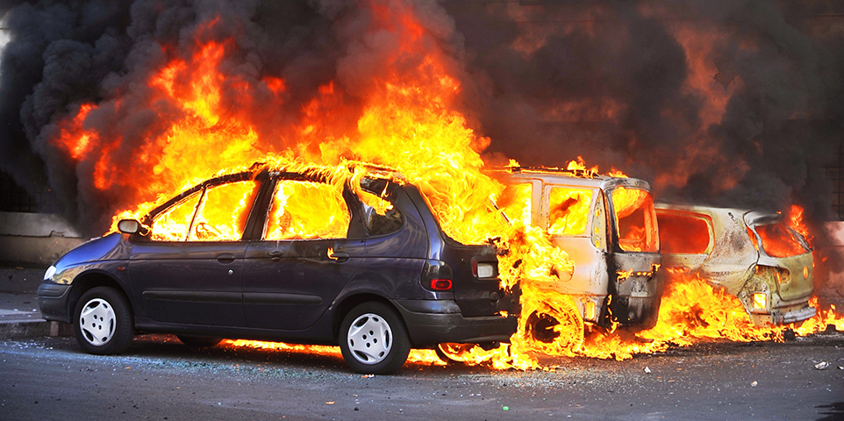
Modern Religion Terrorism
Muslim political behavior has varied greatly throughout history. Some Muslims have cited Scripture to justify violence, and some have cited it to justify peace. If Scripture is a constant but the behavior of its followers is not, then one should look elsewhere to explain why some Muslims engage in terrorism.
McCants, William
“Islamic Scripture Is Not the Problem”
in Foreign Affairs July/August 2015

Slide 20
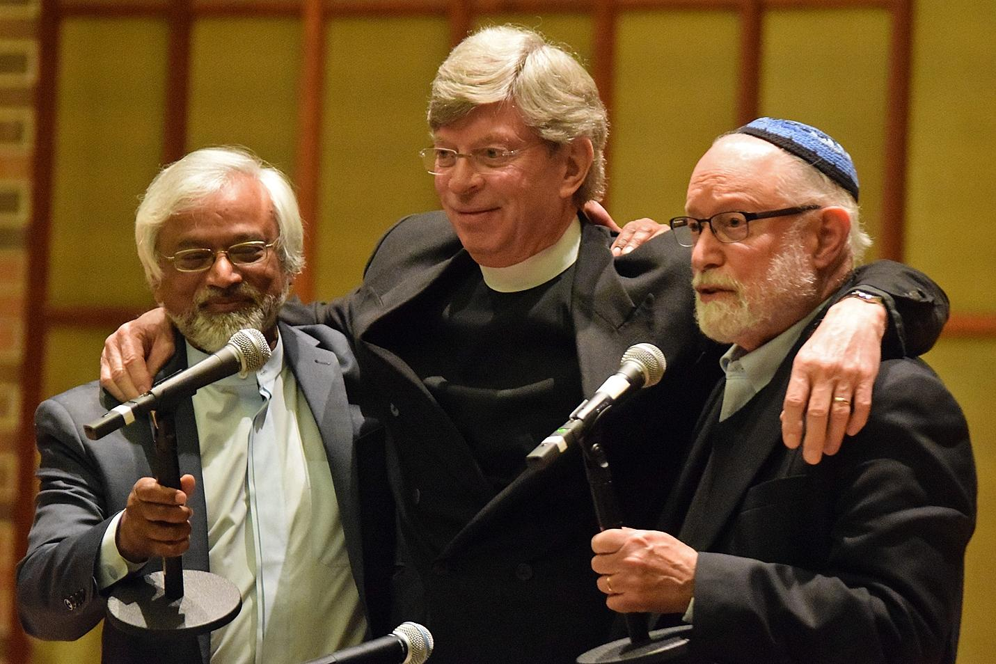
Modern Religion Cooperation
Despite the existence of extremists in the various religions, my personal view is that in the world of today the religions are no longer rivals or enemies, but should learn to see themselves as partners who have to deal with common problems.
William Montgomery Watt
Imam Jamal Rahman,
Pastor Don Mackenzie &
Rabbi Ted Falcon
— the Interfaith Amigos

Slide 21
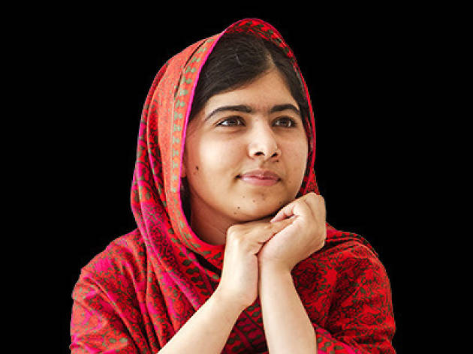
Modern Religion Education, Hope
Malala Yousafzai
Muslim
Activist for female education
Survived being shot by a terrorist
Nobel Peace Prize laureate
(Image credit: www.independent.co.uk)

Slide 22
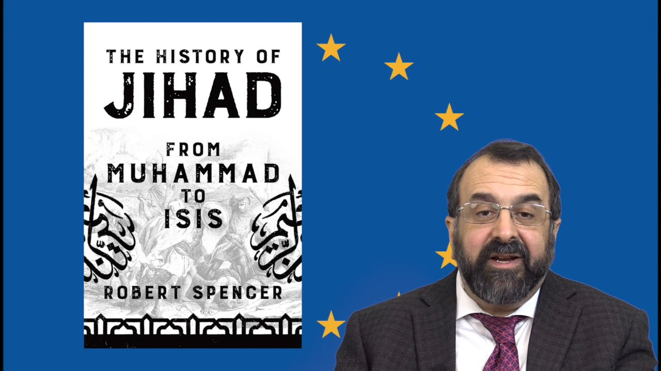
Alternative views
Bypasses expert scrutiny
Before modern scholarship
Neglects historical context

Slide 23
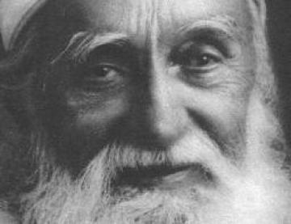
Bahá’í perspectives 1.Propagation of the Faith of God
.. the Faith of God must be propagated through human perfections, through qualities that are excellent and pleasing, and spiritual behavior. …As for the sword, it will only produce a man who is outwardly a believer, and inwardly a traitor and apostate
‘Abdu’l-Bahá,
The Secret of Divine Civilization

Slide 24
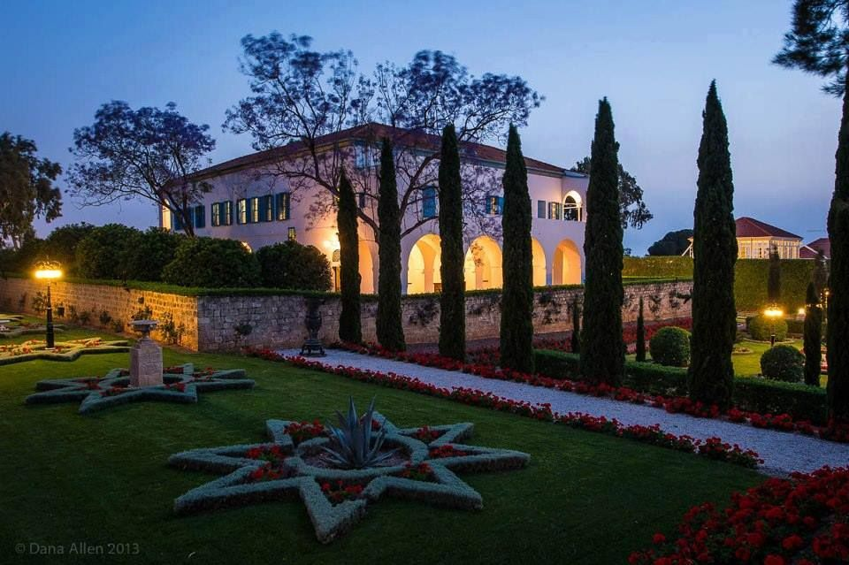
Bahá’í perspectives 2. Freedom from violence
O people of the earth! The first Glad-Tidings which the Mother Book hath, in this Most Great Revelation, imparted unto all the peoples of the world is that the law of holy war hath been blotted out from the Book…
Bahá’u’lláh
Bisharat (Glad-Tidings)

Slide 25
Bahá’í perspectives 3. Dispelling misunderstanding
There is so much misunderstanding about Islam in the West in general that you have to dispel. Your task is rather difficult and requires a good deal of erudition. Your chief task is to acquaint the friends with the pure teachings of the Prophet as recorded in the Qur'an, and then to point out how these teachings have, throughout succeeding ages, influenced nay guided the course of human development. In other words you have to show the position and significance of Islam in the history of civilization.
Shoghi Effendi
quoted in Lights of Guidance
‘Abdu’l-Bahá in a mosque's courtyard in Woking, England, January 1913
Baha’i Media Bank Copyright © Bahá'í International Community

Slide 26
Muhammad and the Soldier
It is said that Muhammad once awoke to find a soldier armed with a sword standing above Him, intending to take His life. The angry man asked, “Who is there now to save Thee?” Muhammad replied that God would save Him. The soldier became afraid and dropped the sword, which Muhammad picked up. He then asked the soldier who would save him. The man did not follow God’s teaching and realised that he was alone, with no one to come to his aid. Muhammad did not harm the soldier but handed the sword back to him, telling him to learn to show forth mercy. The man was changed by this experience and devoted himself to Muhammad and His teachings.
The Ruhi Foundation,
Teaching Children’s Classes Grade 3.

Slide 27
The Attraction of Islam
This PowerPoint presentation submitted on 24 August 2019 (and updated 18 September 2019) by Colin Dibdin as part of the course “Introduction to Islam 2019” offered by the Wilmette Institute [https://courses.wilmetteinstitute.org/].
Based on the essay “Perspectives on the Expansion of Islam” by Colin Dibdin [colin.dibdin@gmail.com]

