Slide 1
When Aliens Meet
Tips for inter-faith dialogue
Image: https://www.dreamworks.com/movies/home
This PowerPoint presentation by Colin Dibdin 19 August 2021

Slide 2
Problem
…major religious moral codes can lead to "us vs. them" group solidarity and mentality which can dehumanise or demonise individuals outside their group as "not fully human", or less worthy.
John Hartung (1995), Love Thy Neighbour: The Evolution of In-Group Morality, Skeptic. 3 (5).
https://en.wikipedia.org/wiki/Criticism_of_religion#Harm_to_society

Slide 3
Problem
The reasons why this kind of questing and this kind of experience is emerging now is just so much to do with our historical moment. We’re living in a global world. We’re living in a multicultural world. We are immensely influenced by one another…It’s one of the wonderful outflows of the globalisation of human experience at this time.
Stephanie Dowrick
Stephanie Dowrick - Interfaith minister at Pitt Street Uniting Church in Sydney, quoted in a book called The Quiet Revolution: The Emergence of Interfaith Consciousness.

Slide 4
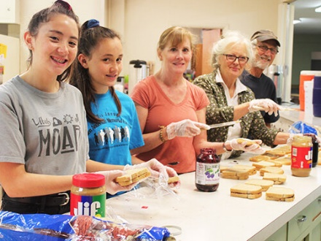
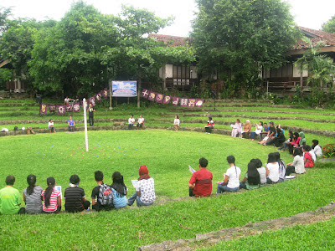
Bridges
The Ethical Bridge.
cooperative social projects
to learn to collaborate with one another on issues that none of us can solve alone
The Intellectual Bridge.
Theological dialogue
Reconciling different representations of the Ultimate.
The Mystical-Spiritual Bridge.
to be drawn onward by the same experience of an outpoured heavenly love....*
The example of the mystics.
Concepts from “Interreligious Dialogue and the Baha’i Faith” by Seena Fazel
*Quote from George Townshend.

Slide 5
By what diverse paths have mystics who had nothing in common save whole-hearted servitude before the one loving God, by what diverse paths have they all alike attained the blessed Presence!
George Townshend
The Mystical-Spiritual Bridge.

Slide 6
Challenges
The first challenge is a lack of focus.
The second challenge is when people feel that they need to “water down” or compromise their religious identity in order to fit in.
The third challenge is proselytizing, or attempting to convert others.
The Berkley Center for Religion, Peace, and World Affairs
https://berkleycenter.georgetown.edu/posts/the-challenges-of-interfaith-dialogue

Slide 7
Principles
Humility
The essential purpose of a dialogue is to learn…
Mutual Trust
Dialogue can only take place on the basis of mutual trust.
Empathy
To truly understand another religion or ideology…
Image: www.scarboromissions.ca
Principles 1, 8 and 10 from Leonard Swidler (Professor of Interreligious Dialogue)

Slide 8
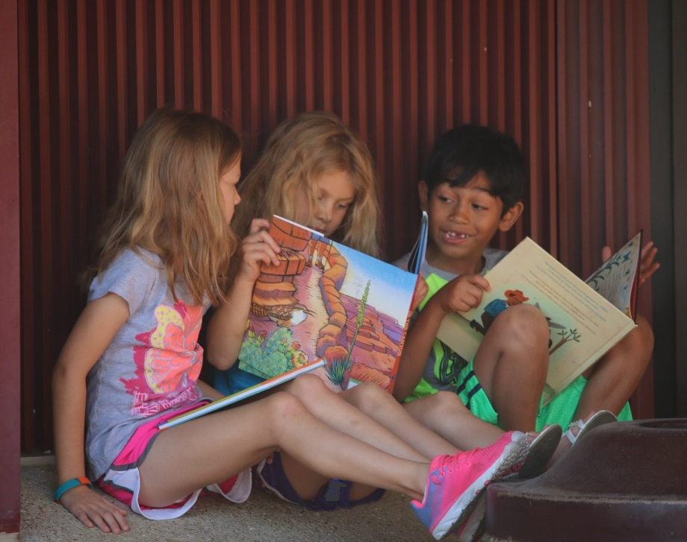
Humility
The essential purpose of a dialogue is to learn, which entails change. At the very least, to learn that one’s dialogue partner views the world differently is to effect a change in oneself.
Dialogue can only take place between equals, which means that partners learn from each other – [peer to peer] - and do not merely seek to teach one another
Leonard Swidler’s principles #1 and #7

Slide 9
Mutual Trust
Because it is persons, and not entire communities, that enter into dialogue, it is essential for personal trust to be established.
Leonard Swidler’s principle #8

Slide 10
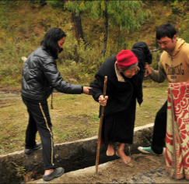
Mutual Trust
Insecurity is the great enemy of communication. When men and women feel insecure in their relationships with each other, ..the quality of their communication will inevitably suffer.
Trust and security do not come easily. One useful strategy for building the security of a relationship is to make your general communication aim to keep the relationship alive; to regard every encounter as being a stepping stone to the next; to ensure that…we will have made it easier to communicate again when next we meet.
Try not to think of any communication encounter as an end in itself. Try to see it as a step in a journey, or a stage in the process of making the channel of communication between us more open, more comfortable and more secure. Argument, intimidation, insensitivity or indifference are likely to erode the other person’s confidence and reduce the sense of security in the relationship, making it even harder to communicate next time. Keep the door open. Keep the flame burning. Keep in touch.
Hugh Mackay, “Why Don’t People Listen?”

Slide 11
Empathy
To truly understand another religion or ideology one must try to experience it from within, which requires a “passing over”, even if only momentarily, into another’s religious or ideological experience.
Leonard Swidler’s principle #10

Slide 12
How does religion address the challenging problems societies and nations face as well as broader societal well-being?
What questions might we ask with humility, mutual trust and empathy?
1. What universal principles may be found in all faiths?
2. In what ways does religion have a vital and constructive role to play in the life of humanity?
3. How does religion address challenging problems societies face?
Inspired by the article “The evolving Baha’i perspective on interfaith dialogue” in https://news.bahai.org/story/1306/ 17 January 2019

Slide 13
What might we find with humility, mutual trust and empathy?
Religion reaches to the roots of motivation.
When it has been faithful to the spirit and example of the transcendent Figures who gave the world its great belief systems, it has awakened in whole populations
capacities to love, to forgive, to create, to dare greatly, to overcome prejudice, to sacrifice for the common good and to discipline the impulses of animal instinct.
From the Universal House of Justice to The World’s Religious Leaders, April 2002

