Slide 1
Reflections on “The Way”
Love
“The Way”
Christian Perspectives (5 slides)
Baha’i Writings and Perspective (5 slides)
Discussion Points
Presentation by Colin Dibdin
6 February 2025
colin.dibdin@gmail.com
Notes:
In the readings we saw that the scriptures of many religions talk about the existence of “The Way” or “A Path” to follow.
One challenge with inter-faith relations is that the followers of religions sometimes see their own religion as showing the true Way, and other religions as leading people the wrong way.
This evening I want to set the tone with a quote about God’s love for humanity.
I will then read a well-known passage from the New Testament in which Jesus says to his disciples that He is the Way.
Then we will look at a several different Christian interpretations of that passage, followed by several passages from the Baha’i Writings on this subject.
I’m not a Biblical scholar, and I feel that have only understood Baha’u’llah’s Writings at a superficial level. So I would very much like to hear views everyone participating tonight, if you are comfortable to share. There’s no “wrong” view in inter-faith dialogue, but we can each improve our understanding by reflecting on sacred Scripture and sharing our insights.

Slide 2
Love is the source of all the bestowals of God
Until love takes possession of the heart no other divine bounty can be revealed in it.
All the prophets have striven to make love manifest in the hearts of men. His Holiness Jesus Christ sought to create this love in the hearts. He suffered all difficulties and ordeals that perchance the human heart might become the fountain-source of love. Therefore we must strive with all our heart and soul that this love may take possession of us so that all humanity whether it be in the east or in the west may be connected through the bond of this divine affection; …
‘Abdu’l-Bahá, The Promulgation of Universal Peace
Notes:
The terminology of “the Way” causes us to think about “the way we reach heaven or God or salvation”.
Another meaning, which is not the focus of this presentation but is mentioned in this quote, is “the way” that Jesus and God’s Prophets experience in their earthly life. That has always, sadly, been a life of troubles and suffering at the hands of ordinary people and religious leaders. In the case of Jesus Christ, God sent John the Baptist to “prepare the way of the Lord”. Still, Jesus suffered. Why?
[READ THE QUOTE]
Questions:
Why did Jesus accept suffering, according to ‘Abdu’l-Baha?: That God’s love takes possession of our hearts.
Why is it important that love take possession of our hearts? Otherwise no other divine bounty can be revealed in it.
I think this concept of love is essential for understanding “The Way”.

Slide 3
I am the way and the truth and the life.
“… You know the way to the place where I am going.”
Thomas said to him, “Lord, we don’t know where you are going, so how can we know the way?”
Jesus answered, “I am the way and the truth and the life. No one comes to the Father except through me. If you really know me, you will know my Father as well. From now on, you do know him and have seen him.”
Philip said, “Lord, show us the Father and that will be enough for us.”
Jesus answered: “Don’t you know me, Philip, even after I have been among you such a long time? Anyone who has seen me has seen the Father. How can you say, ‘Show us the Father’? Don’t you believe that I am in the Father, and that the Father is in me? The words I say to you I do not speak on my own authority. Rather, it is the Father, living in me, who is doing his work…”
The New Testament, John 14: 1-10
Notes:
I’ve highlighted the verse of John 14:6 which is well known and included a few verses before and after for context.
In my discussion with Christians this is often quoted.
Sometimes it seems to be quoted in a way that ends discussion.
READ the quote
Questions:
What do these words of Jesus mean?
Is “the way” recognition of God, or it is following His path, or is it both?
Let’s look back at some previous presentations in this interfaith forum where the verses of John have been explained in different ways.

Slide 4
A Christian View #1
“Jesus is the Only Way”
“Jesus’ claim is incredibly exclusive. He’s saying that all paths do not lead to God. This is extreme but that’s what the Bible teaches. This makes sense as the only way to God is through Jesus. Why would a loving God want to confuse us with a tangle of different contradictory ways?...So if Jesus is right, no other position or religion is valid. ” (Mr Peter Scandrett)
#46 – 4 November 2021 – Jesus is the Only Way – Mr Peter Scandrett https://www.youtube.com/watch?v=7VVPwEMp4Zg
Notes:
I was very appreciative of Peter Scandrett’s presentation on 4 November 2021. The subject was “Jesus is the Only Way”. You can find a link to the YouTube video on the web-page where all our speakers and topics are listed.
Peter began by summarizing the 7 “I am” statements of Jesus as recorded in the Gospel of John:
I am the bread of life: John 6:35
I am the light of the world: John 8:12
I am the door: John 10:7
I am the good shepherd: John 10:11, 14
I am the resurrection and the life: John 11:25
I am the way, the truth, and the life: John 14:6
I am the true vine: John 15:1
[49minutes into the video] Peter interpreted the verse (John 14:6) by saying that: “Jesus’ claim is incredible exclusive. He’s saying that all paths do not lead to God. This is extreme but that’s what the Bible teaches. This makes sense as the only way to God is through Jesus. Why would a loving God want to confuse us with a tangle of different contradictory ways?...So if Jesus is right, no other position or religion is valid. ”
The reason I appreciated Peter’s clarity is because I have found that many Christians will quote 14:6, as if it’s the only verse one needs to know in inter-faith dialogue, and will interpret it as Peter did.
Anecdotes – 1) UNSW library lawn. 2) Village Church Annandale Dominic Steele.

Slide 5
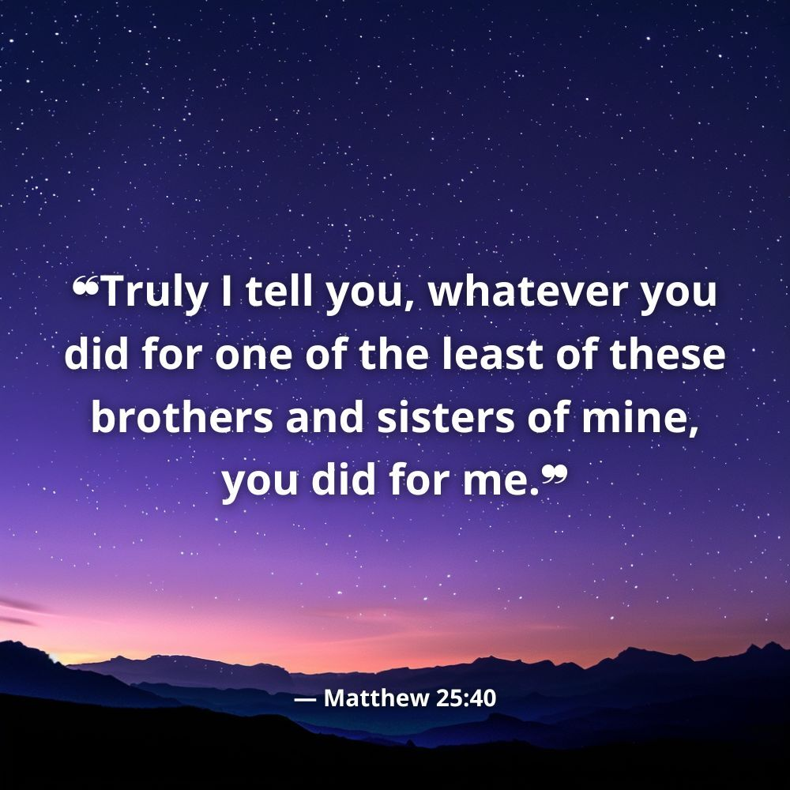
A Christian View #2
The marginalised, the poor and the oppressed
“To me these verses [Matthew 25:31-40] meant Jesus recognising divinity in the most wretched, marginalised, outcast of humanity. This to me was a more uplifting message. I just could not reconcile that with…the exclusivist claims by the more conservative sections of the Christian population…” (Mr Ana Pararajasingham)
Interfaith talk #47 – 11 November 2021 – My Spiritual Journey – Mr Ana Pararajasingham
https://www.youtube.com/watch?v=h5m1WJ_aWwg
Notes:
One week after Peter Scandrett’s presentation we had an eloquent talk by Mr Ana Pararajasingham on 11 November 2021. The topic was “My Spiritual Journey, and you can find it on Youtube along with most other talks on this forum.
Mr Pararajasingham made this profound statement: “I have come to the realisation that we humans, who are endowed with a finite mind, are incapable of fully comprehending an infinite reality. At best what we can hope is to gain during our search is a growing understanding of this truth.”
Mr Pararajisingham explained that he was troubled by the verse “No-one cometh to the Father except by me”. He could not reconcile the idea that only Christians went to God and everyone else went to Hell. He consulted a Uniting Church minister and found a much more uplifting message in the Gospel of Matthew 25:35-40.
Matthew 25: ³¹ “When the Son of Man comes in his glory, and all the angels with him, he will sit on his glorious throne. ³² All the nations will be gathered before him, and he will separate the people one from another as a shepherd separates the sheep from the goats. ³³ He will put the sheep on his right and the goats on his left.
³⁴ “Then the King will say to those on his right, ‘Come, you who are blessed by my Father; take your inheritance, the kingdom prepared for you since the creation of the world. ³⁵ For I was hungry and you gave me something to eat, I was thirsty and you gave me something to drink, I was a stranger and you invited me in, ³⁶ I needed clothes and you clothed me, I was sick and you looked after me, I was in prison and you came to visit me.’
³⁷ “Then the righteous will answer him, ‘Lord, when did we see you hungry and feed you, or thirsty and give you something to drink? ³⁸ When did we see you a stranger and invite you in, or needing clothes and clothe you? ³⁹ When did we see you sick or in prison and go to visit you?’
⁴⁰ “The King will reply, ‘Truly I tell you, whatever you did for one of the least of these brothers and sisters of mine, you did for me.’
Mr Pararajisingham commented “To me these verses meant Jesus recognising divinity in the most wretched, marginalised, outcast of humanity. This to me was a more uplifting message. I just could not reconcile that with…the exclusivist claims by the more conservative sections of the Christian population, [which] greatly troubled me.
He said “I needed to resolve it. I was lucky that in my early 30s, having arrived in Australia, I had started to attend the Uniting Church. Here I found the emphases was very much on social justice. And standing for the marginalised, the poor and the oppressed. This touched a chord, and I chose to remain with this Church.
“Meanwhile the Minister helped me understand a great deal about the Bible, particularly the New Testament. [He] was able to unpack many of the sayings attributed to Jesus….These statements needed to be understood in context.
“The exclusive claim attributed to Jesus that “no-one comes to the Father, God, except through Me” was of concern to many Christian people and theologians. One of them, Rev. Dr. Wesley Ariarajah ( a director with WWC was moved to write books called:
Not Without My Neighbour –Issues in Interreligious Relations (Geneva: WCC Publications, 1999)
The Bible and People of Other Faiths, (Geneva: WCC Publications, 1985)
“One of the main themes of both books was to provide a theological and historical background to this very problematic statement. …“The argument by Dr Wesley Ariarajah was quite persuasive”
Unfortunately Mr Pararajisingham did not share the persuasive argument with us. And I don’t have those books (although they are available through Amazon). Fortunately, however, I found part of the persuasive argument on-line – next slide.

Slide 6
A Christian View #2 (continued)
The language of faith and love
Christian theologian Wesley Ariarajah writes that:
“When my daughter tells me I’m the best daddy in the world, and there can be no other father like me, she is speaking the truth, for this comes out of her experience. She is honest about it; she knows no other person in the role of her father. But of course it is not true in another sense. … one should be aware that in the next house there is another little girl who also thinks her daddy is the best father in the world. And she too is right. …For here we are not dealing with the absolute truths, but with the language of faith and love. …
“The language of the Bible is also the language of faith….The problem begins when we take these confessions in the language of faith and love and turn them into absolute truths. …”
Quoted in:
https://namelessone.co.za/2017/12/08/progressive-interpretation-john-146-jesus-way/
Notes:
https://namelessone.co.za/2017/12/08/progressive-interpretation-john-146-jesus-way/
Christian theologian Wesley Ariarajah writes that,
When my daughter tells me I’m the best daddy in the world, and there can be no other father like me, she is speaking the truth, for this comes out of her experience. She is honest about it; she knows no other person in the role of her father. But of course it is not true in another sense. For one thing, I myself know friends who, I think, are better fathers than I am. Even more importantly, one should be aware that in the next house there is another little girl who also thinks her daddy is the best father in the world. And she too is right. In fact as the level of the way the two children relate to their two fathers, no one can compare the truth content of the statements of the two girls. For here we are not dealing with the absolute truths, but with the language of faith and love. …
The language of the Bible is also the language of faith….The problem begins when we take these confessions in the language of faith and love and turn them into absolute truths. It becomes much more serious when we turn them into truths on the basis of which we begin to measure the truth or otherwise of other faith claims. My daughter cannot say to her little friend in the next house that there is no way she can have the best father, for the best one is right there in her house. If she does, we’ll have to dismiss it as child-talk!

Slide 7
A Christian View #3
Divine Love in a Human Heart
“We cannot see the Transcendent God, but we believe that in watching Jesus we are watching how God reveals God’s Self in a human being…Jesus is the human expression (the ‘incarnation’) of God, and so reveals God in a human way. Jesus says: ‘If you know me, you will know my Father also. Whoever sees me has seen the Father’ (John 14:7,9)…[Jesus] is a constant corrective to our tendency to misunderstand God by projecting onto God our limited concepts and dysfunctional habits of thinking.” (Michael Fallon MSC, Jesus as Portrayed in the New Testament pp19-20)
#58 – 27 January 2022 – Jesus as Portrayed in the New Testament: Divine Love in a Human Heart – Fr. Michael Fallon https://www.youtube.com/watch?v=H0VDDuIzZ7U
Notes:
On 27 January 2022 our presenter was retired Catholic Priest Father Michael Fallon.
Michael’s presentation was based on his recently published book called “Jesus as Portrayed in the New Testament: Divine Love in a Human Heart”.
The extract on screen was not part of the presentation but I have chosen it from his book because it illustrates an interpretation based on love and inclusion.
READ the quote.

Slide 8
A Christian View #4
Interpretation
…some Christian scholars have argued that exclusivist claims are based on an incorrect interpretation of scripture.
…modern Christian scholarship has examined the question of who the "I" of John 14:6 is referring to.
The structure of John's Gospel is significant in that it starts with the incarnation of the Word rather than the story of Jesus' birth. It describes the appearance in this world of the Word, the divine Logos, that had been with God from the beginning, "the Word was with God."
John Cobb, a Protestant scholar of interreligious dialogue, has concluded that, "It is this Word that speaks as `I' in the pages of the gospel."
Seena Fazel, Understanding Exclusivist Texts, https://bahai-library.com/fazel_understanding_exclusivist_texts
Notes:
We have seen a diversity of interpretations.
An article by Dr Seena Fazel “Understanding Exclusivist Texts” has this interesting Christian view which I think is consistent with a Baha’i understanding
I’ll read two paragraphs including the sections missing on screen:
“…some Christian scholars have argued that exclusivist claims are based on an incorrect interpretation of scripture. This is highlighted by discussions over the interpretation of John 14:6--the classic exclusivist New Testament verse. In this verse, Jesus states, "I am the light, the way and the truth. No man comes to Father but my me." Traditional Christians thought has understood this to refer specifically to the historical Jesus Christ.
“The structure of John's Gospel is significant in that it starts with the incarnation of the Word rather than the story of Jesus' birth. It describes the appearance in this world of the Word, the divine Logos, that had been with God from the beginning, "the Word was with God." John Cobb, a Protestant scholar of interreligious dialogue, has concluded that, "It is this Word that speaks as `I' in the pages of the gospel.“
Further quotes (optional to read):
“It is affirmed, then, that the Word who is incarnate in Jesus is the Way, the Truth, the Life, and that no one comes to the Father except through that Word. This cannot mean that the Word is present and active only in Jesus; for in the prologue to the Gospel it is stated that in the Word that was from the beginning was life, that this life was also the true light that enlightens everyone (Jn 1:9). (Cobb, Death 16-7)
“John Macquarrie, a professor of religious studies at Oxford, comments on John 14:6 in a similar way. "In John's gospel, let us remember, the words of Jesus are the words of the Logos, not just of the individual human being, Jesus of Nazareth. That Word or Logos enlightens every one who comes into the world" (Jesus Christ 422).
“Diana Eck writes that she believes that it is "a world-spanning Christ who speaks this `I'. To see the Logos, the Word, is to see God. ... Christ is the Logos, the Word, the divine intention to speak, to disclose, to reveal." Thus, Eck argues that there is no "way" to God as "God is the Way, the Truth, the Life" (Eck, Encountering 95).

Slide 9
From Baha’i Writings
“Show us the right way”
Wherefore Khájih ‘Abdu’lláh [a Sufi leader] —may God the Most High sanctify his blessed soul—hath made, in this connection, a subtle point and spoken an eloquent word as to the meaning of “Guide Thou us on the straight path”, [Qur’an 1:5] which is: “Show us the right way; that is, honour us with the love of Thine Essence, that we may be freed from occupation with ourselves and aught else save Thee, and may become wholly Thine; that we may know only Thee, and see only Thee, and think of none save Thee.”
Bahá’u’lláh, The Seven Valleys
Notes:
In the readings earlier, the Islamic Scripture included the prayer “Show us the right way”
The readings also included this passage written by Baha’u’llah. It is so meaningful, in my opinion, that I will read it again:
“Wherefore Khájih ‘Abdu’lláh [a Sufi leader] —may God the Most High sanctify his blessed soul—hath made, in this connection, a subtle point and spoken an eloquent word as to the meaning of “Guide Thou us on the straight path”,[Qur’an 1:5] which is: “Show us the right way; that is, honour us with the love of Thine Essence, that we may be freed from occupation with ourselves and aught else save Thee, and may become wholly Thine; that we may know only Thee, and see only Thee, and think of none save Thee.”
Comments:
Compare this with the earlier quoted passage of ‘Abdu’l-Baha – “we must strive with heart and soul that this love may take possession of us”
The right way seems to be a condition of purity of heart, where we think only of God, and God’s love transforms us. It seems to be more than “a theology” of “We are saved. You are not saved”.
Theology gives us a sense of understanding things intellectually, and sometimes reduces love to a word. Sadly an all-embracing love is too often reduced to an exclusive doctrine.
This takes me to the next slide “The central truth of revealed religion”.

Slide 10
Baha’i Perspective
“The central truth of revealed religion”
…the soul’s ability to attain to an understanding of its Creator’s purpose is the product not merely of its own effort, but of interventions of the Divine that open the way. The point was made with memorable clarity by Jesus: “I am the way, the truth, and the life: no man cometh unto the Father, but by me.” If one is not to see in this assertion merely a dogmatic challenge to other stages of the one ongoing process of Divine guidance, it is obviously the expression of the central truth of revealed religion: that access to the unknowable Reality that creates and sustains existence is possible only through awakening to the illumination shed from that Realm.
From One Common Faith, Baha’i World Centre, 2005
Notes:
This is from a document called One Common Faith, which was written to help Baha’is contribute to inter-faith dialogue in a unifying way, without insisting on our views but sharing our views as appropriate.
This is very similar to the Christian scholarly view that perhaps the words of Jesus are not “from” Jesus as a person who was born at a certain time but were in fact the Word of God who existed “in the beginning” and has always guided humanity.

Slide 11
From Baha’i Writings
“Inspiration from one heavenly Source”
There can be no doubt whatever that the peoples of the world, of whatever race or religion, derive their inspiration from one heavenly Source, and are the subjects of one God. The difference between the ordinances under which they abide should be attributed to the varying requirements and exigencies of the age in which they were revealed. All of them, except a few which are the outcome of human perversity, were ordained of God, and are a reflection of His Will and Purpose. Arise and, armed with the power of faith, shatter to pieces the gods of your vain imaginings, the sowers of dissension amongst you. Cleave unto that which draweth you together and uniteth you.
Bahá’u’lláh
Notes:
In 2002 the Universal House of Justice (elected governing body of the Baha’i community) addressed a letter to the World’s religious leaders.
In that letter this passage from the Writings of Baha’u’llah was shared.

Slide 12
Baha’i appeal to the World’s Religious Leaders
“Religious leadership, prejudice and violence”
Such an appeal does not call for abandonment of faith in the fundamental verities of any of the world’s great belief systems. Far otherwise. Faith has its own imperative and is its own justification. What others believe—or do not believe—cannot be the authority in any individual conscience worthy of the name. What the above words do unequivocally urge is renunciation of all those claims to exclusivity or finality that, in winding their roots around the life of the spirit, have been the greatest single factor in suffocating impulses to unity and in promoting hatred and violence.
It is to this historic challenge that we believe leaders of religion must respond if religious leadership is to have meaning in the global society emerging from the transformative experiences of the twentieth century.
April 2002 – To The World’s Religious Leaders from the Universal House of Justice
Notes:
We might not all be “religious leaders” in this forum, but I think this letter dated April, addressed to leaders, is of interest to all of us.
We just read, from the 2002 letter, that “the peoples of the world, of whatever race or religion, derive their inspiration from one heavenly Source, and are the subjects of one God. ”
The 2002 letter goes on to say…
READ from the slide
Full quote below if needed.
https://www.bahai.org/library/authoritative-texts/the-universal-house-of-justice/messages/#20020401_001
…
The implications for today are summed up by Bahá’u’lláh in words written over a century ago and widely disseminated in the intervening decades:
There can be no doubt whatever that the peoples of the world, of whatever race or religion, derive their inspiration from one heavenly Source, and are the subjects of one God. The difference between the ordinances under which they abide should be attributed to the varying requirements and exigencies of the age in which they were revealed. All of them, except a few which are the outcome of human perversity, were ordained of God, and are a reflection of His Will and Purpose. Arise and, armed with the power of faith, shatter to pieces the gods of your vain imaginings, the sowers of dissension amongst you. Cleave unto that which draweth you together and uniteth you.
Such an appeal does not call for abandonment of faith in the fundamental verities of any of the world’s great belief systems. Far otherwise. Faith has its own imperative and is its own justification. What others believe—or do not believe—cannot be the authority in any individual conscience worthy of the name. What the above words do unequivocally urge is renunciation of all those claims to exclusivity or finality that, in winding their roots around the life of the spirit, have been the greatest single factor in suffocating impulses to unity and in promoting hatred and violence.
It is to this historic challenge that we believe leaders of religion must respond if religious leadership is to have meaning in the global society emerging from the transformative experiences of the twentieth century.

Slide 13
From Baha’i Writings
“The Way of God”
….The door of the knowledge of the Ancient Being hath ever been, and will continue for ever to be, closed in the face of men. No man’s understanding shall ever gain access unto His holy court. As a token of His mercy, however, and as a proof of His loving-kindness, He hath manifested unto men the Day Stars of His divine guidance, the Symbols of His divine unity, and hath ordained the knowledge of these sanctified Beings to be identical with the knowledge of His own Self. Whoso recognizeth them hath recognized God. Whoso hearkeneth to their call, hath hearkened to the Voice of God, and whoso testifieth to the truth of their Revelation, hath testified to the truth of God Himself. Whoso turneth away from them, hath turned away from God, and whoso disbelieveth in them, hath disbelieved in God. Every one of them is the Way of God that connecteth this world with the realms above, and the Standard of His Truth unto every one in the kingdoms of earth and heaven. They are the Manifestations of God amidst men, the evidences of His Truth, and the signs of His glory.
Gleanings from the Writings of Bahá’u’lláh
Notes:
This is the last slide, and it’s a lot of text, but I want to share it with you for two reasons.
It seems to me to be the basis of a reasonable theology.
Baha’u’llah provides a reasonable interpretation of the term “the Way of God”
READ THE QUOTE
Discussion questions:
Compare with Jesus’ words “if you really know me you will know the father as well”
Can we see the essentials of a Baha’i theology in this passage?
In what way is the knowledge of a Manifestation of God identical with the knowledge of God?

