Slide 1
Foundations of the Covenant
The hand of Omnipotence hath established His Revelation upon an unassailable, an enduring foundation.
Bahá’u’lláh
Overview and quick quiz
Prepared by Colin Dibdin for the Day of the Covenant November 2023

Slide 2
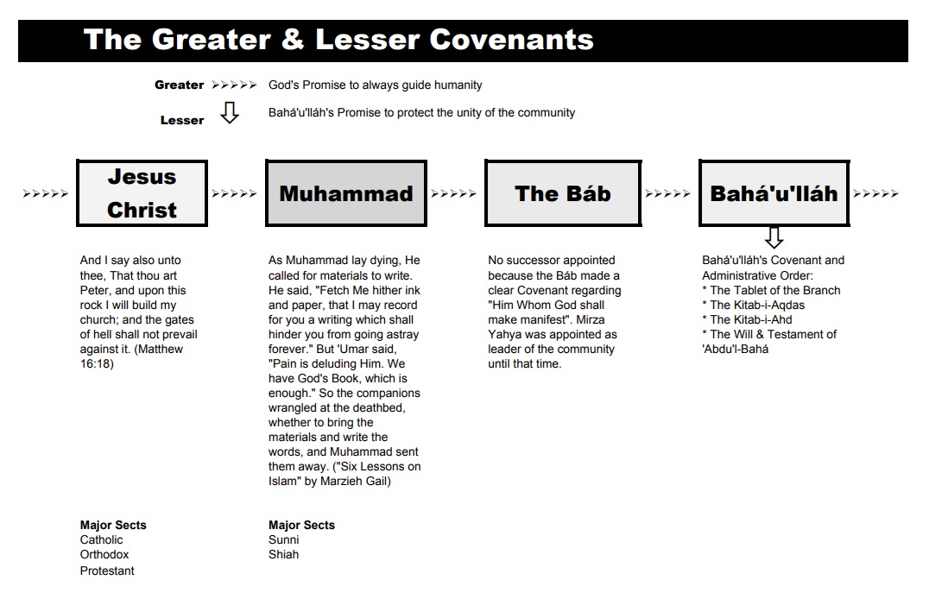

Slide 3
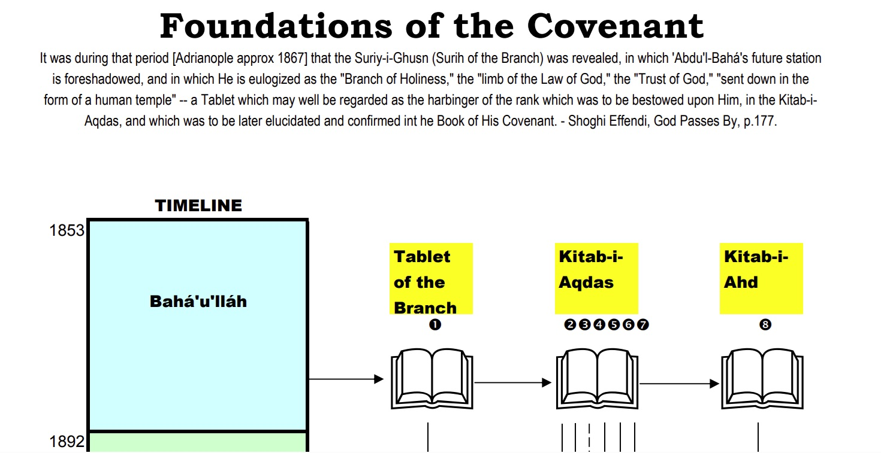

Slide 4
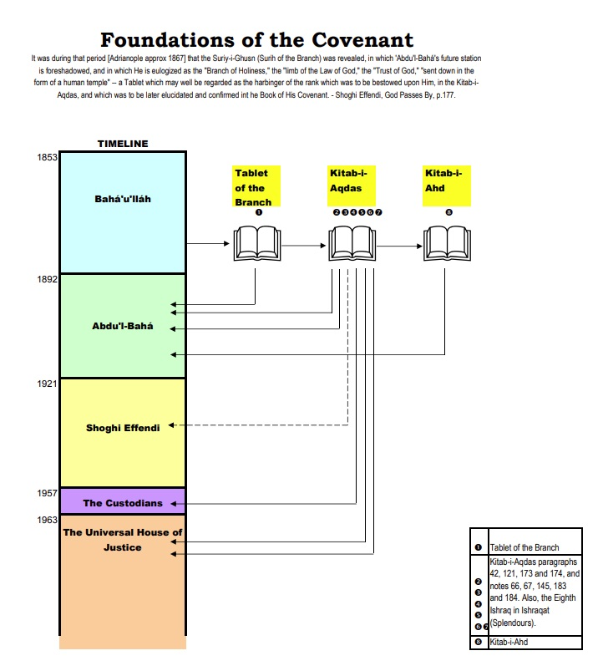

Slide 5
The Súriy-i-Ghusn (Tablet of the Branch):
Bahá’u’lláh offers us a glimpse of ‘Abdu’l-Bahá’s exalted rank.
They who deprive themselves of the shadow of the Branch, are lost in the wilderness of error, are consumed by the heat of worldly desires, and are of those who will assuredly perish..
Bahá’u’lláh

Slide 6
The Kitáb-i-Aqdas (The Most Holy Book):
Bahá’u’lláh appoints ‘Abdu’l-Baha as the Centre of His Covenant.
When the ocean of My presence hath ebbed and the Book of My Revelation is ended, turn your faces toward Him Whom God hath purposed, Who hath branched from this Ancient Root.
Bahá’u’lláh

Slide 7
The Kitáb-i-Aqdas (The Most Holy Book):
Bahá’u’lláh provides for the possibility that the line of Aghṣán would terminate prior to the establishment of the Universal House of Justice.
None hath the right to dispose of [endowments dedicated to charity] without leave from Him Who is the Dawning-place of Revelation. After Him, this authority shall pass to the Aghsán, and after them to the House of Justice -- should it be established in the world by then …Otherwise, the endowments shall revert to the people of Bahá who speak not except by His leave …
Bahá’u’lláh

Slide 8
The Kitáb-i-Aqdas (The Most Holy Book):
The Eighth Ishráq:
Bahá’u’lláh ordained the Universal House of Justice.
The men of God’s House of Justice … are the Trustees of God among His servants and the daysprings of authority in His countries. They …are the recipients of divine inspiration from the unseen Kingdom.
Bahá’u’lláh

Slide 9
The Kitáb-i-Ahd (The Book of the Covenant):
Bahá’u’lláh explicitly enjoins the faithful to turn, after His passing, to ‘Abdu’l-Bahá.
When the ocean of My presence hath ebbed and the Book of My Revelation is ended, turn your faces towards …the Most Mighty Branch [‘Abdu’l‑Bahá].
Bahá’u’lláh

Slide 10
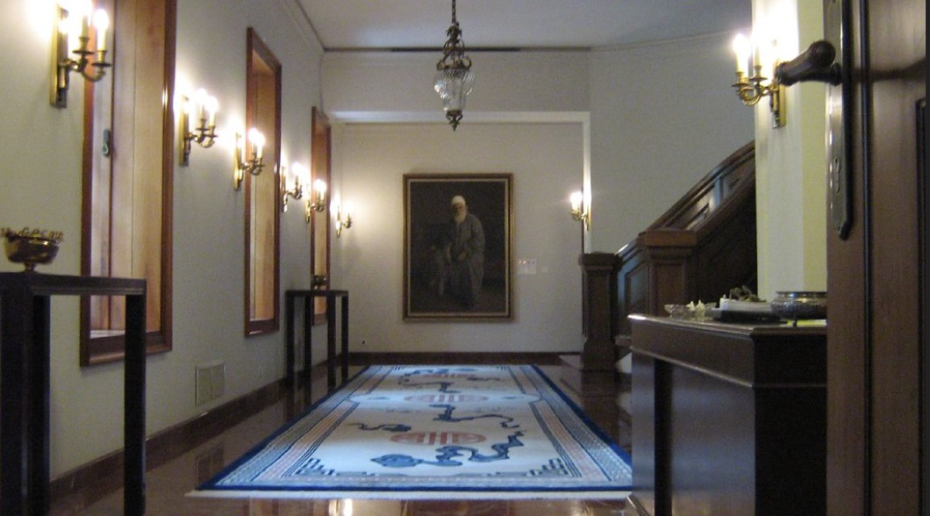
QUIZ
(6 Questions)

Slide 11
Of the following 4 documents, which 3 were revealed by Bahá’u’lláh?
  Súriy-i-Ghusn (Tablet of the Branch)
  The Kitáb-i-Aqdas (The Most Holy Book)
  The Kitáb-i-‘Ahd (The Book of the Covenant)
  The Will and Testament of ‘Abdu’l-Bahá

Slide 12
2. Which of these was revealed before the other two?
  Súriy-i-Ghusn (Tablet of the Branch)
  The Kitáb-i-Aqdas (The Most Holy Book)
  The Kitáb-i-Ahd (The Book of the Covenant)

Slide 13
3. To whom did Baha’u’llah command all to turn after His passing?
  The Most Mighty Branch [`Abdu'l-Bahá]
  The Greater Branch [Muḥammad ‘Alí]
  The rulers and learned among the people of Bahá

Slide 14
4. Who were the custodians of the Cause between 1957 (when the Guardian died) and 1963 (when the Universal House of Justice was elected)?
  The National Spiritual Assemblies
  The Believers, guided by the Holy Spirit
  The Hands of the Cause

Slide 15
5. Which institution did Baha’u’llah ordain to be “the Trustees of God among His servants and the daysprings of authority in His countries”
  The Most Mighty Branch
  The Hands of the Cause
  The Universal House of Justice

Slide 16
6. What is the “unassailable, enduring foundation”, upon which “the hand of Omnipotence hath established His Revelation”
  The Word of God
  The Example of ‘Abdu’l-Bahá
  The Covenant of Bahá'u'lláh

