Slide 1

The Meanings of Unity
How have religions created unity?
Are there different levels of unity?
What is more important – to be united or to be right?
Is the world heading towards disunity or unity?
Can we have peace without first having unity?
Does religion still have a unifying role?
Weekly Interfaith Meeting #253
4 December 2025

Slide 2
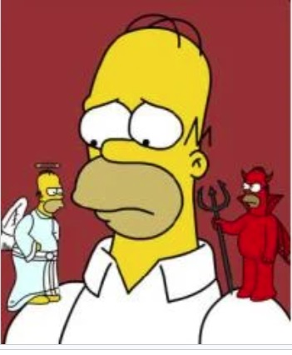
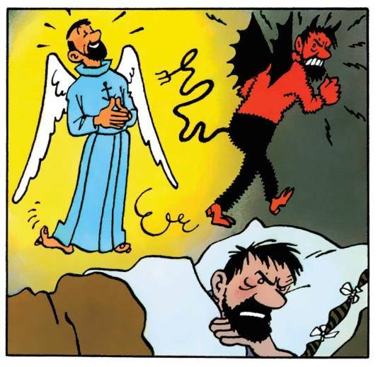
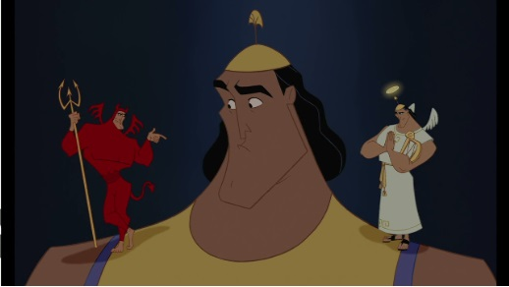
Individual Unity
Temptation vs Conscience
A comic device: When someone wrestles with a temptation, two miniature versions of himself, an Angel and a Devil, sit on each shoulder and try to pull him in different directions.

Slide 3
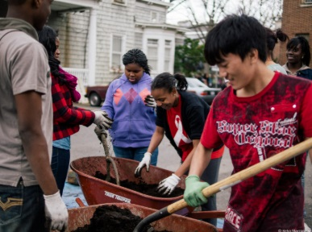
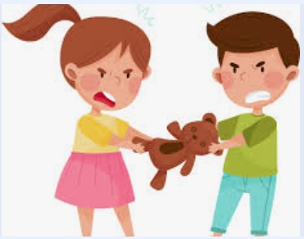
Interpersonal relationships
– friends, family, neighbours, community
What does disunity feel like?
Can hard feelings be overcome?
What does it mean to love our neighbour as we love ourselves?

Slide 4


Organisational Unity
What happens when someone is attached to their own idea and feels hurt when the idea is criticised?

Slide 5

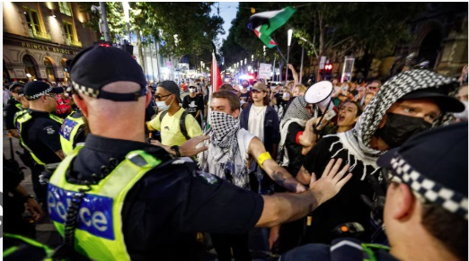
Social cohesion
The Nation (constitution, culture, security)
But what about racism, wealth distribution, partisan politics?
“Unity itself is seen as an ongoing process that starts with people sitting together and ends with a mystical or spiritual communion.”
Robert Stockman:
https://bahai-library.com/stockman_unity_principle

Slide 6
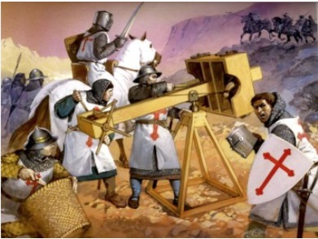
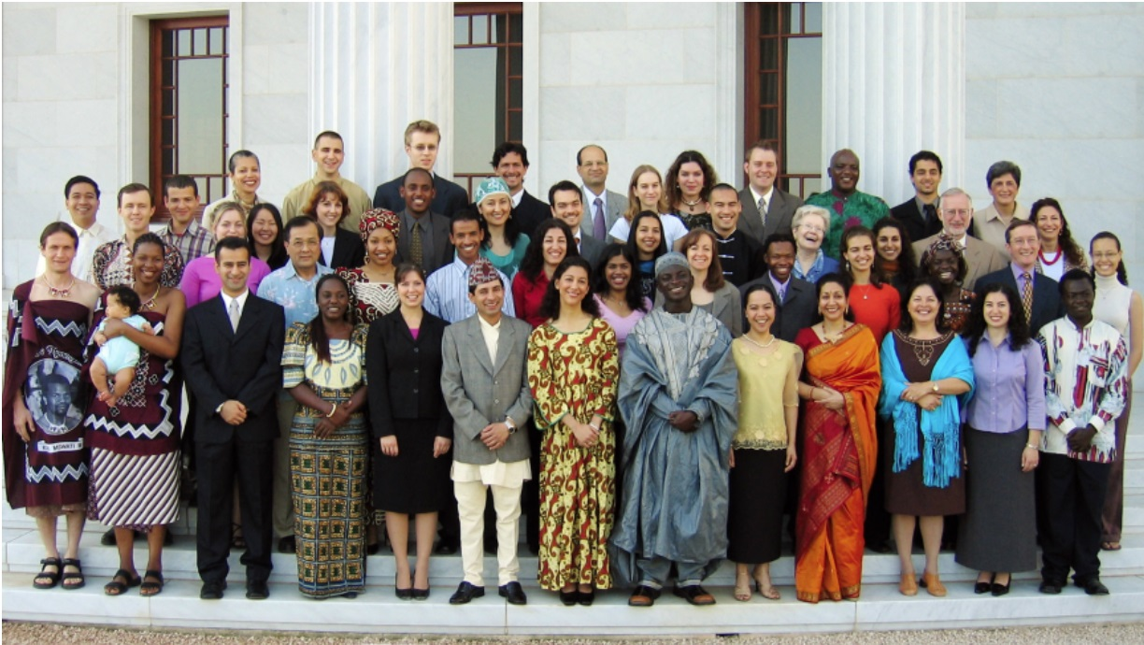
Oneness of Humanity
Us and them prejudices (race, gender, age, nation, identity, loyalties, views, ideologies, religious beliefs, interests, personalities, values etc)

Slide 7
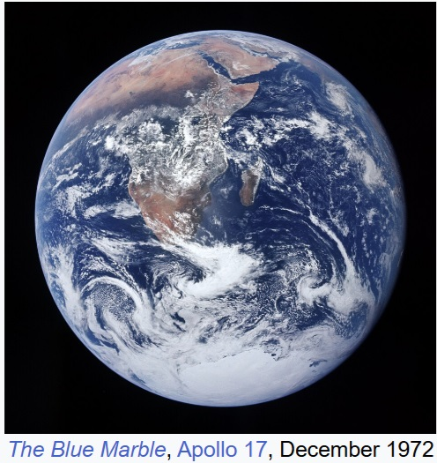
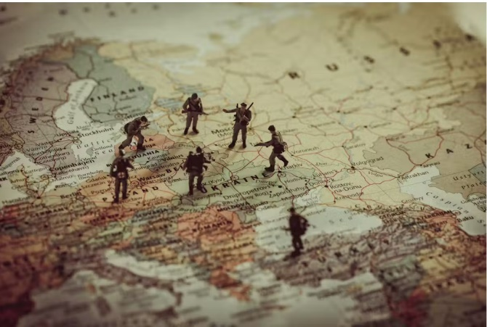
International relations
(threats, ambitions, national sovereignty)
Global peace (as per the nation, the world needs a step towards maturity and collective security)

Slide 8
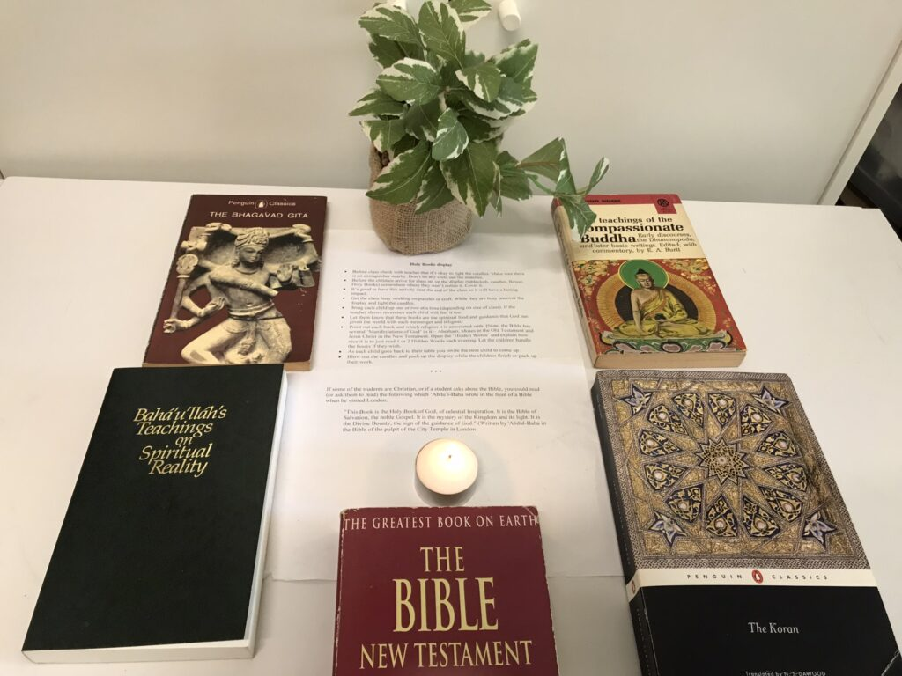
What do sacred texts say about unity?
Christianity
Jesus prayed for his followers to be one, "even as we are one" (John 17:22), setting a divine example of selfless, unified love.
Islam
The Quran commands believers to "hold firmly to the rope of Allah all together and do not become divided".
Hinduism
A central tenet is "Truth is one, but the wise refer to it by various names". The Upanishads state that the universal spirit resides in all beings.
(See also Zoroastrian, Jewish, Baha’i and Buddhist readings on the theme of Unity.)

Slide 9

Why is religion potentially an effective cause of unity?
Religion, as we are all aware, reaches to the roots of motivation. When it has been faithful to the spirit and example of the transcendent Figures who gave the world its great belief systems, it has awakened in whole populations capacities to love, to forgive, to create, to dare greatly, to overcome prejudice, to sacrifice for the common good and to discipline the impulses of animal instinct.
“Letter to the World’s Religious Leaders”, 2002

Slide 10
How religion contributes to unity
Universal benefits derive from the grace of the divine religions, for they lead their true followers to sincerity of intent, to high purpose, to purity and spotless honor, to surpassing kindness and compassion, to the keeping of their covenants when they have covenanted, to concern for the rights of others, to liberality, to justice in every aspect of life, to humanity and philanthropy, to valor and to unflagging efforts in the service of mankind. It is religion, to sum up, which produces all human virtues, and it is these virtues which are the bright candles of civilization.
‘Abdu’l-Baha

