Slide 1
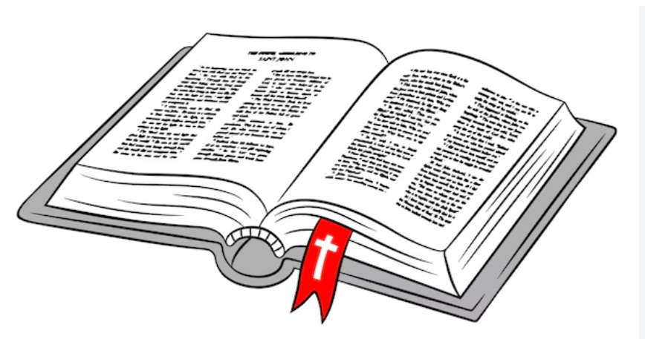
A Bahá’í View of the Bible
IS THE BIBLE THE WORD OF GOD?
BAHA’I AFFIRMATIONS
WHAT IS THE BIBLE?
A DIVERSITY OF VIEWS
ANSWERS
Interfaith presentation by Colin Dibdin
10 September 2026
Based on https://bahai-library.com/dibdin_bahai_view_bible

Slide 2
A question
A Baha'i View of the Bible
IS THE BIBLE THE WORD OF GOD?
BAHA’I AFFIRMATIONS
WHAT IS THE BIBLE?
A DIVERSITY OF VIEWS
ANSWERS

Slide 3

  I asked myself…
  What is the Bahá’í view of the Bible?”
  The question was relevant to how I should converse with Christians.

Slide 4
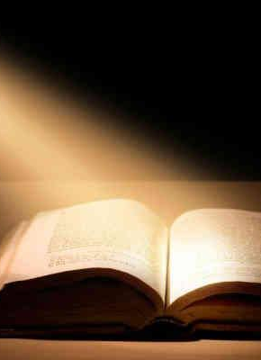
  I observed that many Christians believe that the Bible is the word of God,
  " ...no words can too strongly express the importance of securing, beyond doubt, the unsuperseded authority of the sacred Scriptures in all religious discussions...“
  Hammond, T.C., and Wright, D.F., In Understanding Be Men: A handbook of Christian doctrine, 6th edn., Inter-Varsity Press, Leicester, 1986, p.40.

Slide 5
Bahá’í affirmations of the Bible
A Baha'i View of the Bible
IS THE BIBLE THE WORD OF GOD?
BAHA’I AFFIRMATIONS
WHAT IS THE BIBLE?
A DIVERSITY OF VIEWS
ANSWERS

Slide 6

The Holy Book of God
That City is none other than the Word of God revealed in every age and dispensation. In the days of Moses it was the Pentateuch; in the days of Jesus the Gospel
Bahá’u’lláh, The Kitáb-i-Íqán (Book of Certitude)
This Book is the Holy Book of God, of celestial Inspiration. It is the Bible of Salvation, the noble Gospel. It is the mystery of the Kingdom and its light. It is the Divine Bounty, the sign of the guidance of God.
Written by 'Abdul-Baha (in the Bible of the pulpit of the City Temple in London)

Slide 7
Reflect: the words of the verses themselves eloquently testify to the truth that they are of God.
Bahá’u’lláh, The Kitáb-i-Íqán
Therefore I tell you, do not worry about your life, what you will eat or drink; or about your body, what you will wear. Is not life more than food, and the body more than clothes? … Can any one of you by worrying add a single hour to your life? … But seek first his kingdom and his righteousness, and all these things will be given to you as well. Therefore do not worry about tomorrow, for tomorrow will worry about itself. Each day has enough trouble of its own.
Words of Jesus
(Matthew 6:25 -34)
But to you who are listening I say: Love your enemies, do good to those who hate you, bless those who curse you, pray for those who mistreat you.
Words of Jesus
(Luke 6:27-28)
Now that you know these things, you will be blessed if you do them.
Words of Jesus
(John 13: 17)

Slide 8
The sheltering shade of the Gospel
Observe how those souls who drank the living waters of redemption at the gracious hands of Jesus, the Spirit of God, and came into the sheltering shade of the Gospel, attained to such a high plane of moral conduct that Galen, the celebrated physician, although not himself a Christian, in his summary of Plato’s Republic extolled their actions. A literal translation of his words is as follows:
    “The generality of mankind are unable to grasp a sequence of logical arguments. For this reason they stand in need of symbols and parables telling of rewards and punishments in the next world. A confirmatory evidence of this is that today we observe a people called Christians, who believe devoutly in rewards and punishments in a future state. This group show forth excellent actions, similar to the actions of an individual who is a true philosopher. For example, we all see with our own eyes that they have no fear of death, and their passion for justice and fair-dealing is so great that they should be considered true philosophers.”
‘Abdu’l‑Bahá, The Secret of Divine Civilization

Slide 9
What is the Bible?
A Baha'i View of the Bible
IS THE BIBLE THE WORD OF GOD?
BAHA’I AFFIRMATIONS
WHAT IS THE BIBLE?
A DIVERSITY OF VIEWS
ANSWERS

Slide 10
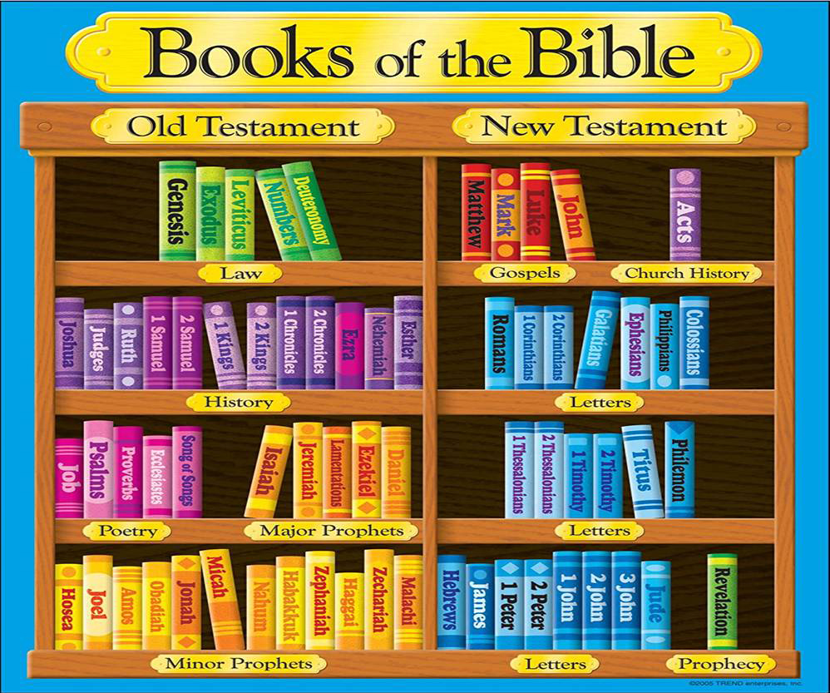

Slide 11
  Christian Scholarship and the Bible
Christian perspectives on the Bible are also diverse, and it is helpful to know of the strongest arguments that both evangelical and liberal scholars have used to support their respective cases.

Slide 12
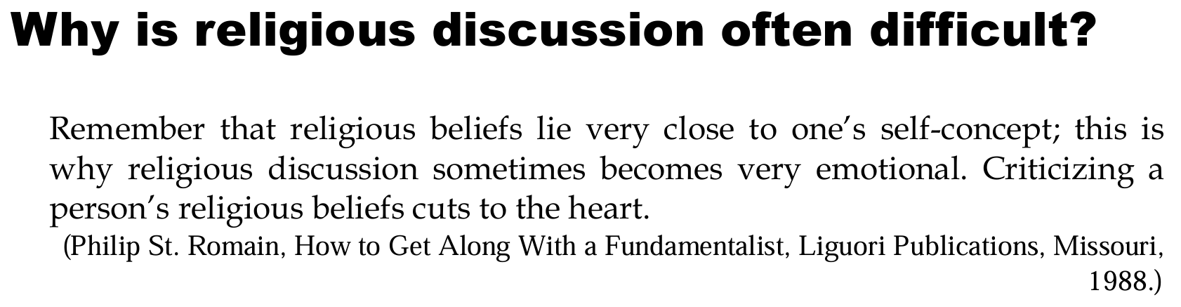
  Caution…

Slide 13
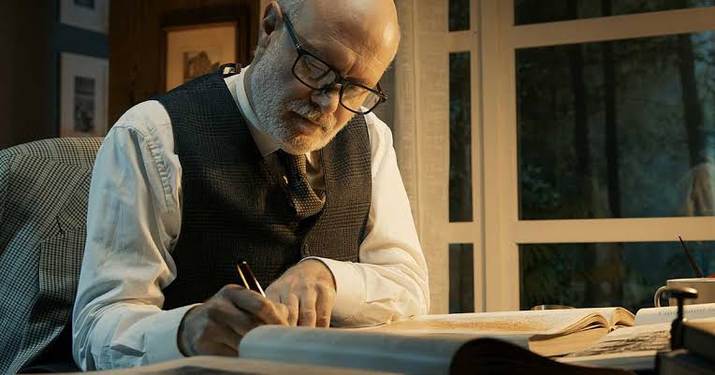
  Christian Scholarship and the Bible
Evangelical writers argue for the authority of the New Testament along the following lines:
Jesus chose twelve whom He named apostles, and sent them out to preach. The meaning of 'apostle' and 'to send', as used by Jesus, implies that these twelve had "...a specific commission to assume the role of a prophet and to speak God's word to the people."
Furthermore Jesus assured them that they would be guided by the Holy Spirit to those truths which He had not yet given them.
The Holy Spirit also guided the church in its collection and selection of books. In this way, say evangelical Christians, Christ provided for the writing of the New Testament.

Slide 14

  Christian Scholarship and the Bible
On the other hand Christian scholars draw our attention to the following facts:
The Gospels, despite their attribution to Matthew, Mark, Luke and John, were not necessarily written by the apostles of Jesus.
There are inconsistencies between the Gospels, especially with regard to historical detail, which makes them fallible documents.

Slide 15
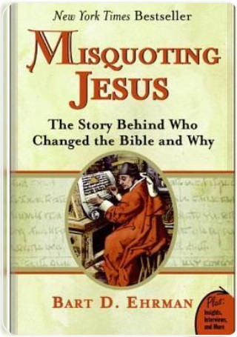
  Biblical Scholarship
In Misquoting Jesus, biblical scholar Bart Ehrman argues that the New Testament is a human text shaped by centuries of hand-copied manuscripts containing hundreds of thousands of variants. He demonstrates that while many changes were accidental, scribes also made intentional alterations to counter heresies and align scripture with evolving orthodox theology. Consequently, Ehrman asserts that these pervasive modifications make recovering the exact original words of the biblical authors an elusive task.
https://share.google/aimode/CkFKsMaVvuY7zRHsh

Slide 16

  A library analogy
A library has many books…
Different authors with their own writing styles.
Different audiences (adults, children, scholars, seekers of knowledge, leaders, ordinary citizens).
Different subjects (poetry, history, stories, wisdom, perspectives, experiences, predictions, reference material, inspirational and meaningful stories)
There may be inconsistencies between books.
Still, a library is a treasure house for those who love to read and learn.

Slide 17
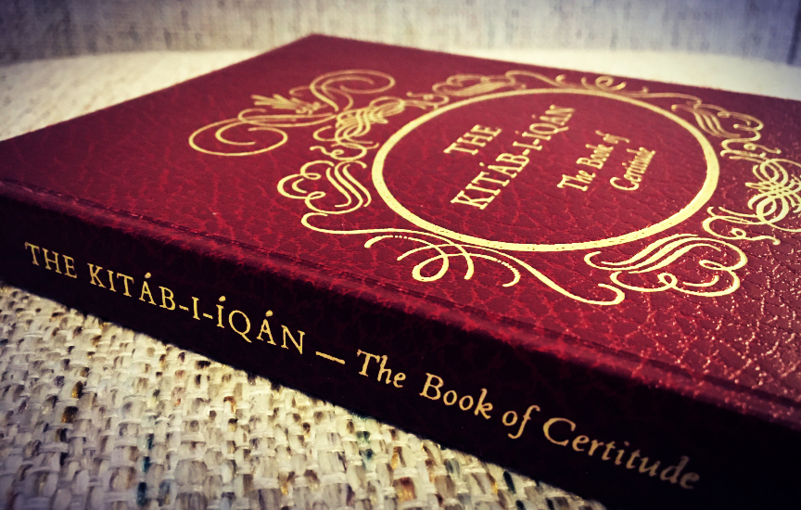
  A library analogy (continued)
Similarly, the Bible is not a single book. It is a collection. We should not be surprised or disillusioned if we find different writers convey different perspectives or if some books are more difficult to understand than others.
Bahá'u'lláh assured us that Christians possess the “genuine text of the heavenly Gospel”, and that the books of God are “the City of Certitude”.
Bahá'u'lláh added that:
  That city is none other than the Word of God revealed in every age and dispensation. In the days of Moses it was the Pentateuch; in the days of Jesus the Gospel.” "

Slide 18

  A library analogy (continued)
A question: Why did Baha’u’llah and ‘Abdu’l-Baha, who encourage use of reason and the scientific method, not engage in theological disputes about the Bible?
An answer: Their mission was no less than to lead every soul to reunion with God, and to establish the foundations of world unity and peace. Engaging the followers of Christ in controversy over secondary issues would have obscured that purpose.
Bahá'u'lláh counseled:
Every person who in some degree turneth towards the truth can himself later comprehend most of what he seeketh. However, if at the outset a word is uttered beyond his capacity, he will refuse to hear it and will arise in opposition.

Slide 19
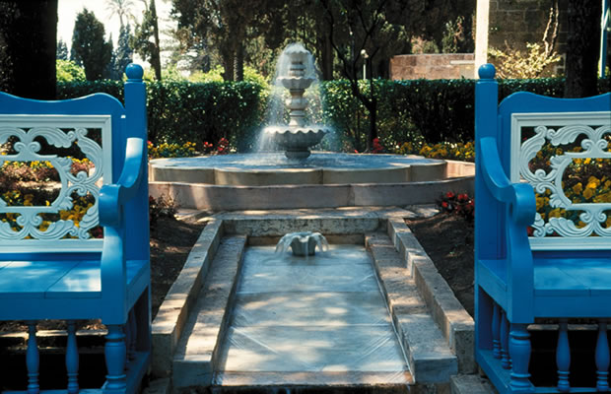
  A library analogy (continued)
Revisiting the library analogy...
A librarian does not create barriers to us coming in and finding treasures.
A librarian does not need to warn us that there are contradictions between books.
To do so would be to unnecessarily deter readers from seeking knowledge.
Similarly, in the Bible, we can find the water of life.
  But whosoever drinketh of the water that I shall give him shall never thirst; but the water that I shall give him shall be in him a well of water springing up into everlasting life.
  Words of Jesus (John 10:14)

Slide 20
A diversity of views
A Baha'i View of the Bible
IS THE BIBLE THE WORD OF GOD?
BAHA’I AFFIRMATIONS
WHAT IS THE BIBLE?
A DIVERSITY OF VIEWS
ANSWERS

Slide 21
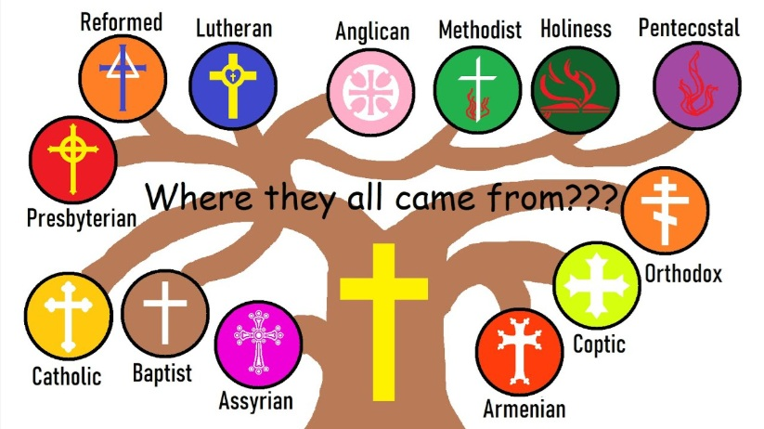
The European wars of religion were waged in Europe during the 16th, 17th and early 18th centuries.
The total death toll for the European wars of religion is estimated between 7 million and 17 million people.
Wikipedia

Slide 22
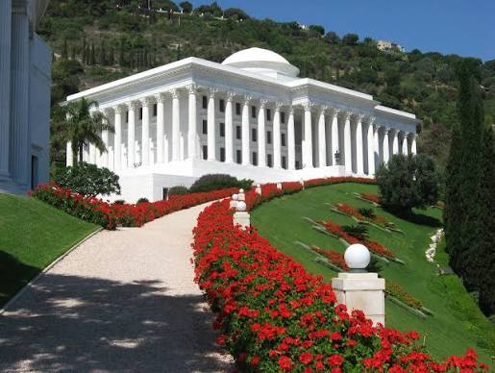
  Unity in Diversity
As the Bahá’í Faith is a young religion, it addresses many of the features of the modern world which have caused so much pain and discord in other religions.
…being united is considered a higher truth in the Baha’i Faith than being right.
…Closely connected to this teaching of unity in the Baha’i Faith is the concept of the Covenant. This concept means that the primary focus of loyalty and unity in the Baha’i Faith is not towards any set of doctrines or dogmas.
…The source of unity in the Baha’i Faith is a focus on and loyalty towards the designated center of the Faith
Moojan Momen, Fundamentalism and Liberalism:
Towards an Understanding of the Dichotomy

Slide 23
Answers
A Baha'i View of the Bible
IS THE BIBLE THE WORD OF GOD?
BAHA’I AFFIRMATIONS
WHAT IS THE BIBLE?
A DIVERSITY OF VIEWS
ANSWERS

Slide 24
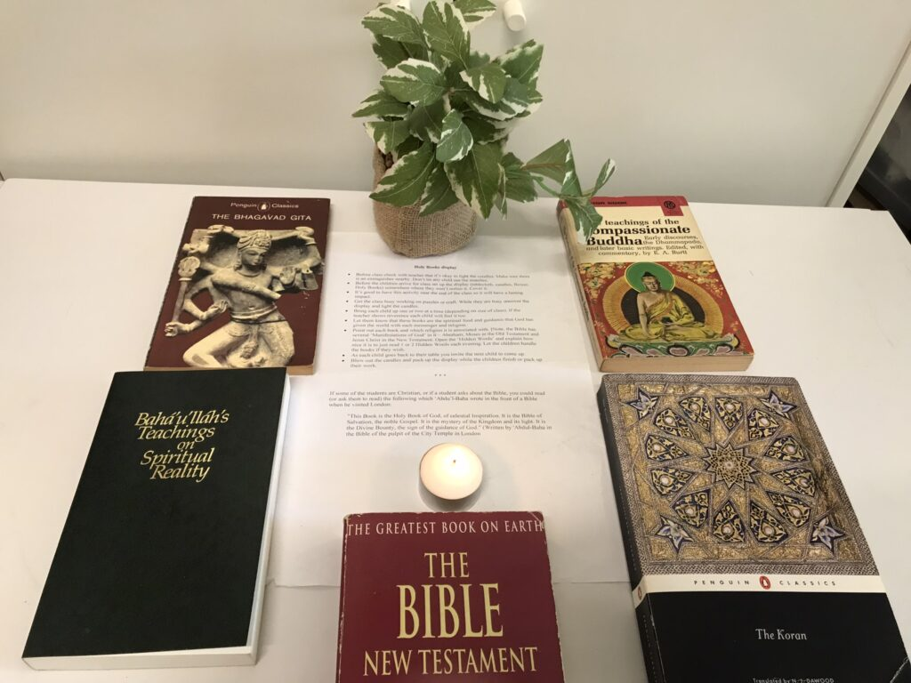
  God's justice and mercy have guaranteed the authenticity of the Gospel as the Book of Jesus.
"..We have also heard a number of the foolish of the earth assert that the genuine text of the heavenly Gospel doth not exist amongst the Christians, that it hath ascended unto heaven. How grievously they have erred! How oblivious of the fact that such a statement imputeth the gravest injustice and tyranny to a gracious and loving Providence! How could God, when once the Day-star of the beauty of Jesus had disappeared from the sight of His people, and ascended unto the fourth heaven, cause His holy Book, His most great testimony amongst His creatures, to disappear also? What would be left to that people to cling to...
Bahá'u'lláh, The Kitáb-i-Iqan

Slide 25

The Word of God is the king of words and its pervasive influence is incalculable.
(Tablets of Bahá’u’lláh)
...The Word is the master key for the whole world, inasmuch as through its potency the doors of the hearts of men, which in reality are the doors of heaven, are unlocked.

Slide 26
thank you
A Baha'i View of the Bible
Interfaith presentation by Colin Dibdin
10 September 2026
colin.dibdin@gmail.com

